Slide 1





Improving
Operational Efficiency
Avoiding Common Pitfalls
Samuel Hill
Director – Product Marketing
samuel@medigate.io
(206) 402-2757

Slide 2
Agenda
Device Life-Cycle Challenges
Reality of BioMed Today
The Challenge of Change
Key Strategies to Manage Change
  Understand & Communicate Reality
  Define & Clarify Vision
  Manage Loss, Not Change
Improved Operational Efficiency
Q & A

Slide 3

Healthcare is challenged by poor medical device data, and this affects security and operations.

Slide 4

Medigate built a leading platform, so healthcare can improve the effectiveness of every device.

Slide 5
Device Life-Cycle Challenges
CMMS Data is Hard to Keep Up-to-Date
Time Consuming Preventative Maintenance
Ineffective PAR-Levelling
Leased Device Over-Abundance
Lost/Missing Devices Still In Use
Nurses Hoarding Devices

Slide 6
Reality of BioMed Today (on Average)
1500 Bed System, Approximately 8000 Medical Devices | Time (minutes) | Total Hrs. (per year)
Manually add a device | 21 | 27
Manually update a device | 21 | 70
Manually delete a device | 21 | 9
Manually reassign a device | 21 | 91
Average time to manually find missing devices | 60 | 1,300
Average time to close a preventative maintenance ticket | 120 | 365
Average time to process a manufacturer’s recall | 120 | 73
Average time to reconcile rental inventory, return and order | 60 | 52
Total Hours |  | 1,987

Slide 7
The Challenge of Change
A Problem to Solve
An Alternative Vision of the Future
A Strategy to Embrace Risk
A Willingness to Change

Slide 8

Key Strategies to Manage Change
Understand & Communicate Reality
“Yes, leadership is about vision. But leadership is equally about creating a climate where the truth is heard, and the brutal facts confronted.”
Jim Collins: Good to Great: Why some companies make the leap… and others don’t.

Slide 9
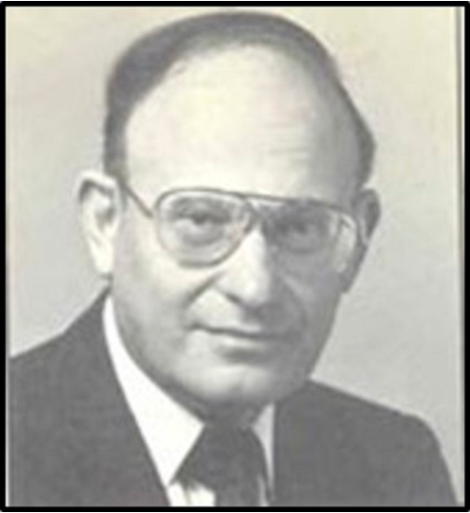
Key Strategies to Manage Change
Define & Clarify Vision
“Leadership can be thought of as a capacity to define oneself to others in a way that clarifies and expands a vision of the future.”
Ed Friedman: A Failure of Nerve: Leadership in the age of the quick fix

Slide 10
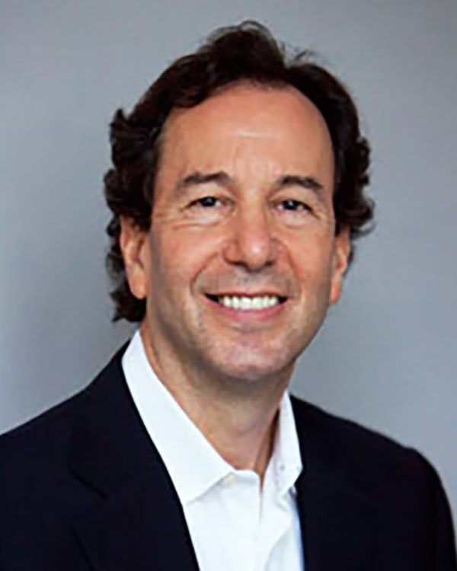
Key Strategies to Manage Change
Manage Loss, not Change
“What people resist is not change per se, but loss.”
Ronald Heifetz: The Practice of Adaptive Leadership: Tools and Tactics for Changing Your Organization and the World

Slide 11





Improved Operational Efficiency
Saved $2M through better C-Arm utilization
Discovered thousands of devices that had not connected to the network in over 6 months
Reduced 500 hours spent locating devices to 2
Saved $700k on new device purchases
Opened additional hours for PET and saved $3M

Slide 12
Thank you

