Slide 1
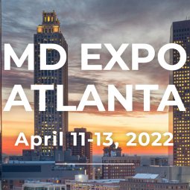

Work
Orderology
Alan Gresch
VP of Healthcare Strategy
Accruent

Slide 2
Why?
  Staffing
  Capital Planning
  Benchmarking
  Improved & More Efficient Operations
How?
  Data Integrity
  Data Standardization
What?
  Potential Results

Slide 3
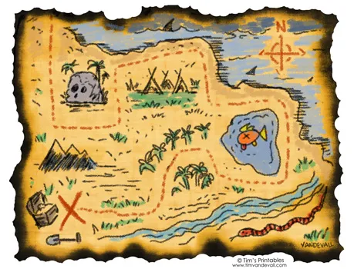

Slide 4
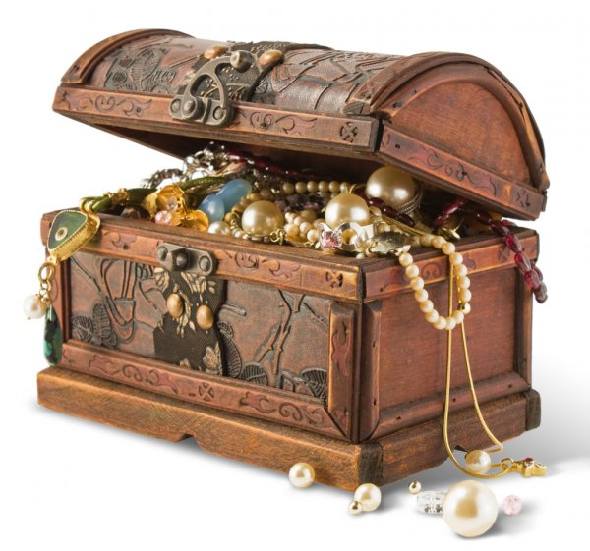

Slide 5


HTM/HFM MATURITY CURVE
CURRENT STATE
FUTURE STATE
5
CUSTOMER SATISFACTION
VALUE CREATION & RECOGNITION (SAFETY, COMPLIANCE, COST SAVINGS)
Cost Center/Necessary Evil
Maintenance & Repair Focused
Reactive / Fire Fighting
“Point” Solutions
Customer Focused Service “Business” Recognized as valuable part of organization Predictive and Proactive
Total Life Cycle Management Integration of
+ Engineering + Finance
+ Safety + IT
+ Logistics
4
VISBILITY & ACCOUNTABILITY
Deployment of product is faster
Automatically stay up to date with the latest features without the, labor, and expense of OnSite upgrades
Better vendor/customer application use collaboration
3
KEY PERFORMANCE INDICATORS
2
CENTRALIZATION & STANDARDIZATION
1
DATA STRUCTURE & INTEGRITY
OPERATIONAL EFFECTIVENESS (PRODUCTIVITY)
Accruent Confidential and Proprietary ©2020
Accruent Confidential and Proprietary ©2020
Notes:
Today’s webinar really is the culmination of all of these

Slide 6
Work Orders
Types:
  Repair or On Demand
  PM or maintenance
  Training
  Customer Service/Rounds
  Meetings
  Projects
  ANYTHING YOU SPEND TIME DOING!!!

Slide 7
Work Orders
Contains:
  Work done
  Parts used
  Time to complete each task

Slide 8
HTM Measurement Metrics
PM Completion Percentage
Time Management
Average Repair Time
Total Time to Repair
Cost of repairs- labor and parts
Work Order Analysis

Slide 9
Cost of Repairs
Cost of Service Ratio (COSR)
  Purchase cost of equipment inventory
  Factors:
    Shop hourly labor rate
    Cost of parts
    Cost of vendor repairs
    Cost of services expenses- such as mileage reimbursement or transportation cost
    Cost of service contracts
    Operational Costs- example: office supplies, printer paper, etc.
  All of these factor into a ratio (COSR)
  Measured in a percentage

Slide 10
Cost of Repairs
Cost of repairs can help identify equipment with high repair costs
Can look at history of the equipment and how much has been spent to repair it over its lifetime.
Once the equipment reaches a threshold it can be added to a list of equipment needing to be replaced with new equipment.
Can help identify “lemons”
Helps equipment planning
Helps identify “time hogs”

Slide 11
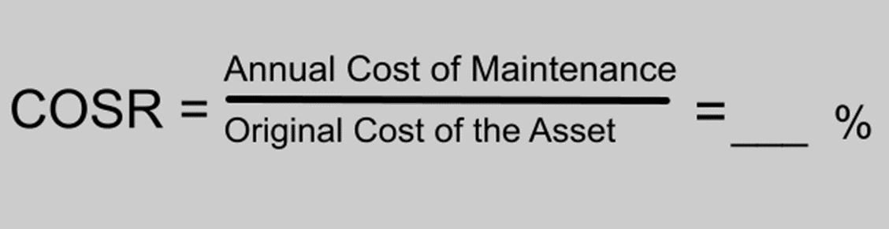
Cost of Repairs
COSR – Cost of Service Ratio is a measurement of department efficiency
COSR can help in looking at areas to cut costs and service contracts
Your medical equipment requires PM labor, PM parts, repairs, some user errors, service calls, maybe a service contract.

Slide 12
AEM Analysis
PM and CM work orders are analyzed to determine whether an AEM can be done
AEM is Alternate Equipment Maintenance
This maintenance differs from the manufacturer recommended interval or PM steps.
If PMs are routinely completed on a certain piece of equipment with no adjustments necessary, then maybe an AEM can be considered.
Equipment with no previous service history are not eligible for AEM

Slide 13
AEM Analysis
It is important to code PM & CM work orders correctly.
If a PM passes with no adjustments the work order should be closed noting no adjustments needed.
If minor adjustments are needed, then close it that way.
If repairs are needed at PM close with completed- repairs needed and open a corrective maintenance work order.
All these closing codes play into the AEM determination.

Slide 14
Why?
  Staffing
  Capital Planning
  Benchmarking
  Improved & More Efficient Operations
How?
  Data Integrity
  Data Standardization
What?
  Potential Results

Slide 15
Why?
  Staffing
  Capital Planning
  Benchmarking
  Improved & More Efficient Operations
    AEM
    More balanced PM vs. CM workload
    More Device Hrs. vs. Non-Device Hrs.

Slide 16
Device Hours vs. Non – Device Hours
Device Hours
  PM
  CM
  Incoming Inspections
  Incident Investigations
  Hazard Alerts
  Recalls
  Average/Tech
    1001 Dev. Hrs.
    859 Non-Dev Hrs.
Non-Device Hours
  Department Meetings
  Compliance Training
  Vendor Training
  Administrative Work
  Travel

Slide 17
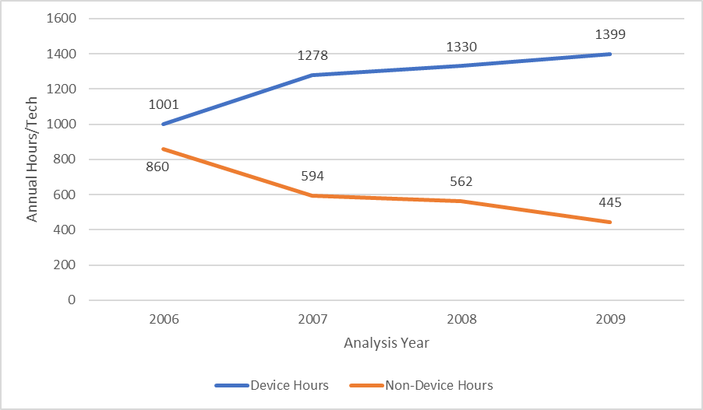
Device Hours Trend
Notes:
Yr. 4 = 1399/1844 X 100 % = 75.87% = The new 100% Productivity
Sends the message, “We have the same goals you do, Mr. or Mrs. Finance person!”

Slide 18
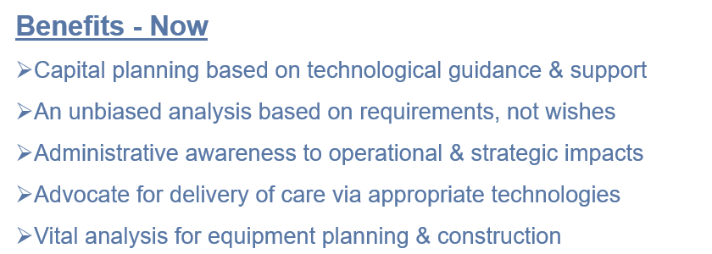
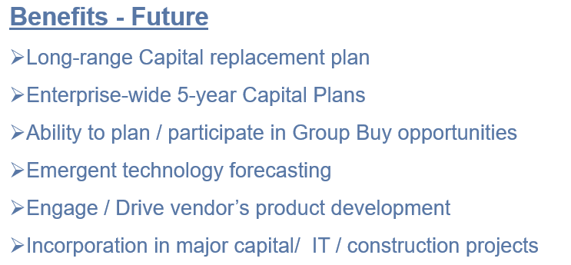

Slide 19
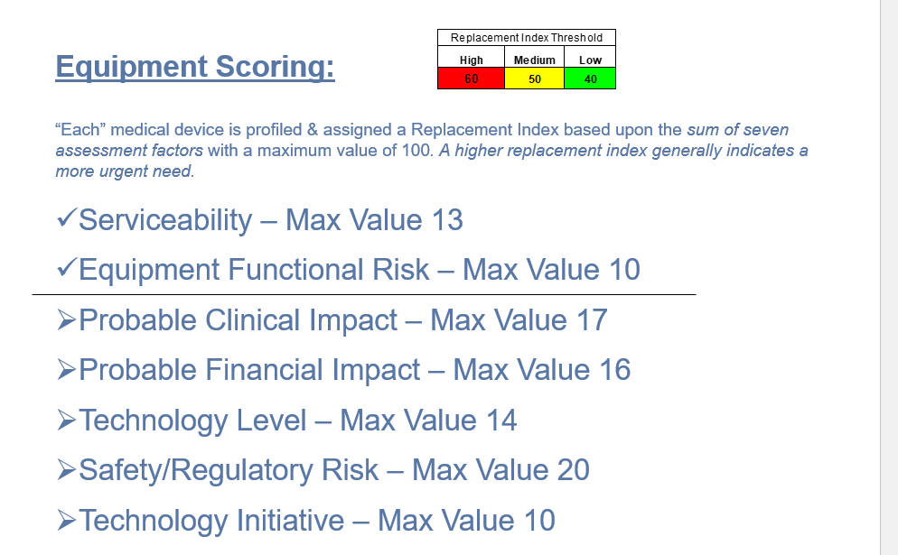

Slide 20
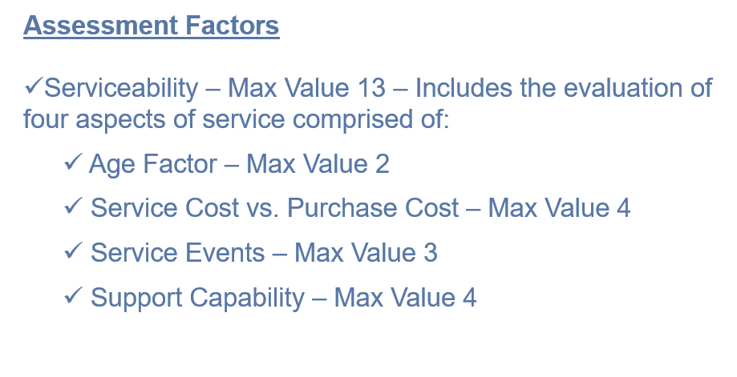

Slide 21
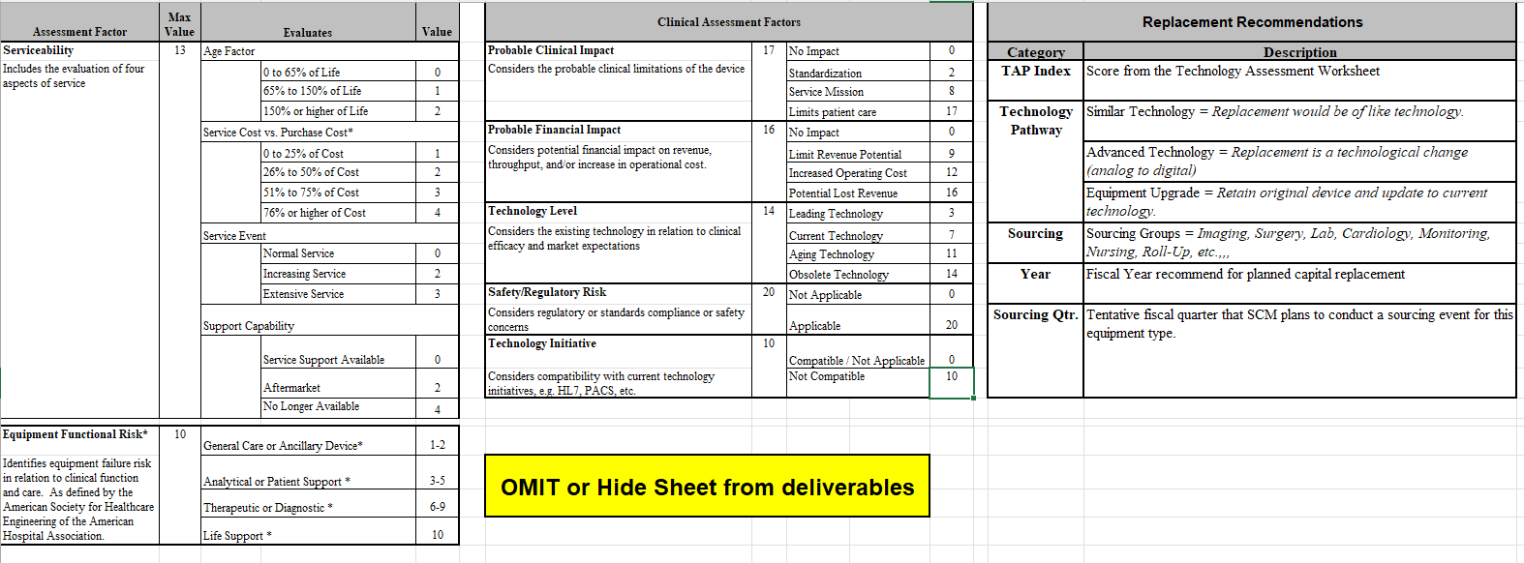
Capital Planning Assessment Factors

Slide 22
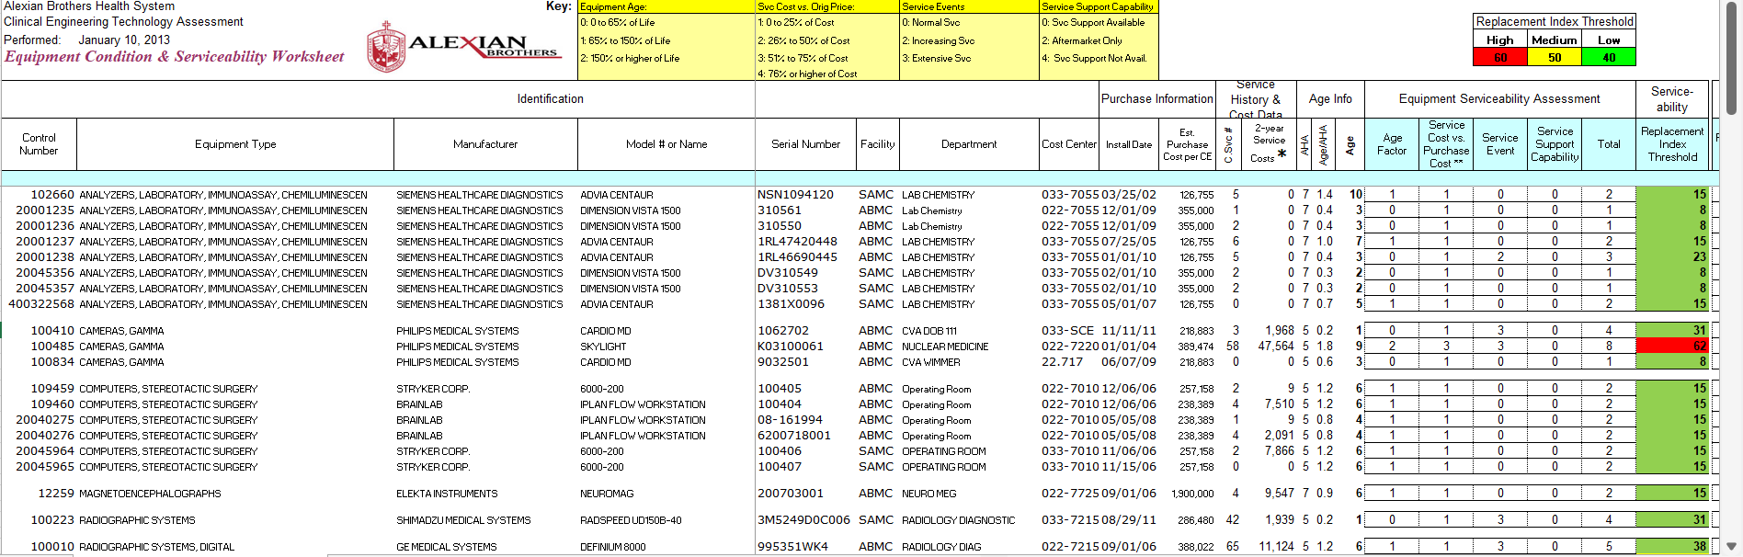
Capital Plan

Slide 23
Why?
  Staffing
  Capital Planning
  Benchmarking
  Improved & More Efficient Operations
    AEM
    More balanced PM vs. CM workload
    More Device Hrs. vs. Non-Device Hrs.

Slide 24
Why?
  Staffing
  Capital Planning
  Benchmarking
  Improved & More Efficient Operations
    AEM
    More balanced PM vs. CM workload
    More Device Hrs. vs. Non-Device Hrs.

Slide 25
Why?
  Staffing
  Capital Planning
  Benchmarking
  Improved & More Efficient Operations
How?
  Data Integrity
  Data Standardization
What?
  Potential Results

Slide 26
DATA INTEGRITY!

Slide 27
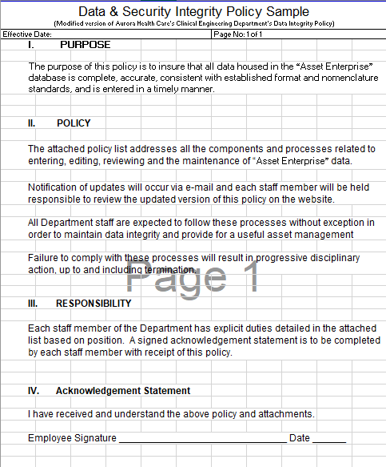
Data
Integrity
Policy

Slide 28
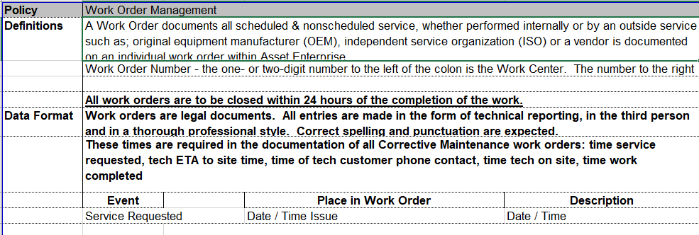
Data Integrity Policy

Slide 29
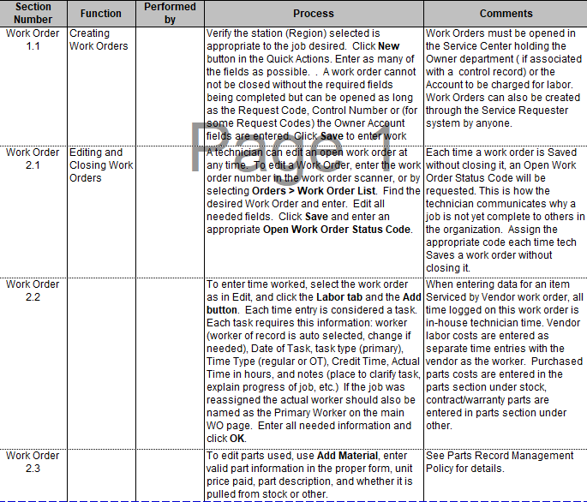
Data
Integrity
Policy

Slide 30
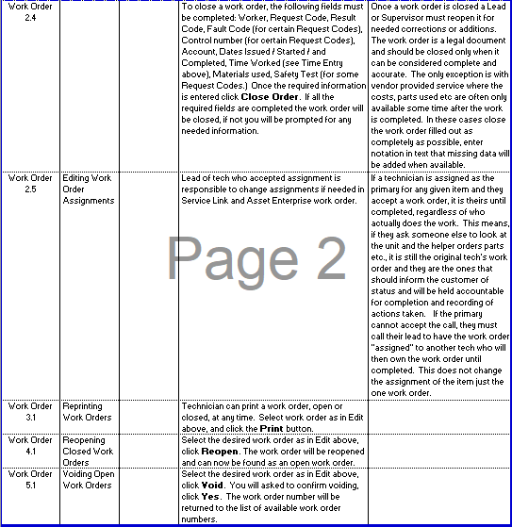
Data
Integrity
Policy

Slide 31
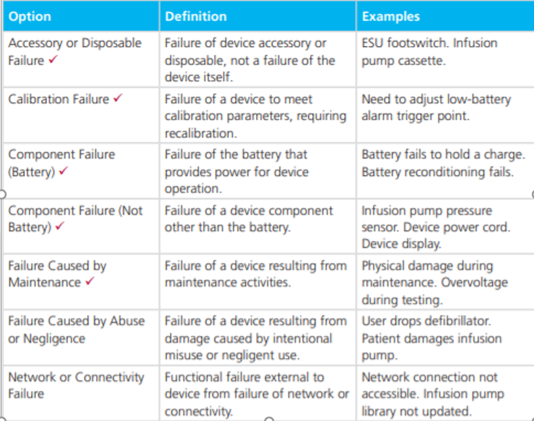
Failure Code
Field Options -
CMMS Collaborative

Slide 32
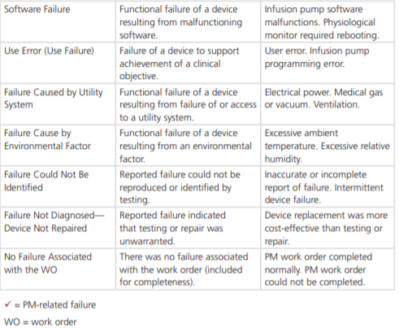
Failure Code
Field Options -
CMMS Collaborative

Slide 33
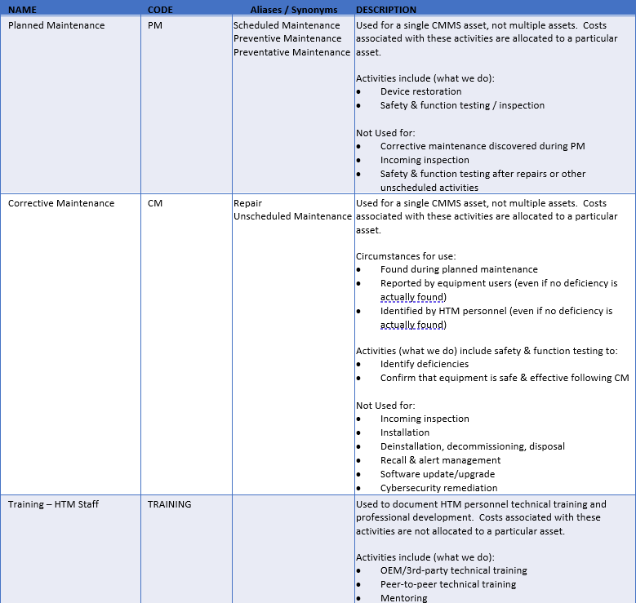
Work Order
Type Options -
CMMS Collaborative

Slide 34
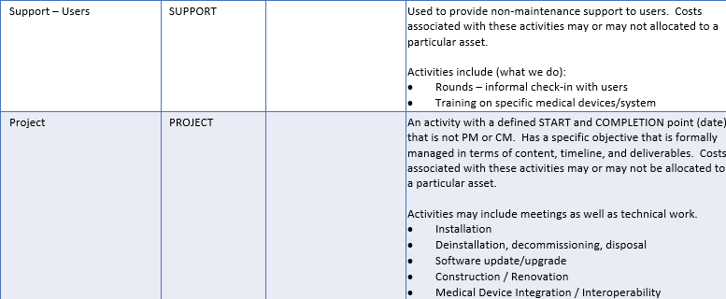
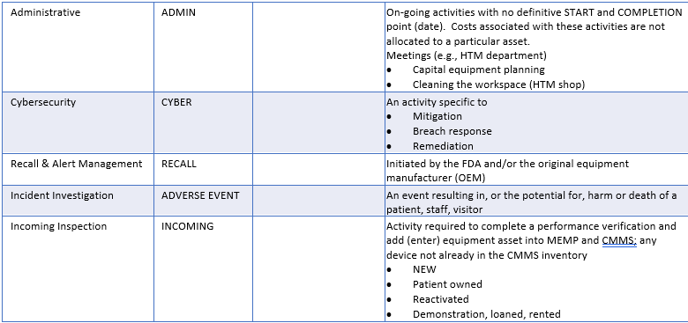
Work Order
Type Options –
CMMS Collaborative

Slide 35
Manning Data
Device Category | Active Inventory | Rich's Hours per device | Rich's Total Device Hours
Aerator, Ethylene Oxide | 6 | 1.90 | 11.40
Air Cleaner, Particulate, Germicidal, UV | 3 | 1.00 | 3.00
Air Cleaner, Particulate, High-Efficiency Filter | 4 | 0.00 | 0.00
Alarm, Occupancy, Bed | 928 | 0.75 | 696.00
Amalgamator | 5 | 1.00 | 5.00
Analyzer, Lab, Hematology, Platelet Aggregation | 4 | 0.30 | 1.20
Analyzer, Lab, Hemo,Erythrocyte Sedimentation Rate | 96 | 0.30 | 28.80
Analyzer, Lab, Immunoassay, Chemiluminescent | 2 | 0.80 | 1.60
Analyzer, Lab, Immunoassay, Photometric, Microplat | 14 | 0.74 | 10.36
Analyzer, Lab, Microbiology, Susceptibility, Auto | 28 | 0.74 | 20.72
Analyzer, Laboratory, Blood Gas/pH | 22 | 0.76 | 16.72
Analyzer, Laboratory, Body Fluids, Glucose | 3 | 0.51 | 1.53
Analyzer, Laboratory, Breath, Carbon Dioxide | 3 | 0.51 | 1.53
Analyzer, Laboratory, Clinical Chemistry | 61 | 0.28 | 17.08
Analyzer, Laboratory, Hematology | 77 | 0.42 | 32.34
Analyzer, Laboratory, Hematology, Coagulation | 57 | 0.56 | 31.92
Analyzer, Laboratory, Hematology, Hemoglobin | 7 | 0.56 | 3.92
Analyzer, Laboratory, Immunoassay | 40 | 1.30 | 52.00
Analyzer, Laboratory, Urine | 109 | 1.03 | 112.27
Analyzer, Phys, Middle Ear, Impedance Tympanometry | 116 | 0.80 | 92.80
Analyzer, Phys, Neuro Musc Funct, Body Motion | 20 | 4.81 | 96.20
Analyzer, Phys, Neuromuscular Funct,Posturographic | 3 | 2.65 | 7.95
Analyzer, Phys, Peristaltic Motility, Esophageal | 7 | 0.75 | 5.25
Analyzer, Physiologic, Body Composition | 4 | 1.00 | 4.00
Analyzer, Physiologic, Joint Laxity | 1 | 1.00 | 1.00
Analyzer, Physiologic, Metabolic Rate, O2 Based | 1 | 2.77 | 2.77
Analyzer, Physiologic, Pulmonary Function | 27 | 4.78 | 129.06

Slide 36
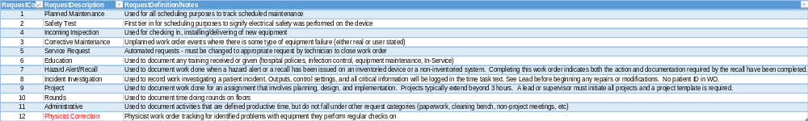
Code Definitions

Slide 37
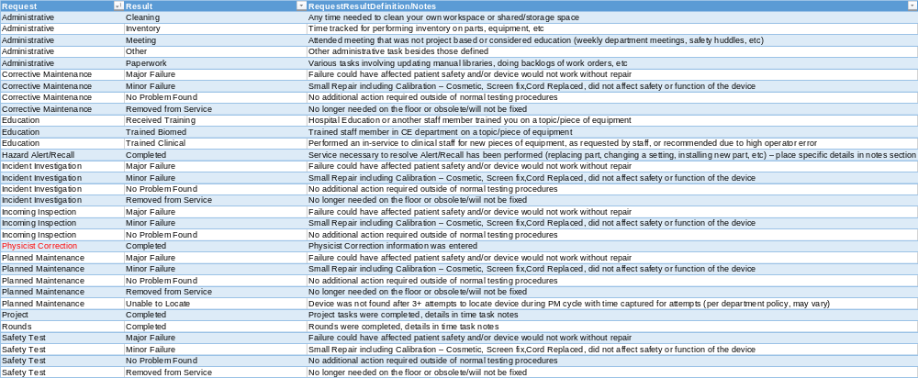
Code Definitions

Slide 38
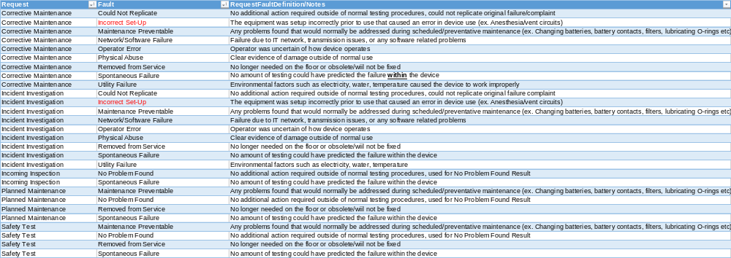
Code Definitions

Slide 39
Why?
  Staffing
  Capital Planning
  Benchmarking
  Improved & More Efficient Operations
How?
  Data Integrity
  Data Standardization
What?
  Potential Results

Slide 40
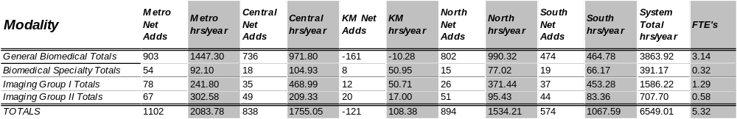
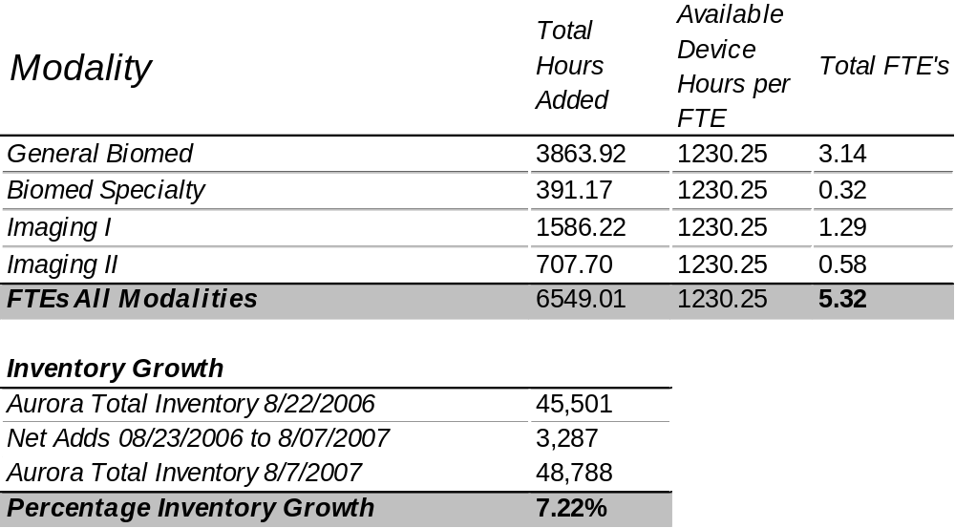
Annual Manning Analysis
Productivity = 100.8%

Slide 41
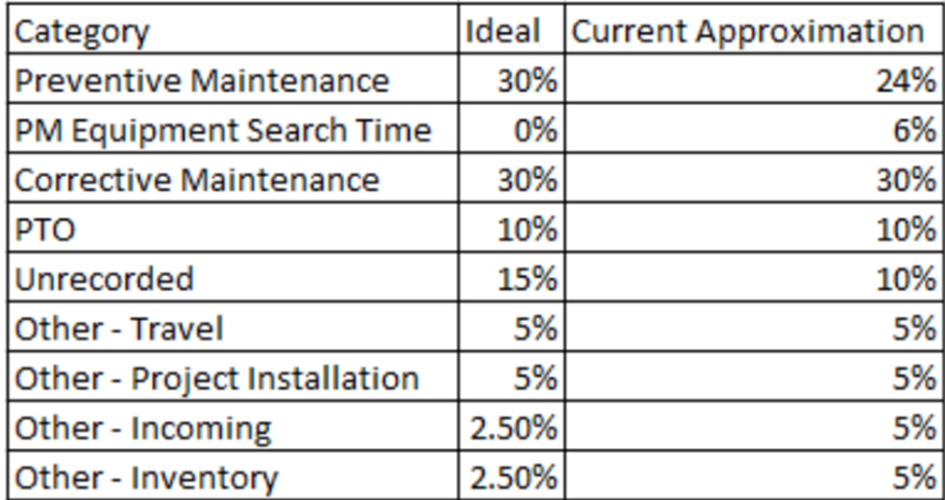
Staff Documentation

Slide 42
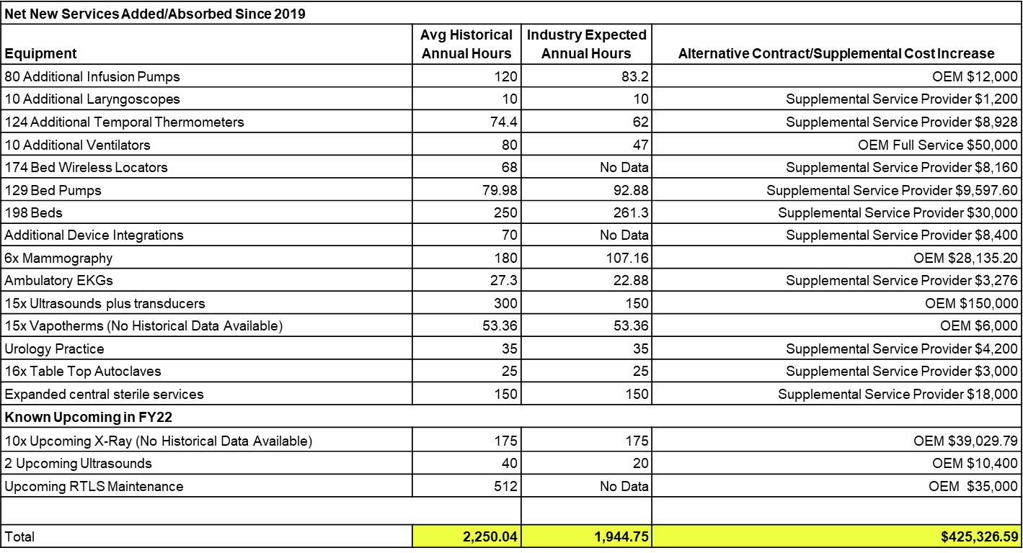

Slide 43
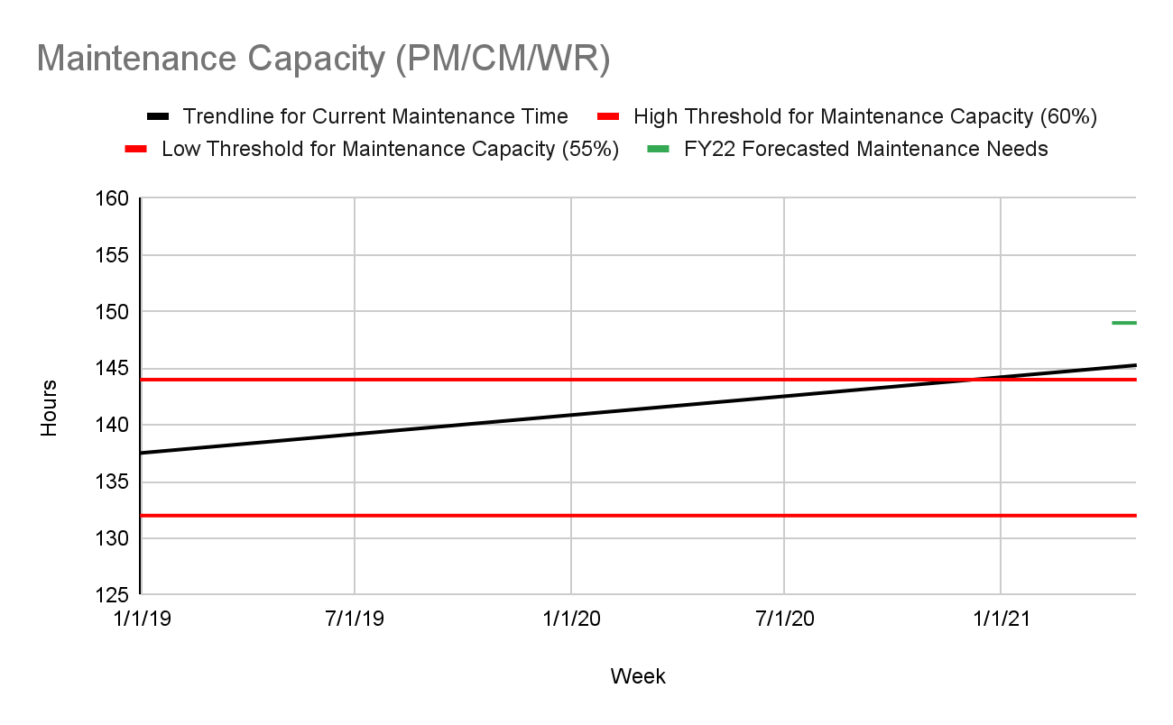

Slide 44
Future Strategy
Upon capital request or contract renewal, review service options for device comparing contract, T&M, and In-House using best available data.
  For every capital or contract renewal request that will result in In-House support show the current capacity, expected change in capacity, and budget growth.
    Example: (Numbers below are for example purposes only)
      Purchase 10 Defibrillators
      Current Annual Maintenance Capacity: 400 Hours
      Expected Annual Maintenance Capacity Growth: 80 Hours resulting in 320 Hours remaining
      Expected Cost of Service Ratio In-House: 6% ($20,300.23)
      Expected Cost of Service Ratio Lowest Contract: 24% ($81,200.92)
      Expected Annual Operational Budget Growth: $20,300.23 (Savings of $60,900.69)

Slide 45
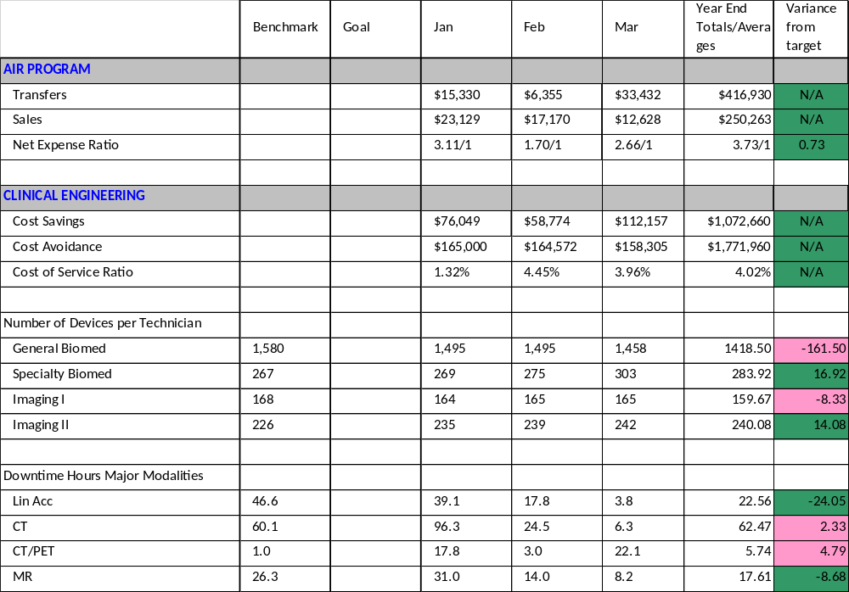

Slide 46
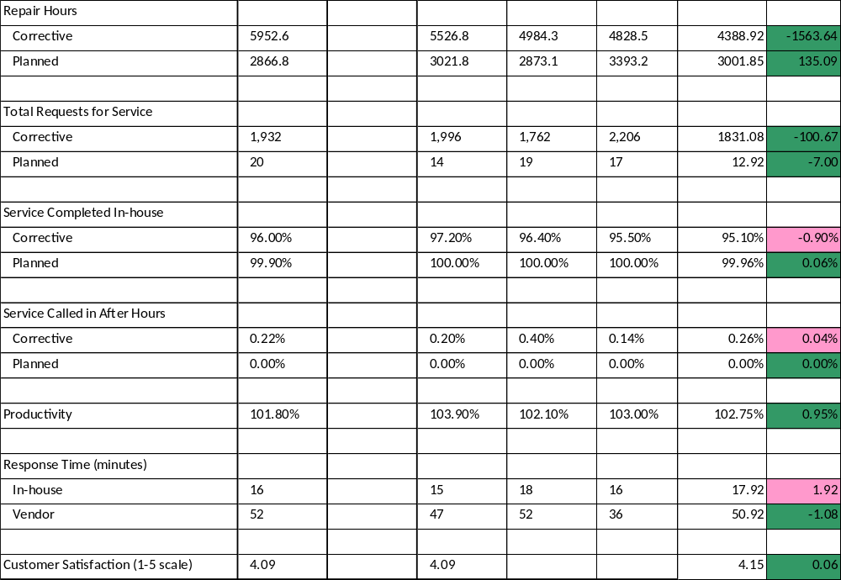

Slide 50
agresch@accruent.com

