Slide 1

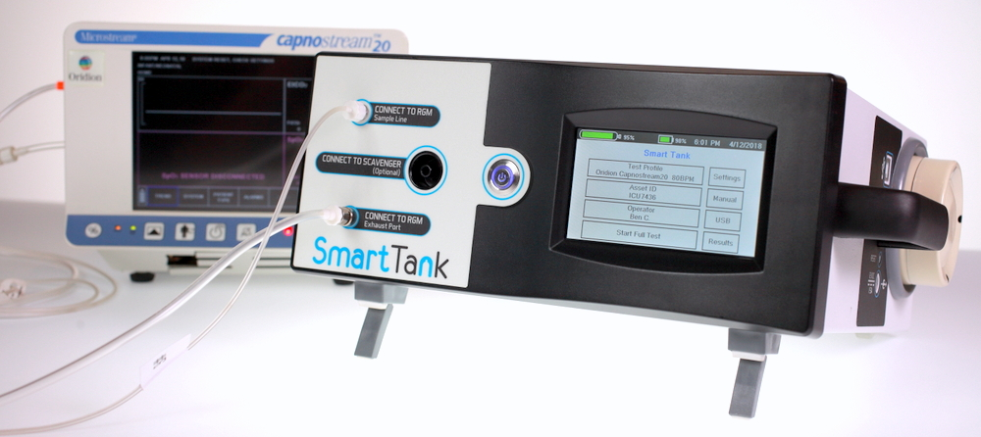

Life Spark Medical

Slide 2
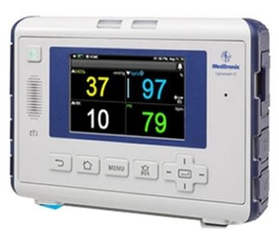
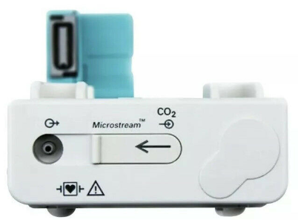
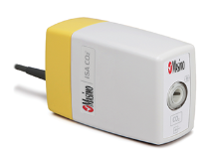
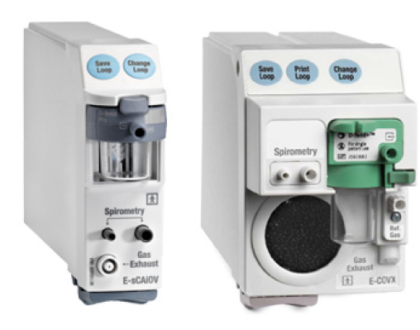
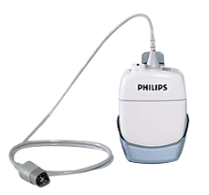
Gas Monitor 101
Measures gas concentration in patient breath
Capnometers (end tidal modules) measure CO2
Anesthesia gas monitors measure CO2, O2, N2O & anesthetic agent
Doctors rely on them in critical care scenarios
  Provide earliest warning of compromised respiratory system
  Can make the difference between life and death

Slide 3
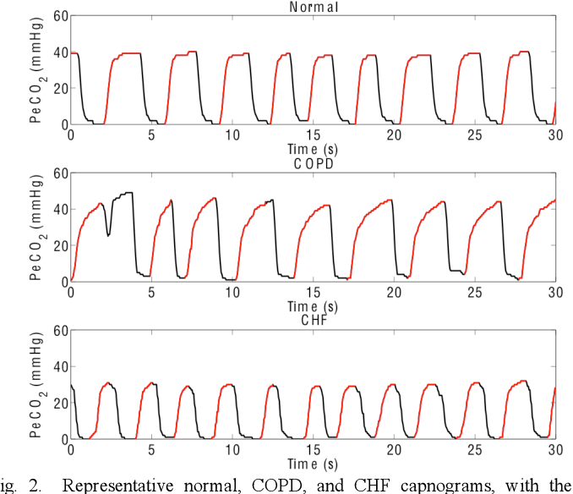
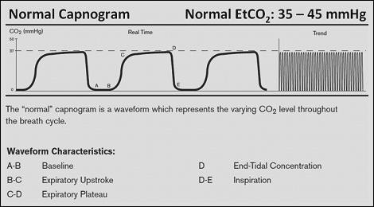
Gas Monitor 101
Provide end tidal CO₂ value (end of exhale) and capnogram (CO₂ waveform)

Slide 4
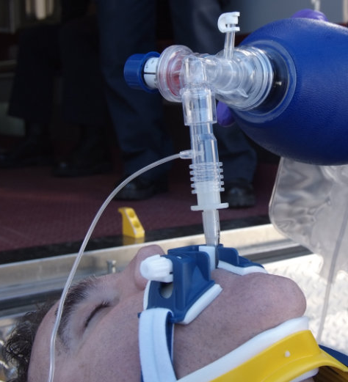
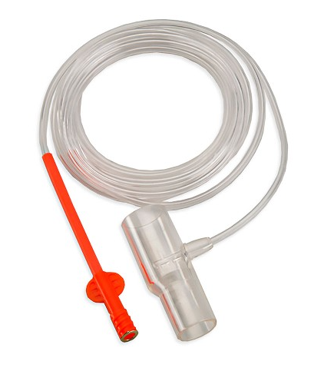
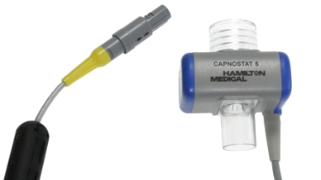
Gas Monitor 201
Two types
Side Stream
  Pulls a small sample from the patient using a built-in pump
  Account for 80%+ of all capnometers in hospitals
  Complex device requiring multiple tests by biomeds including pump flow rate, check for leaks, calibration and alarms
Mainstream (On airway)
  Located in the main breathing circuit
  Not as common
  Biomeds only check calibration

Slide 5
Gas Monitors are Proliferating
Clinicians are embracing the value of capnometry
Capnometry use has risen sharply due to guideline changes
  2004 – Joint Commission recommends capnometry for patients self-administering analgesia (infusion pumps)
  2010 - American Heart Association (AHA) modified guidelines to use continuous capnometry during CPR and ECC events (defibrillators)
  2011 - American Association for Respiratory Care (AARC) recommended continuous capnometry during ventilation (vents and patient monitors)
Capnometers are abundant and will continue to grow aggressively

Slide 6
Where are they found?
Side stream monitors are found all over
Stand alone (less common today)
Gas modules – plug into multi-parameter monitors
  GE & Phillips are the most common
Infusion pumps
Defibrillators
Ventilators
Anesthesia machines
Found in many different hospital departments, dentist offices, surgical centers.
Are often sent to depots or the OEM for repair
GE e-sCXX and E-CXX
Philips

Slide 7
Problems –
Current testing is sub-par and inefficient
Manual process requiring an assortment of manual test setups and equipment
Slow - many recommended test steps are skipped
Minimal documentation if they fill out the worksheets
Wastes expensive calibration gas (3 to 5 times more gas)
No method to simulate breath so can’t verify performance
Inefficient Testing + Ballooning Inventory = Serious PM burden

Slide 8
Solution – the SmartTank
Introducing the SmartTank - YouTube

Slide 9
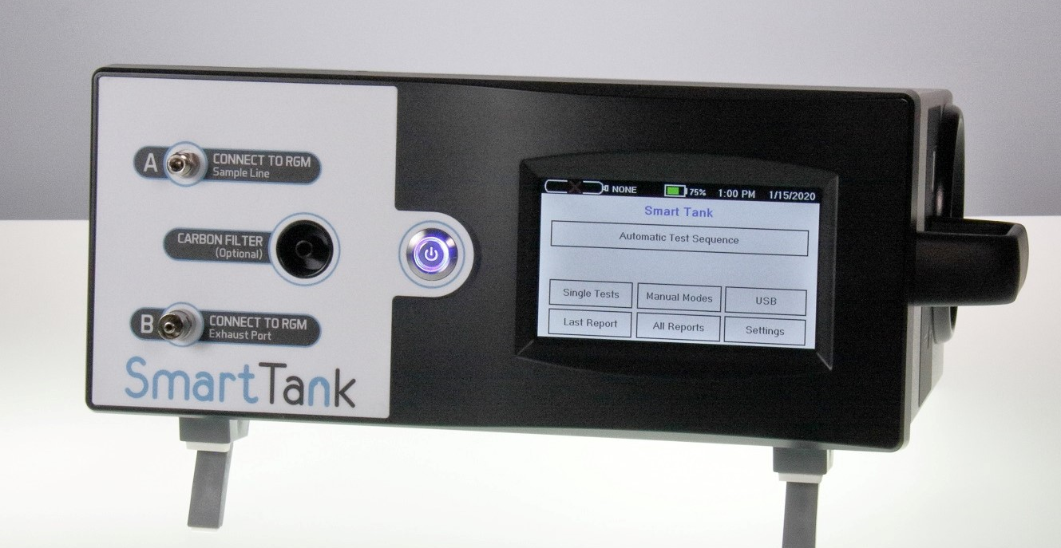
Solution – the SmartTank
One tool - everything you need to test gas monitors and modules
  Calibrate/test gas monitors and modules
  Simulate breath: verify performance with realistic capnogram
  Suitable for testing etCO2 modules and multi-gas modules
  Portable/battery powered
  Automated testing follows manufacturer’s PM procedures
  Automated test report generation

Slide 10
Value Proposition
Reduce risk by eliminating errors/inconsistency in…
  Test setup
  Test execution and acceptance criteria
  Reporting
Save time/money:
  Automated testing is faster
  Simplicity/automation makes it easy for less experienced biomeds
  Manufacturer’s PM instructions built into the test sequences
  Expensive calibration gas usage is minimized

Slide 11
SmartTank vs. Current Test Methods
 | Current Method | Smart Tank
Testing Time | 15 min | 3-5 min
Value of Time Savings | $1500 - $3500 annually
Equipment Cost | $2000 - $4000 | $6950
Training | Requires on the job training and experience | Less than 10 min
Risk Mitigation* | Low - Inadequate methods | High - Comprehensive
Reporting | Manual - By hand | Auto - Full details
CMMS Integration | No | USB Serial Available
Gas Waste | High flow / Left on | Minimal Approx. $300/yr. savings
* While difficult to estimate, risk mitigation is the greatest value. The avoidance of a single legal judgement can rank in the $100K’s.
Significant advantages with the SmartTank

Slide 12
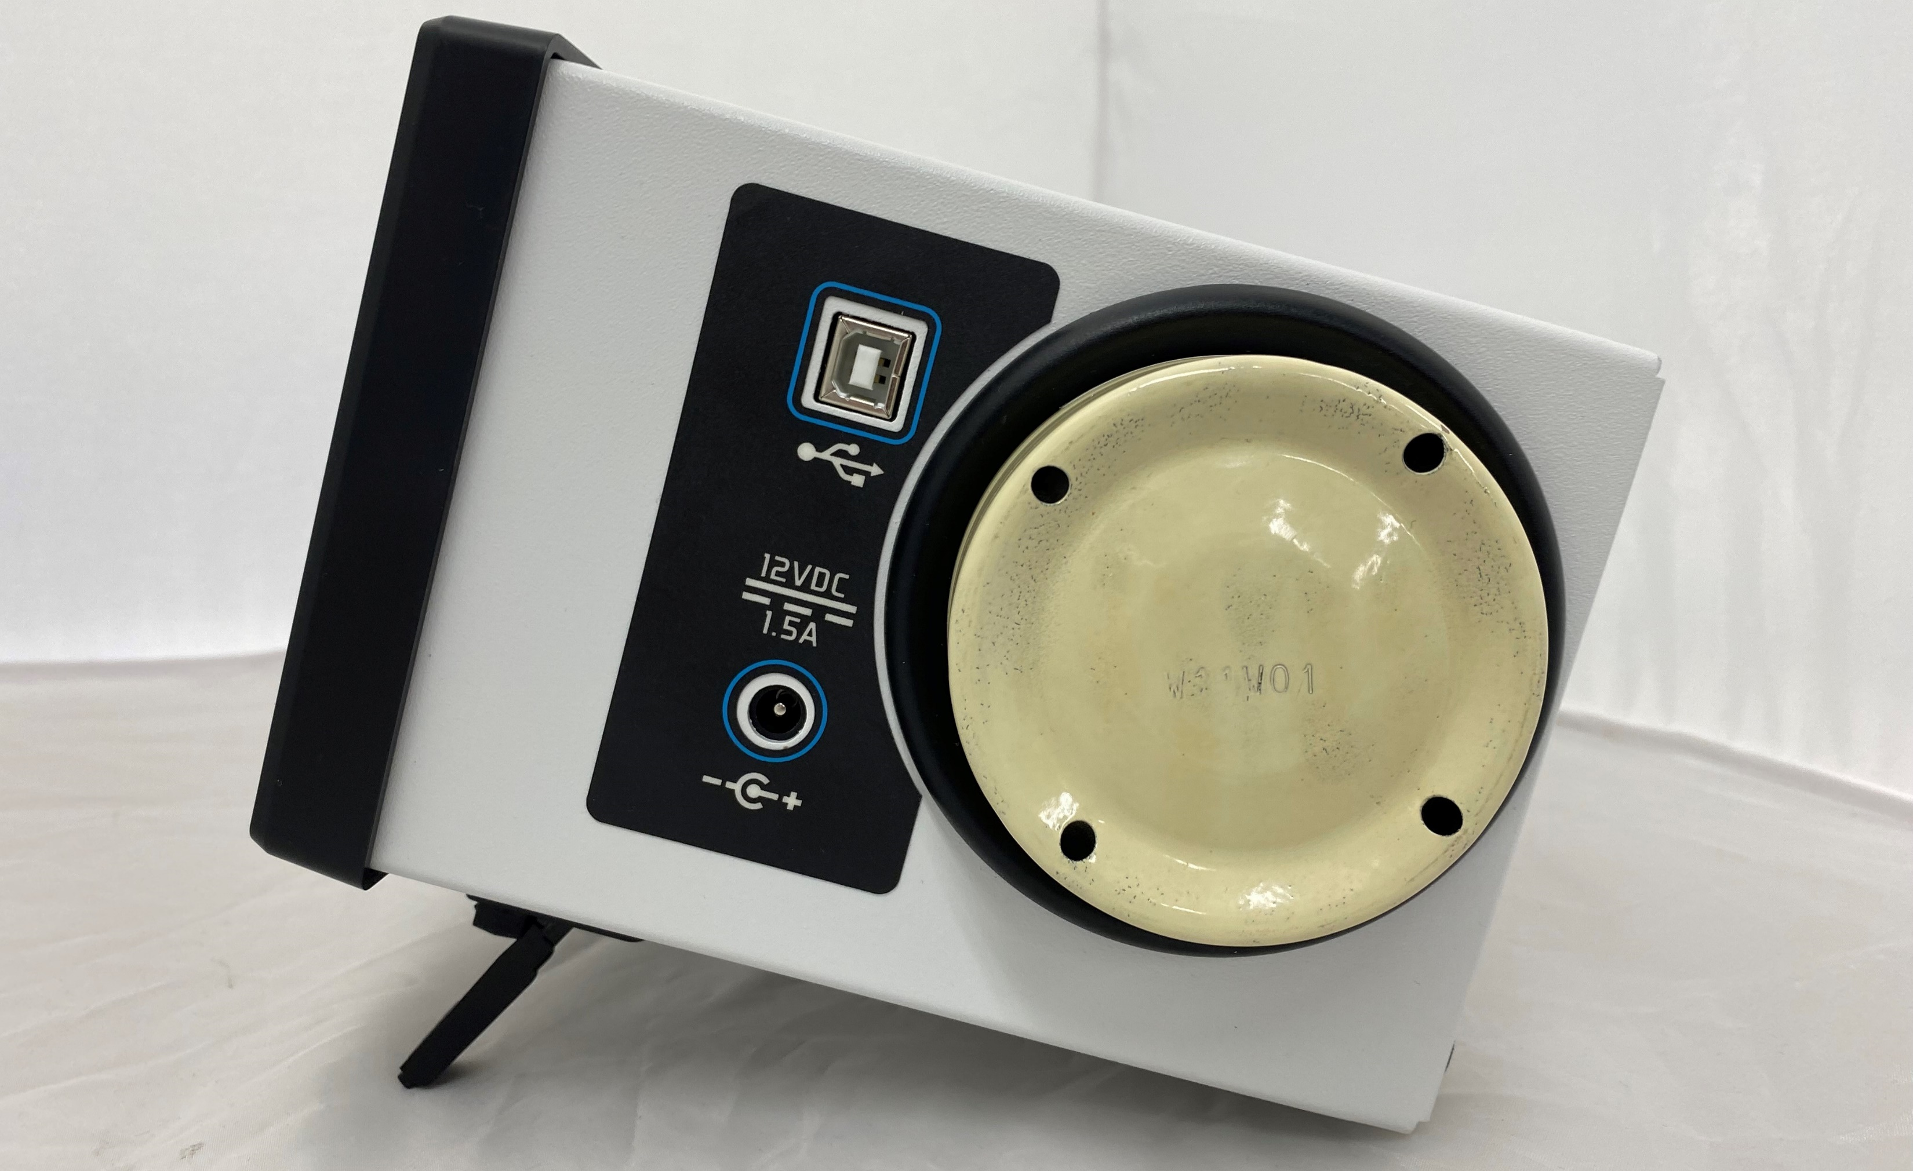
SmartTank - Features
Manufacturer’s PM instructions built into test sequences
Measures sample flow rate
Two leak test methods (Direct measure and leak down)
Built-in manometer
Built-in barometer
Built-in flowmeter
Pressure relief test
Constant pressure source
Controls calibration gas – minimize use
Collects data and automatically generates report
Versatile - swap gas bottles to test different monitors
Touchscreen display user interface
Easy retrieval of reports – USB to phone or computer
Cal Gas Bottle

Slide 13
The ST does not compete with existing test equipment.
ST does not measure anesthetic agent like the Reiken or Fluke Vapor. (This is a common source of confusion)
ST does not simulate ECG, Cardiac Output, SpO2, IBP, Temperature or NIBP.*
*The ST is equipped to perform a leak test and to serve as a manometer. Thus, the ST could be used to perform testing of some NIBP modules that don’t require simulation.

Slide 14
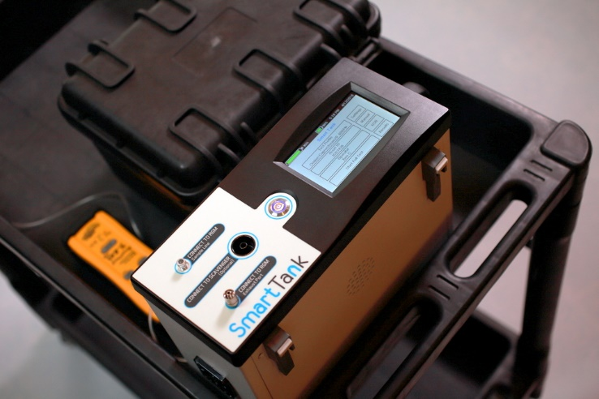
Benefits to Biomeds
Simplify by automation
No additional setup or equipment – just connect and test
Integrates into existing workflows (CMMS)
Minimizes required training
Comprehensive testing avoids costly unneeded service
Decreases testing time (15min-> under 4min)
Automated reporting ensures compliance
Save time and money while decreasing risk

Slide 15
Test Sequence 101
Preloaded with database for most common monitors
  Based on service manuals
  Main version – All steps in Service Manual. These are long and most people don’t do all the steps
  Short versions – trimmed down to key steps
If missing a monitor, we will add it, no-charge
Fully customizable
  Can add/modify or delete steps
  Currently no easy way for user to edit sequences
  We will assist with the edits for free
Can run single hardware tests or spot check with manual modes

Slide 16
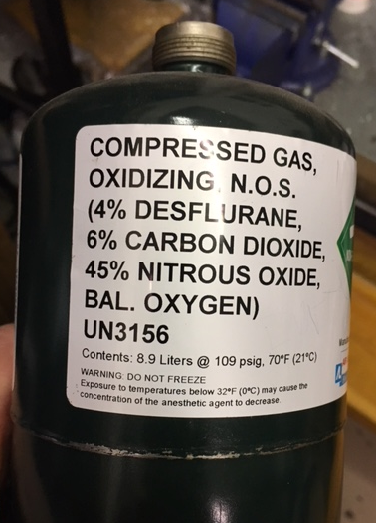
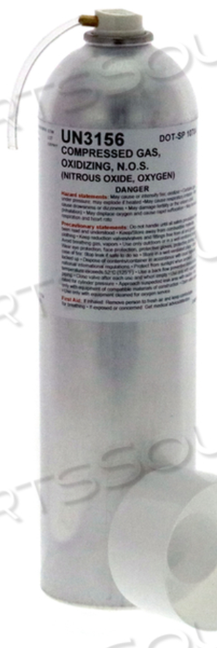
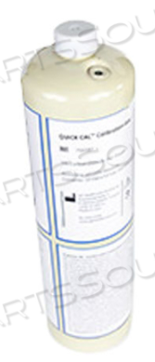
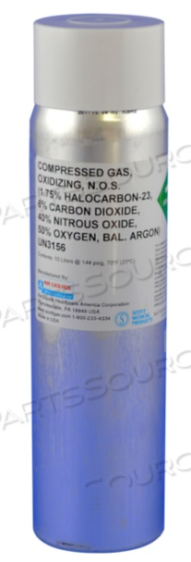
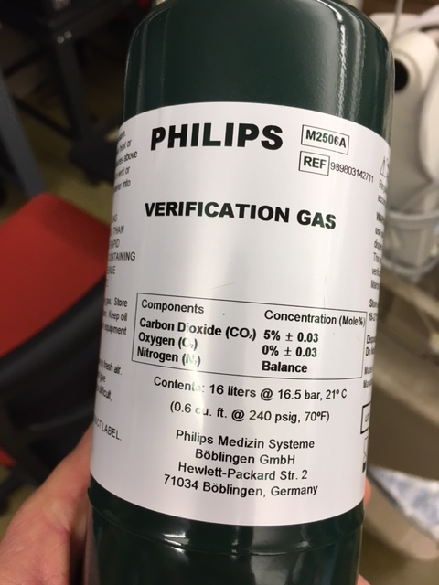
Gas 101
Two main types of gas
  Metabolic gases
    Typically 5%/10% CO2 mixed with various amounts of Oxygen, Nitrogen or regular air
    Used for simple capnometers
  Anesthetic gases
    Metabolic + Anesthetic gases like Desflurane and Nitrous Oxide (N2O)
    Used in anesthesia multi-gas monitors
Come in a wide variety of shapes, sizes and pressures/volumes -> results in a wide price range

Slide 17
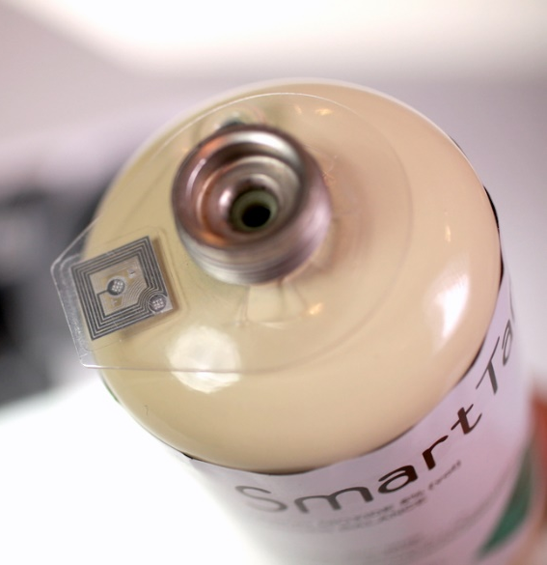
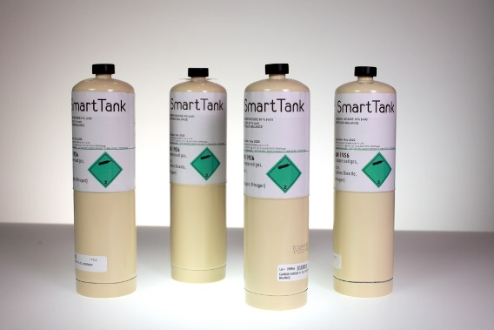
SmartTank Gas Bottle and Pricing
Single package type – 17L (240 psi)
RFID tag on the bottle allows the device to verify the gas mix and insert gas specific information into the report.
Metabolic cal gas- $80
Anesthetic cal gas- $190
Price match guarantee!
Longer expiration periods (2-4 years)
We will price match – must be medical grade and comparable volume/pressures
One-stop shop for all your monitors
Made in USA by the best FDA registered manufacturer.
Same or higher-grade cal gas compared to OEMs

Slide 18
Frequently Asked Questions
Q: Do we have to buy cal gas from you? Are you going to gouge us on price? A:Yes, best quality FDA registered gas manufacturer. Price matching. We are usually less expensive volume for volume.
Q: Does it have to be plugged in to run? A: No internal battery will run all day. You can still use the device while it is plugged in and charging.
Q: Do I have to send it in for calibration? A: Yes, the flowmeter is built for super low flow and high accuracy. It requires an automated system that calibrates it at over 50 flow levels. All NIST traceable equipment.
Q: How much does calibration cost? A: See price sheet. It is very reasonable for calibration of three test modalities (flow, pressure, barometer). You also get a 4-year extended warranty if you send it in each year.
Q: Do I have to load software to get reports off the SmartTank? A: No, the USB port is recognized by computers and smartphones as a mass storage device (thumb drive). It shows up in your file explorer like any other drive with folders inside it. You can simply drag-and-drop reports from the SmartTank to your computer. New test sequences, same way.

