Slide 1

Creating a Strong HTM Pipeline Together

Slide 2


TODAY’S PLAN…
A Bit About AAMI
5 Resources to Promote HTM
HTM in a Box Demo
AAMI Outreach
AAMI’s BMET Apprenticeship
Questions

Slide 3
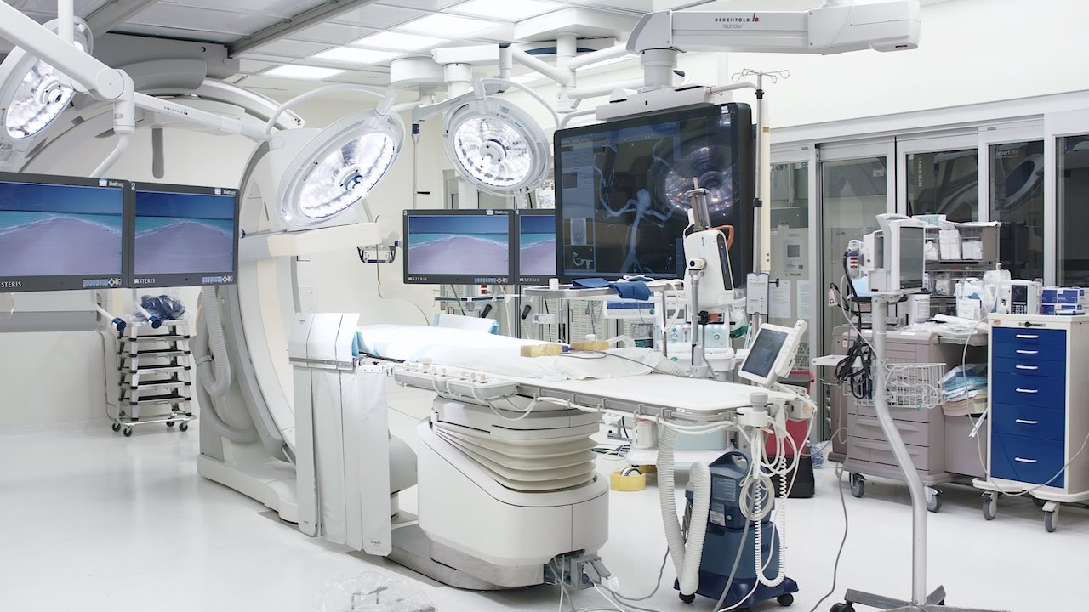
AAMI brings together a diverse international community of healthcare professionals dedicated to developing, managing and using health technology safely and effectively.
  Development and use of AAMI standards and guidance docs
  Professional certification
  Professional education & training
  Publications
  Online communities
  Mentorship & job boards

Slide 4
AAMI
in Numbers…
Represent nearly 10,000 members (manufacturers, clinicians, HTM professionals, educators)
Reach an estimated 55,000 healthcare technology professionals annually through programs
Employ 45 staff, most based at AAMI headquarters in Arlington, VA

Slide 5
5 Resources to Promote HTM
Let’s refuel the HTM pipeline together!

Slide 6
#1. Succession Planning Guide

Slide 7


5 Resources Affecting You!
1. HTM Succession Planning Guide
Because nothing and no one is forever, a succession plan for all levels of HTM staffing can help minimize the effects of a sudden departure and potentially lingering vacancy.
A succession plan will provide a clear roadmap into the future that will help avoid making impulse decisions in an emergency staffing situation.
With an ageing HTM work force, succession planning is now more critical than ever.
Staff retention is much higher when employees see a clear and consistent pathway for their career trajectory.
#IamHTM

Slide 8
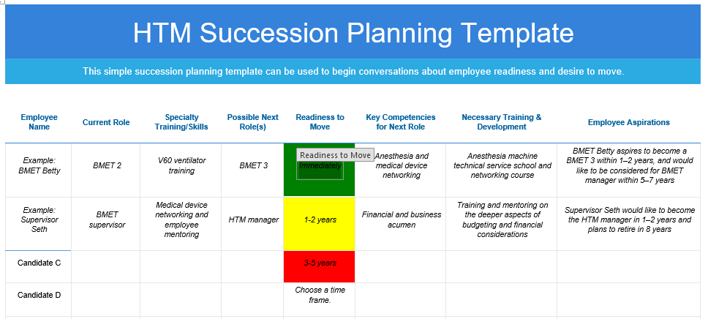
5 Resources Affecting You!
HTM Succession Planning Guide
Guide provides a template to help you start planning now!
#IamHTM

Slide 9
#2. HTM Training Guide

Slide 10
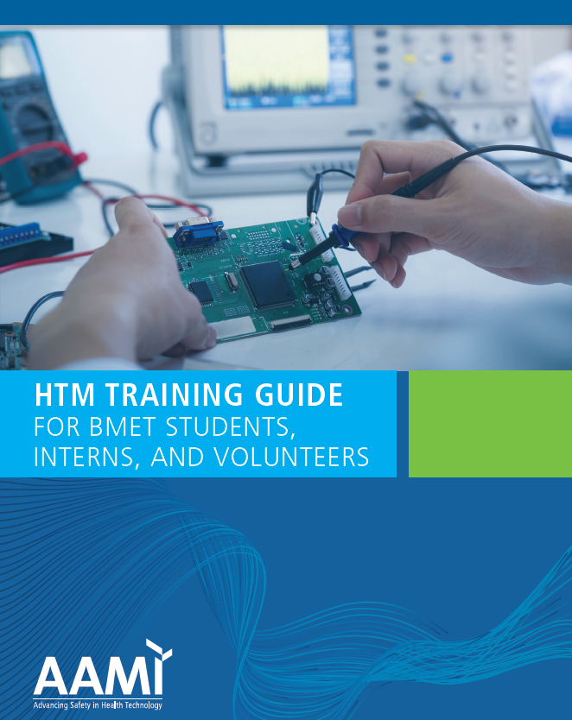
5 Resources Affecting You!
3. HTM Training Guide
Built from the BMET Apprentice Curriculum and AAMI’s Core Competency Guide, the HTM Training Guide provides a comprehensive outline of competences HTM trainees should learn during an internship
Internships are two ways: Both the employer and trainee can reap huge benefits
Integral part of Succession Planning
Retention: Employees are more likely to stay at organizations that invested in their training and development
#IamHTM

Slide 11
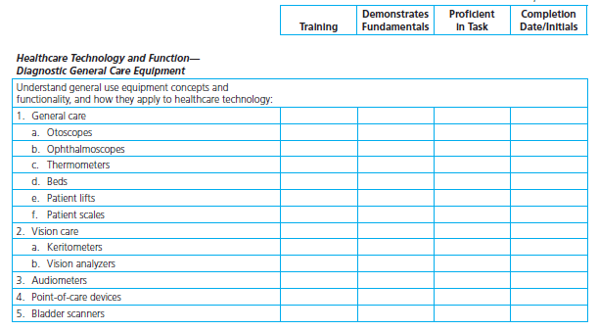
5 Resources Affecting You!
2. HTM Training Guide
#IamHTM

Slide 12
#3. The Certified Associate in Biomedical Technology (CABT)

Slide 13
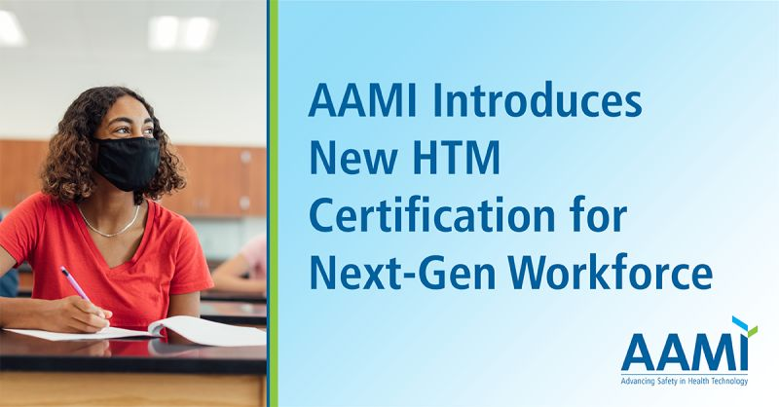
5 Resources Affecting You!
3. The Certified Associate in
Biomedical Technology (CABT)
Allows all HTM Professionals the opportunity the hold a certification from the day they decide to enter the work force
Only requires a high school diploma to qualify
Lasts for 5 years and is nonrenewable
At the five-year expiration date, the candidate will have the necessary experience to sit for the CBET or CRES exam
Proves to employer applicant meets a minimum knowledge competency
#IamHTM

Slide 14
#4. BMET101 Course

Slide 15
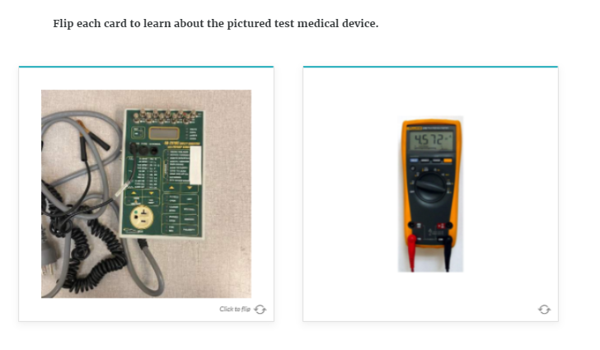
5 Resources Affecting You!
4. BMET 101 Course
Geared towards individuals who have limited to no experience in HTM and need an entry-level overview of the field.
6 Modules:
  About a BMET
  Safety
  Regulatory
  Anatomy
  Electronics
  Medical Devices
#IamHTM

Slide 16
#5. HTM in a Box

Slide 17
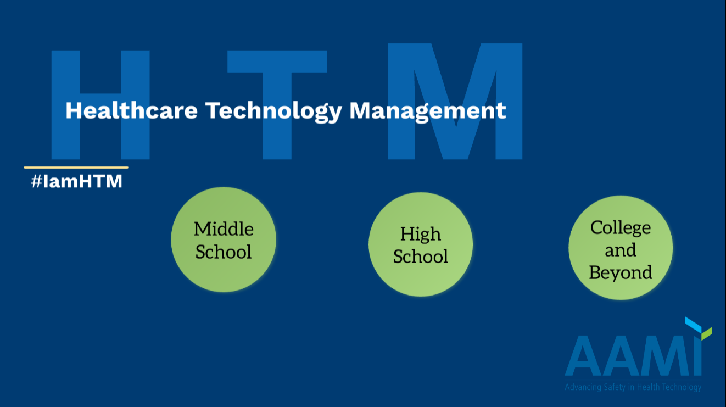
5 Resources Affecting You!
5. HTM in a Box
Standardized presentations to help YOU promote the field to any age demographic!
FREE to everyone!
Getting the word out about HTM is large task
Getting the word out about HTM is large task
We need YOU as messengers
Visit www.aami.org/HTMinaBox
#IamHTM

Slide 18
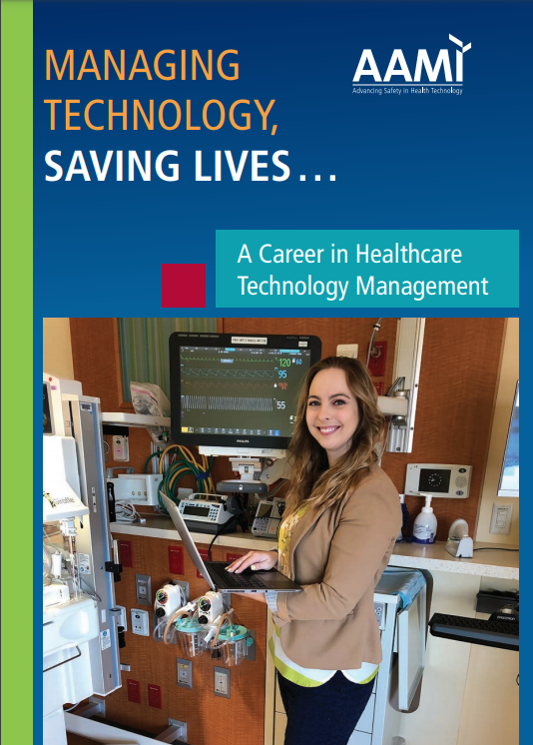
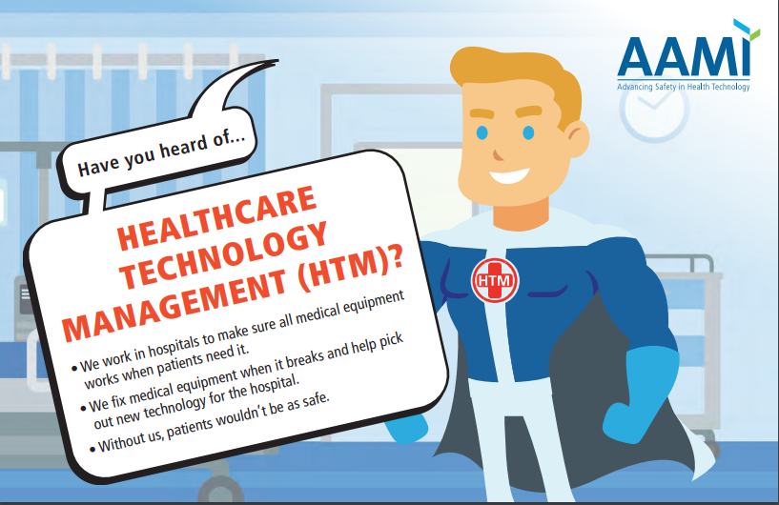
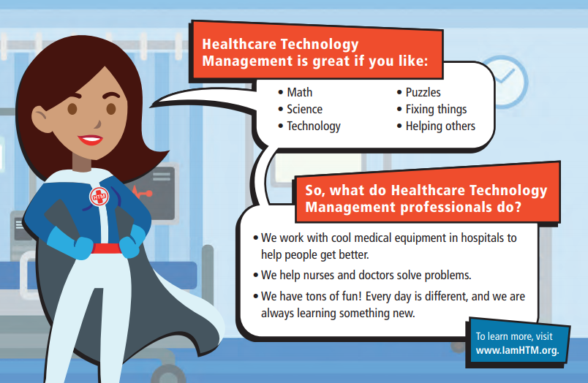
5 Resources Affecting You!
Additional FREE Tools to Help YOU Promote HTM
Career Brochures
  Children's Version
  Adult Version
Complete listing of all HTM Schools organized by state
Email and phone scripts to use when cold calling organizations and schools
#iamHTM

Slide 19
AAMI HTM Outreach

Slide 20

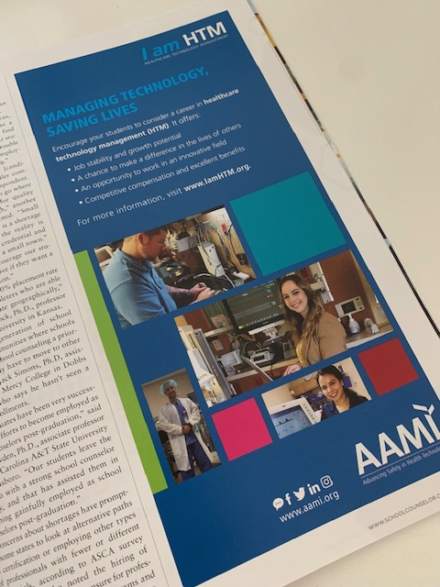


Promoting the Field/Pipeline Development
American School Counselor Association
Attended National Conference in Boston
  15,000 attendees
HTM ad in “conference” and “back to school” magazine issues
  Reaches 30,000 counselors
“Careers You Should Know About” Webinar Series in 2020 and 2021
#IamHTM

Slide 21
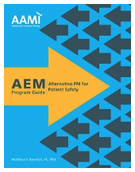
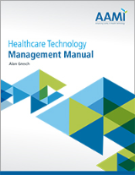


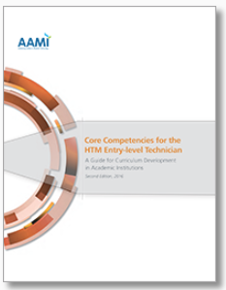
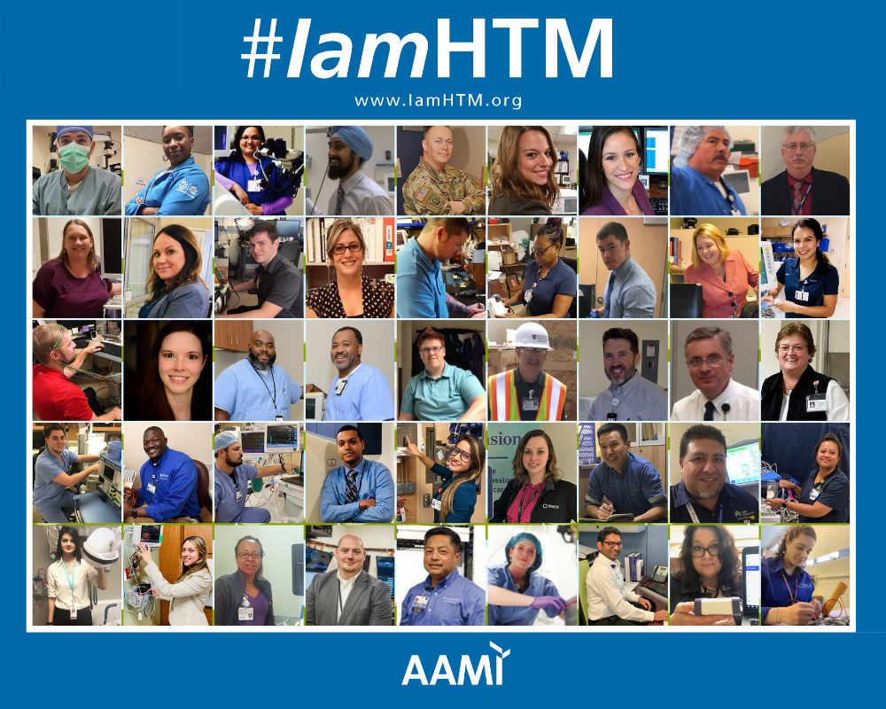
Promoting the Field/Pipeline Development
HTM Outreach
  HTM Associations
  HTM Educators
  High School Contests
  Girl Scouts
  ASHE, OR Today, USA Today
  YearUp
  HOSA
#IamHTM Campaign
Core competencies for HTM education programs
Healthcare Technology Management Manual
Acquisition, Servicing and AEM Guides
PM Compliance and Definitions White Paper
HTM Emergency Preparedness Guide
#IamHTM

Slide 22
The BMET Apprenticeship

Slide 23

Nationally recognized program through the US Department of Labor and AAMI
The BMET Apprenticeship is a two-year hybrid program that combines education and up to 6000 hours of paid, on-the-job, competency-based learning.
Created so ANYONE, regardless of economic status, can become a BMET
Ensures employers are training new BMETs consistently across the nation to AAMI’s minimum standards and recommended knowledge competencies.
#IamHTM

Slide 24
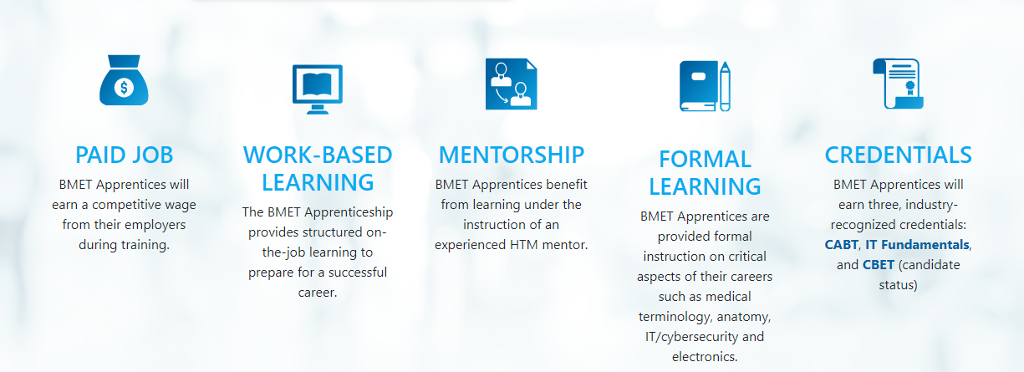
What is Apprenticeship?
Industry-driven, high-quality career pathway where employers can develop and prepare their future workforce, Employers can choose to register their programs with the AAMI through the U.S. Department of Labor to show prospective job seekers that their apprenticeship program meets national quality standards.
Five key components differentiate apprenticeships from other types of workplace training programs:
#IamHTM

Slide 25

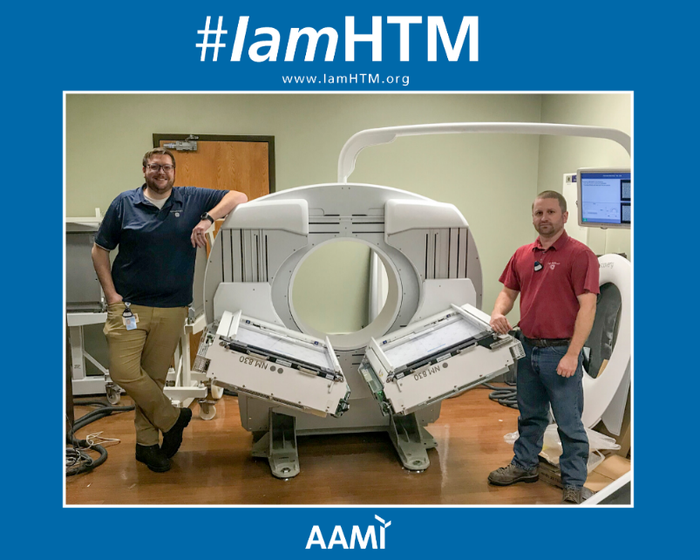
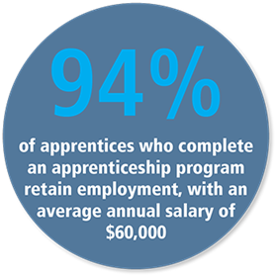
Paid Job
BMET Apprentices are the employer’s employees – not AAMI’s. Apprentices are hired through the employer’s HR.
AAMI/DOL minimum requirements to participate is a high-school diploma or GED. Employers can require more (Drivers License, Flu Shot, etc.)
Employers set the starting salary. However, apprentices must at least make their state’s minimum wage. Employers are not required to pay benefits.
Apprentices must receive at least one raise during their two-year apprenticeship. How much and when this raise occurs is determined by the employer. More skills = more value to organization
#IamHTM

Slide 26

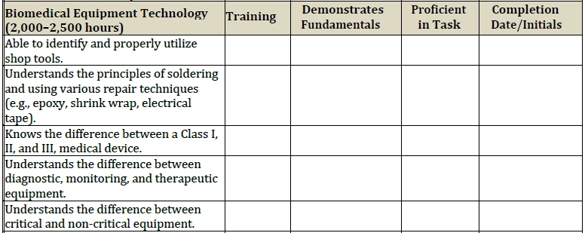
Work Based Learning
Trained to your organization’s culture, on your equipment, with your tools. No retraining necessary when done program!
Program includes a 14-page, work-based learning curriculum that trains perspective BMETs in eight main competency areas:
  Hospital Orientation and Healthcare Safety
  Anatomy and Physiology
  Mathematics
  Electronics
  Biomedical Equipment Technology
  Information Technology
  Communication Skills
  Professional Skills
Must meet 80% of curriculum as written
#IamHTM

Slide 27

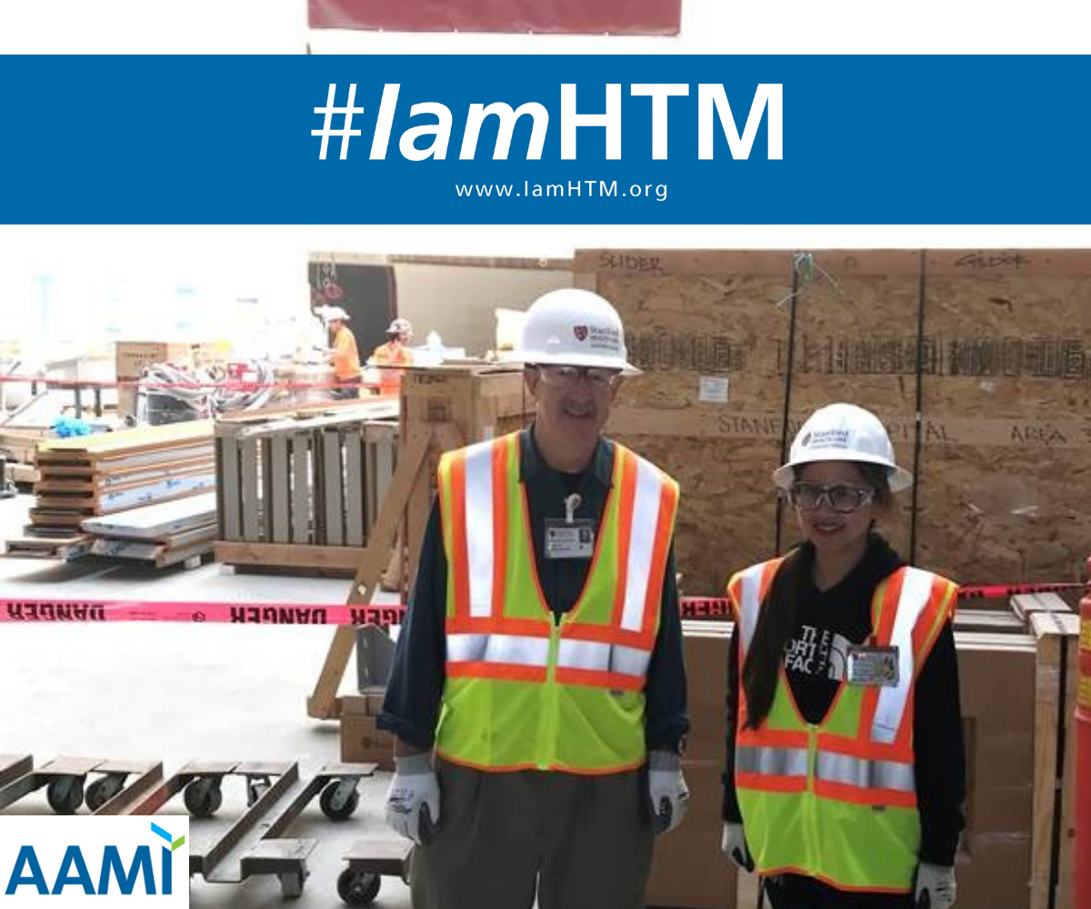
Mentorship
BMET Apprentices benefit from learning under the instruction of an experienced HTM mentor.
DOL refers to mentors as “Journey Workers.”
Employers determine who is qualified to be a Journey Work at their organization.
Employers cannot have more Apprentices then Journey Workers.
Only qualification requirement of a Journey Worker is that they take a free sexual harassment course on the DOL website.
#IamHTM

Slide 28

Formal Learning
BMET Apprentices are provided formal instruction on critical aspects of their careers such as medical terminology, anatomy, IT/cybersecurity and electronics.
DOL requires at least 144 hours of formal learning each year.
Formal education must be 100% paid for by the employer – if there is a cost.
Employers can follow their individual reimbursement polices (e.g., apprentice is reimbursed after passing a certification)
Learning curriculum includes 6 college credits to set apprentice up to go to college.
Education is non-repetitive (e.g., If apprentice has already taken a college math course, they do not need to take it again)
#IamHTM

Slide 29
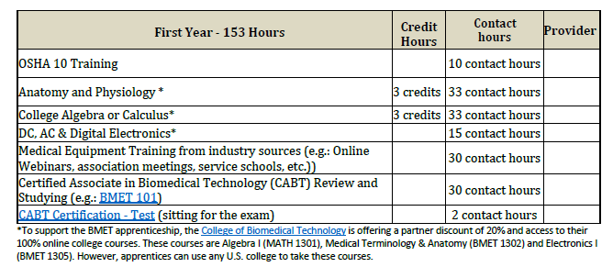
Formal Learning
#IamHTM

Slide 30
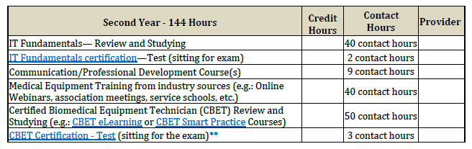
Formal Learning
#IamHTM

Slide 31




Formal Learning
Employers can decide how training is delivered (e.g. webinars or service schools)
Curriculum was built to be scalable so employers can build the BMET they need/want.
Curriculum was built to not be cost prohibitive. Plenty of FREE training available.
Plenty of industry support
#IamHTM

Slide 32



Portable Credentials
BMET Apprentices will receive 3 industry recognized credentials:
  Certified Associate in Biomedical Technology (CABT) – Year 1
  IT Fundamentals by CompTIA – Year 2
  Certified Biomedical Equipment Technician (CBET) in Candidate Status– Year 2
Certifications serve as a checks and balance system for employer training
Those who become certified early in their career are more likely to maintain certification throughout their career!

Slide 33
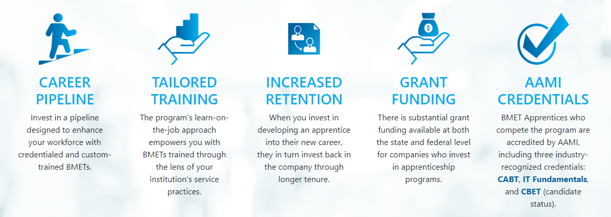
Employer Benefits – Why would you want to do this?
#IamHTM

Slide 34
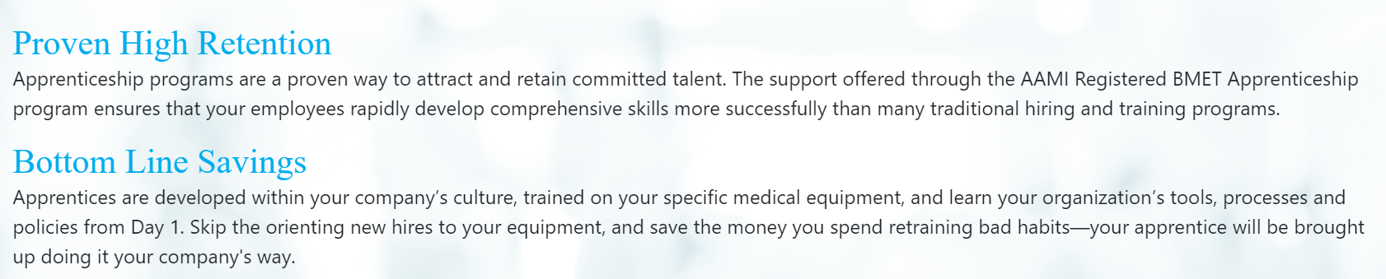





Employer Benefits – Why would you want to do this?
AAMI scaled the mountain of paperwork, you reap the benefits!
Getting a new apprenticeship approved through the U.S. Department of Labor is a hurdle—and we've already cleared it for you! As the sponsoring partner of the program, AAMI will not only certify your apprentices that complete the program, but is here to support both the employer and apprentice through the process by serving as your liaison to the DOL.

Slide 35





Employer Benefits – Why would you want to do this?
#IamHTM

Slide 36

Visit www.aami.org/BMETApprenticeship to learn more!
#IamHTM

Slide 37
Questions?
How Can We Help You?

Slide 38
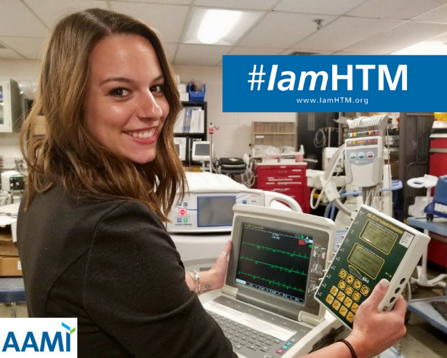

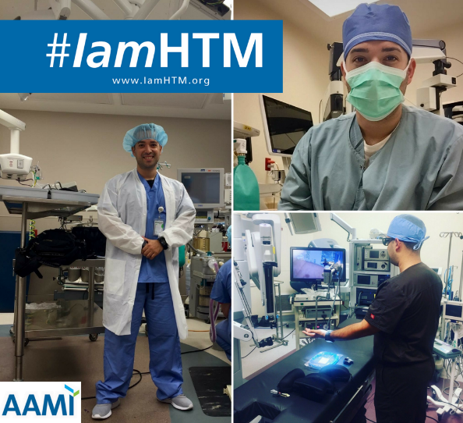





FIND US!
aami.org/connect
Search for AAMI
Search for AAMI
@aamiconnect
@AAMI_Connect
https://aamiblog.org
#IamHTM

