Slide 1

Career Path Guide

Slide 2
Dave Scott – Example- Ideal Career Path
Clinical Equipment Technician or other
Certified Associate in Biomedical Technology (CABT) entry level certification
BMET1
Tuition Reimbursement from job/workplace
BMET Certificate (education)
Associate Degree

Slide 3
Dave Scott – Example- Ideal Career Path
Certified Biomedical Technician (CBET)
BMET2
Other certifications if wanted/needed (A+, N+, S+, CCNA, CCNP, PMP, etc.)
BMET3
Bachelor Degree in Biomed or other (business, engineering, IT, etc.)
Possibly Management if so, then maybe Masters Degree
Possibly Specialist – Imaging, etc.

Slide 4
Brian Wilson – Example- Ideal Career Path
Hospital Networking Technician
Internship through school
Associate Degree (Biomedical Technology)
BMET1
BMET2
Manufacturer Field Service Representative
CBET Certification

Slide 5
Brian Wilson – Example- Ideal Career Path
BMET3
Senior Biomed
Imaging Service Engineer 1
CRES Certification
Imaging Service Engineer 2
Imaging Service Engineer 3
CT/MRI Specialist

Slide 6
Clinical Equipment Technician
Entry Level – little or no experience works under close supervision
Cleans and Distributes Clinical Medical Equipment
Can perform minor repairs under Biomed supervision
Equipment inventory management
0-1 years experience
CABT Certification (Advised)
Education- High School Diploma, maybe working on College Degree

Slide 7

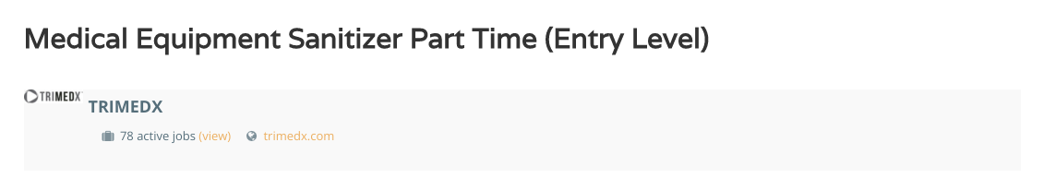
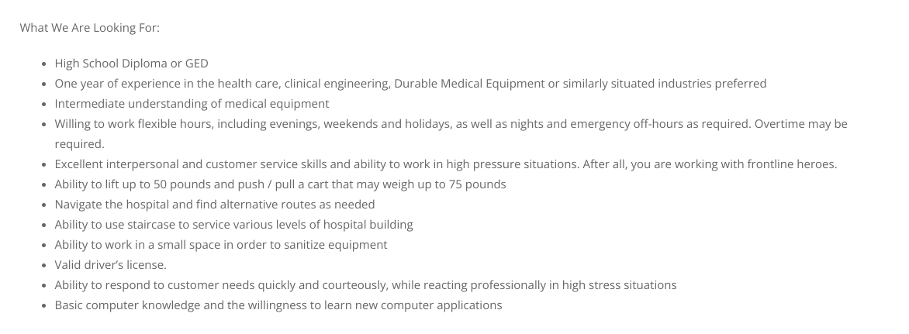
Show job opening for Clinical Equipment Technician

Slide 8
Biomedical Internship
Entry Level – little or no experience works under close supervision
Arranged through a school or Biomedical Association
Can also be sourced from Temporary Labor agreements.
Often has technical, non-hospital experience
Also used as a steppingstone for current hospital employees
CABT Certification (Advised)
Education- High School Diploma, maybe working on College Degree or have a degree in a non-related field

Slide 9

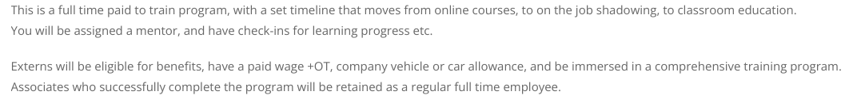
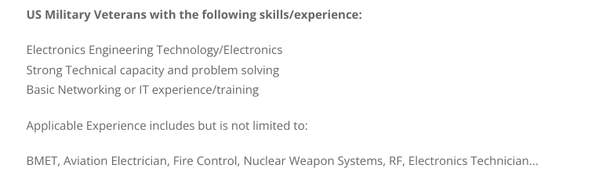

Slide 10
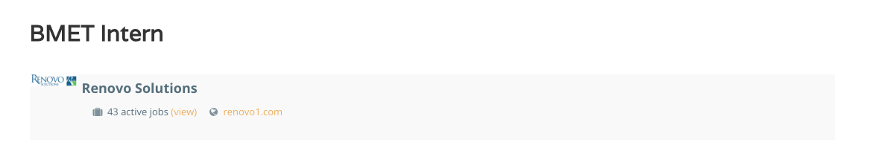
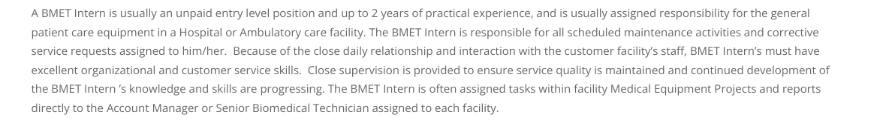

Slide 11
BMET1- Biomedical Technician 1
Entry Level – little or no experience works under close supervision
Perform PMs
Repairs
Safety testing
Recording functional test data
0-2 years experience (typically outside of healthcare)
Possibly CABT Certification (Advised)
Education- BMET certificate, working toward associate degree

Slide 12

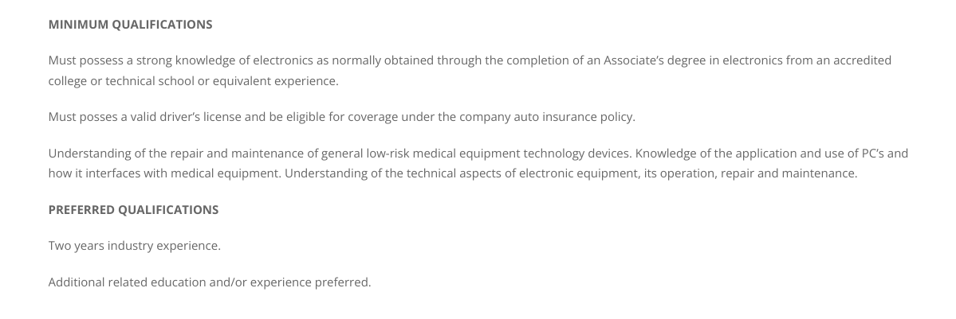

Slide 13
Education vs. Training
Education- formal education
  Certificate
  Associate Degree
  Bachelor Degree
  Masters Degree
  PhD
Training- Manufacturer Training Certificate of Completion
  Examples- Bedside monitor, central monitor, anesthesia machine, laser, etc.
  Specialty training- Imaging, Lab
  Usually directly job related

Slide 14
BMET2 Biomedical Technician 2
Experienced Tech
Works independently
Knowledge of a variety of equipment
Maintains records
Writes reports
Coordinates outside repairs
Certified Biomedical Technician (CBET) possibly
3 or more years of experience
Several training class certificates
Education- certificate or Associate degree in Biomed
Education if no associate degree- working toward degree

Slide 15

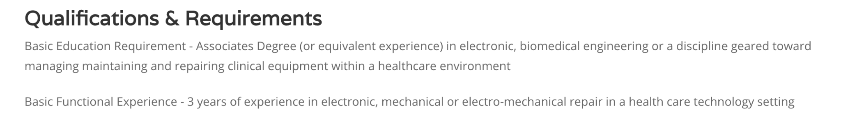

Slide 16
BMET3 Biomedical Technician 3/ Senior Tech
Highly experienced tech
Usually, 5 or more years experience
Capable of highly skilled work
Capable of difficult repairs
Broad knowledge of practices, procedures, and types of equipment
Education- Usually Associate Degree or higher
Certified Biomedical Equipment Technician (CBET) maybe required

Slide 17
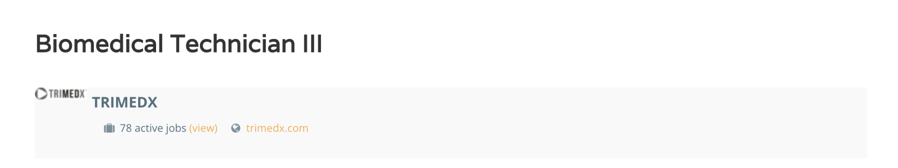
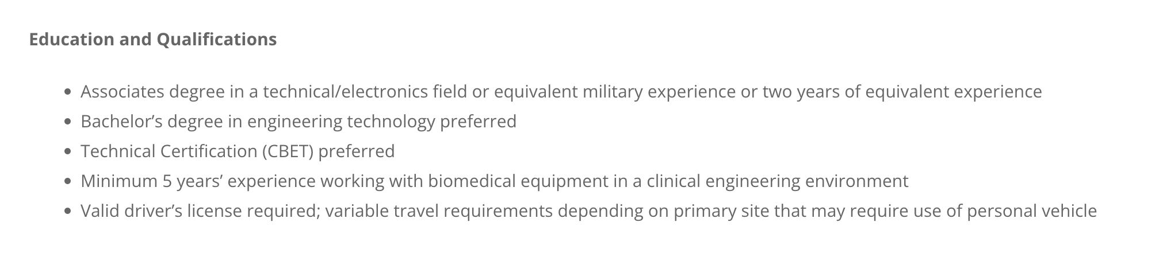

Slide 18
Clinical Lab Equipment Specialist
Highly experienced tech, BMET 2 or 3
Usually from 3 to 5 years of Biomed experience
Capable of highly skilled work without supervision
Maintain required calibration records for regulatory agencies
Advanced training on several types of lab equipment
Education- Associate Degree or higher
Certified Biomedical Equipment Technician (CBET) recommended

Slide 19
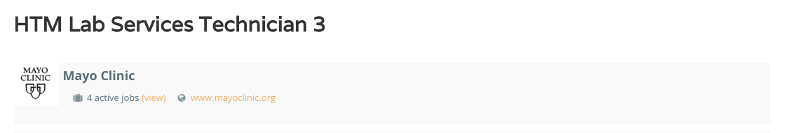
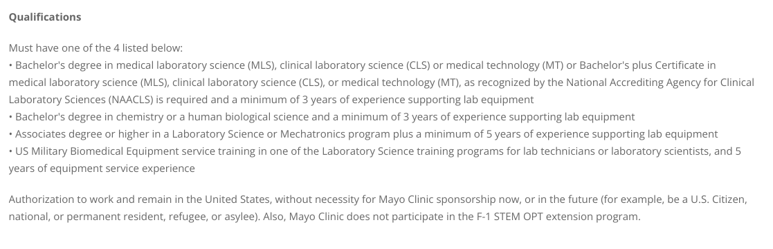
Job opening for Clinical Lab Specialist

Slide 20
SPD (Sterilizer) OR Equipment Specialist
Highly experienced tech, BMET 2 or 3
Usually, 7 or more years of Biomed experience
Capable of highly skilled work without supervision
Maintain required test and calibration records
Advanced training on several types of SPD and OR equipment
Education- Associate Degree or higher
Certified Biomedical Equipment Technician (CBET) recommended

Slide 21
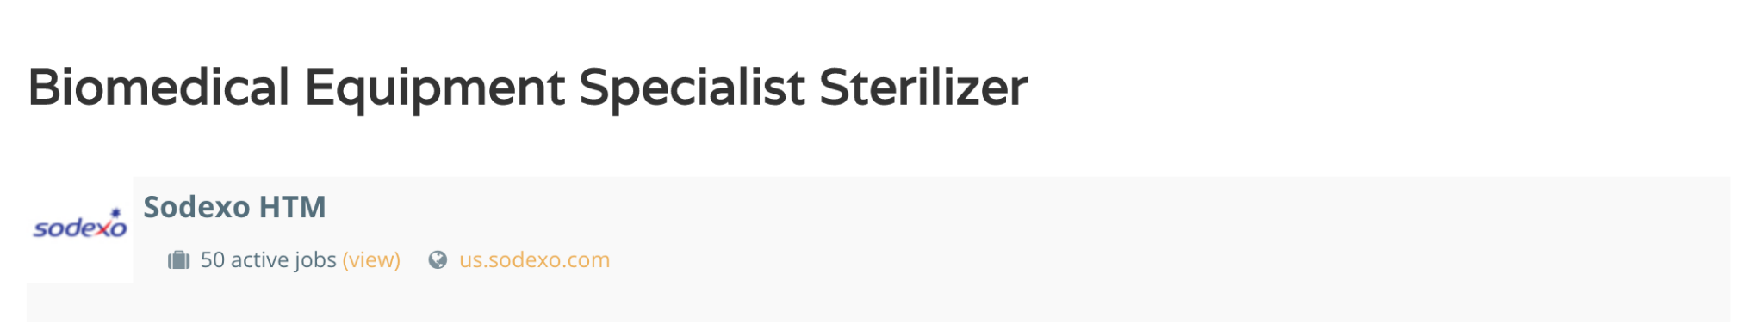
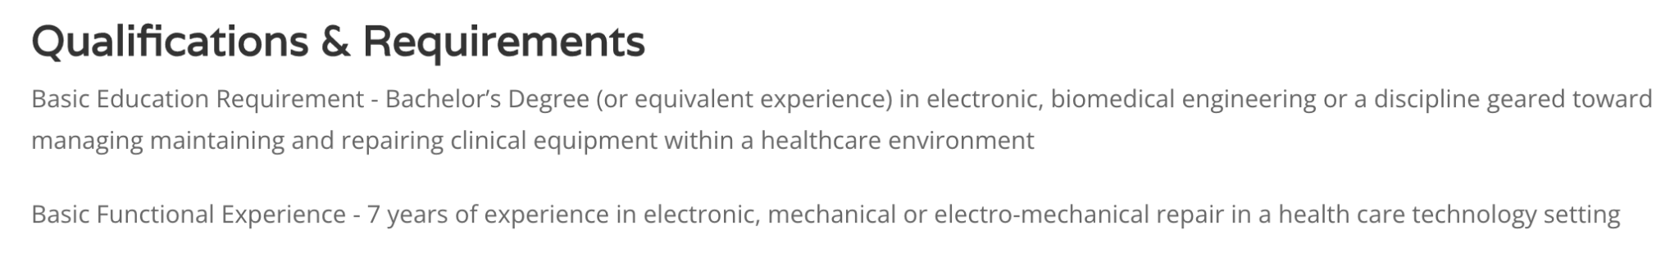

Slide 22
Imaging Service Engineer 1 (ISE 1)
Usually, an experienced Biomed Tech (BMET 2 or 3)
Knowledge of a variety of Imaging Equipment (Ultrasound, X-Ray)
Coordinates outside vendor repairs
Certified Biomedical Technician (CBET) recommended.
2 to 5 years of Biomed experience.
X-Ray service training certificates (Vendor or X-Ray specific school)
Education- certificate or Associate Degree
May need a State issued license to work on Radiology Equipment.

Slide 23
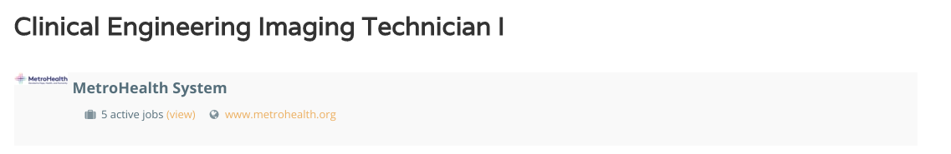
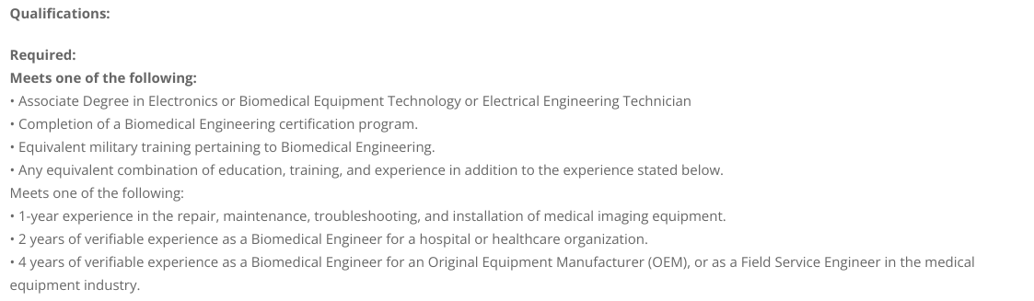
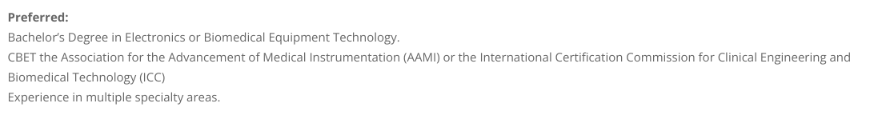
Job opening for ISE 1

Slide 24
Imaging Service Engineer 2 (ISE 2)
Usually, an experienced Imaging Service Engineer 1
Knowledge of advanced Imaging Equipment (Nuclear Med, Mammo)
Coordinates outside vendor repairs
Certified Radiology Equipment Specialist (CRES) recommended.
3 years or more of Imaging experience.
Several advanced training certificates (Vendor or X-Ray specific school)
Education- certificate or Associate Degree
May need a State issued license to work on Radiology Equipment.

Slide 25

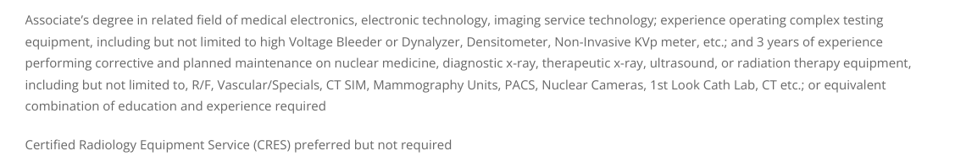

Slide 26
Imaging Service Engineer 3 (ISE 3)
Usually, an experienced Imaging Service Engineer 2
Knowledge of advanced Imaging Equipment (Cath, IR, CT, MRI)
Coordinates outside vendor repairs
Certified Radiology Equipment Specialist (CRES) recommended.
7 to 10 years of Imaging experience.
Several advanced training certificates (Vendor or X-Ray specific school)
Education- certificate or Associate Degree
May need a State issued license to work on Radiology Equipment.

Slide 27
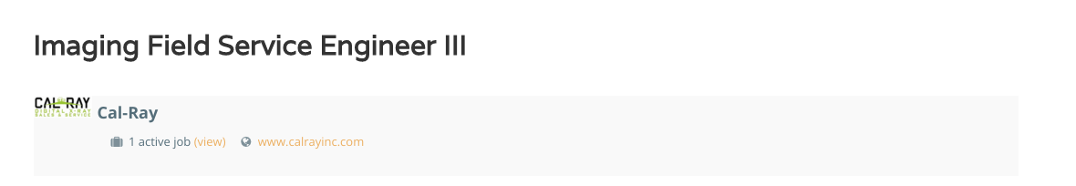
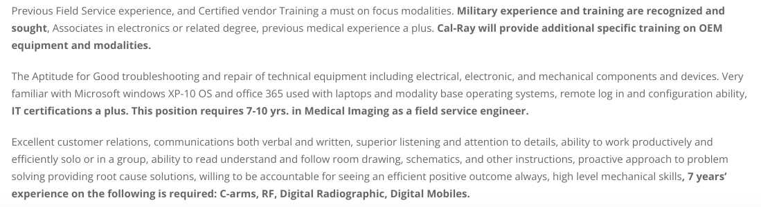
Job opening for ISE 3

Slide 28
IT Technologist / Technician
Knowledge of System Administration
Specialize in networking or cyber security
Work in the development of software.
Provide support for hospital HIS, LIS, RIS and PACS
Several advanced training certificates A+, N+, S+, CCNA, CCNP
Education- certificates, Associate Degree or Bachelor Degree

Slide 29
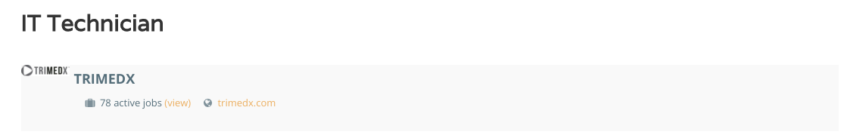
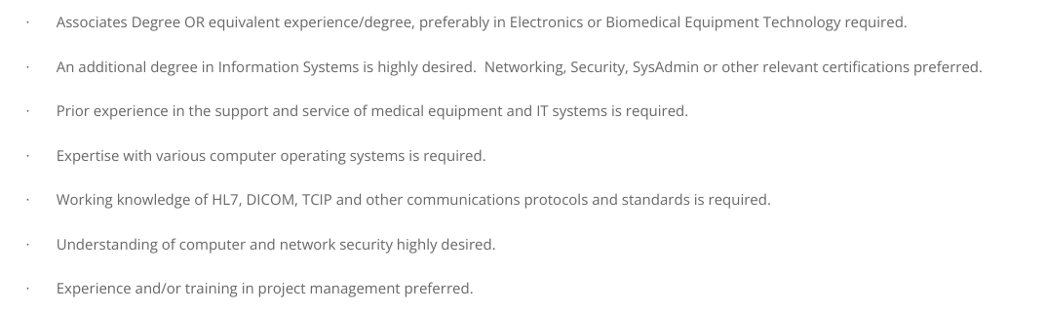

Slide 30
Field Service Engineer
Usually, an experienced BMET or ISE that provides outside support of hospital owned medical equipment
Access to advanced repair and service techniques
Coordinates vendor repairs for hospitals and other medical facilities
CBET or CRES recommended. Vendors rarely require it.
1 to 2 years of BMET or ISE experience.
Several advanced training certificates (Vendor specific training)
Education- Certificate, Associate Degree or Bachelor Degree

Slide 31

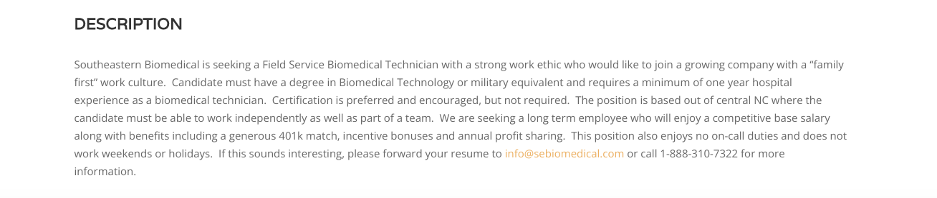
Job opening for Field Service Engineer

Slide 32
BMET Supervisor
Significant amount of training, education or equivalent experience
Associate Degree or higher usually required
CBET may be required
Schedules work to subordinates
May continue to work at highly skilled repairs
Comprehensive knowledge of practices, procedures, and equipment
Attends meetings
Coordinate projects
May be responsible of annual review of employees
May hire, council and terminate employees
Works closely with manager/director

Slide 33
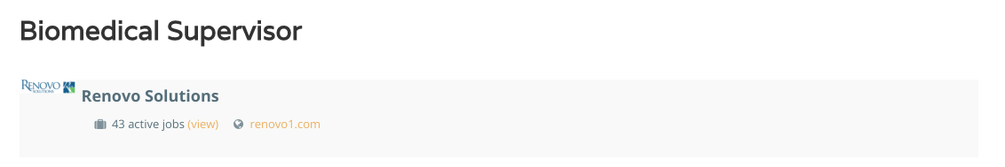
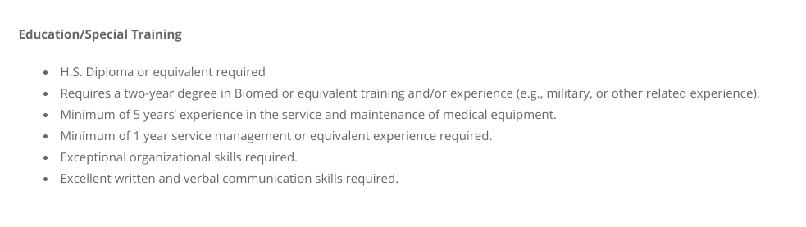
Job opening for BMET Supervisor
  Possibly CBET
  Possibly high experience level

Slide 34
Clinical Engineer
Graduate Engineer- BS, MS, PhD most likely Engineering focused
Performs engineer level work considerable difficulty
May investigate equipment incidents
Conducts analysis of devices and/or systems
Possibly Certified Clinical Engineer (CCE)

Slide 35
Clinical Engineering Supervisor
Clinical Engineer (CE) who supervises BMET/peer/subordinate Ces
May supervise equipment specialists such as Imaging or other
Usually a degreed engineer- BS, MS, PhD
Most likely is a Certified Clinical Engineer (CCE)
Average experience is 5+ years

Slide 36
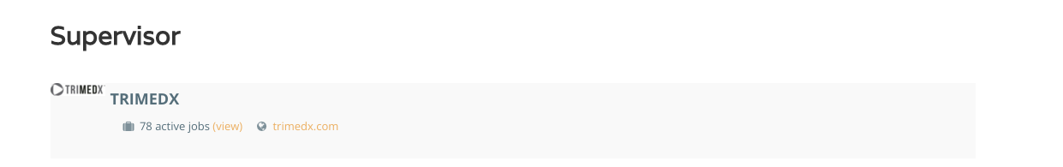
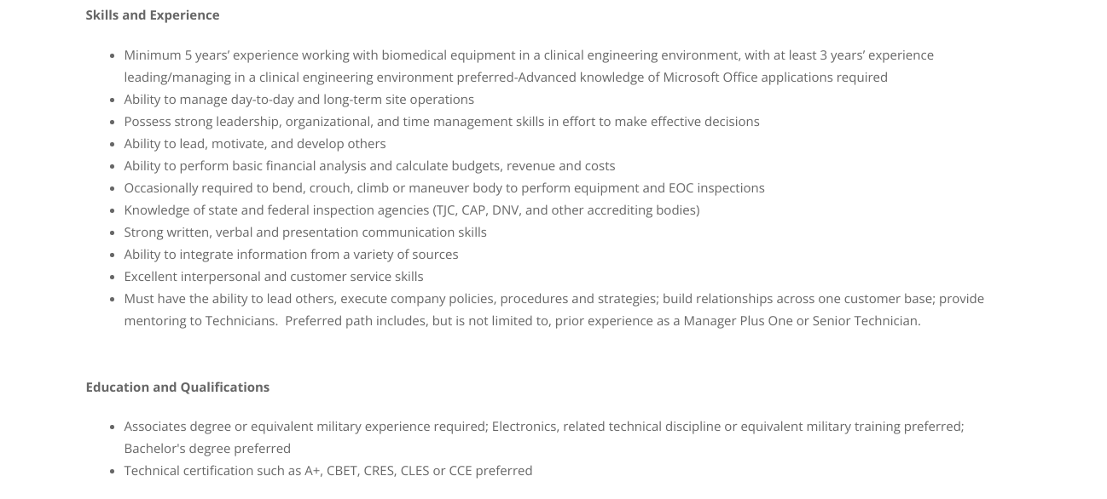

Slide 37
Director/Department Manager
Significant amount of technical and/or management experience
Bachelor or higher education required, 6 or more years experience
Skilled in: Equipment selection. Acquire, maintain and repair equipment
Familiar with accreditation process
Supervises- BMETs, BMET supervisors, CEs, and support personnel
Represents HTM/Biomed department in meetings and committees
Coordinate projects
Annual review of employees
May be certified CBET, CRES, CCE or other
May also be Chief Technology Officer or Vice President of Healthcare Technology

Slide 38
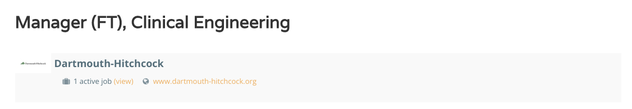
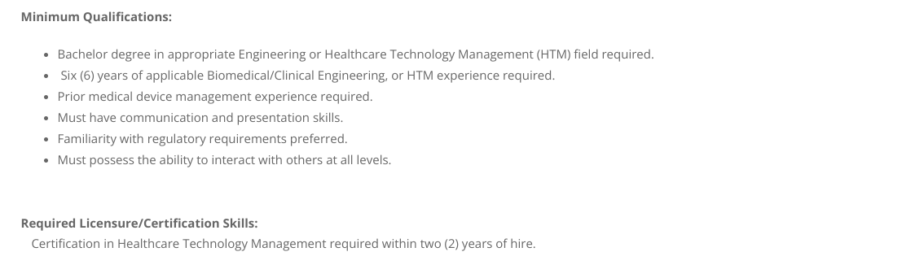

Slide 39
Thank You for your time!

Slide 40
Many thanks to HTM Jobs as well!

Slide 41



Slide 42


