Slide 1

The Future of Healthcare and HTM
Part Quatro
David W. Braeutigam
Consultant/Author/Educator
Arlington, Texas
https://www/BraeutigamEnterprises.com
https://www/BraeutigamPublishing.com
https://TalesOfTheBiomed.com
dave@BraeutigamEnterprises.com
dave@TalesOfTheBiomed.com

Slide 2
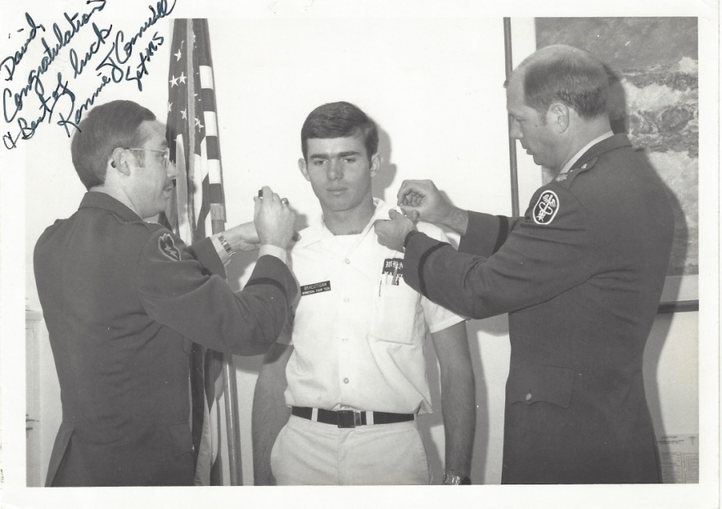




About David Braeutigam
Many years in Healthcare Technology Management
Trained at Fitzsimons in the U.S. Army
BMET at Walter Reed Army Medical Center; Ft. Bragg, NC; El Paso, TX; and in Dallas, TX
Former System Director for 22+ hospitals and 400+ clinics in Texas
Currently teaching, consulting and writing in HTM

Slide 3
Agenda
Today – what are the big things in HTM and Healthcare today?
Tomorrow – what can we expect of HTM and Healthcare in the future?
What should I do to prepare for the changes?

Slide 4
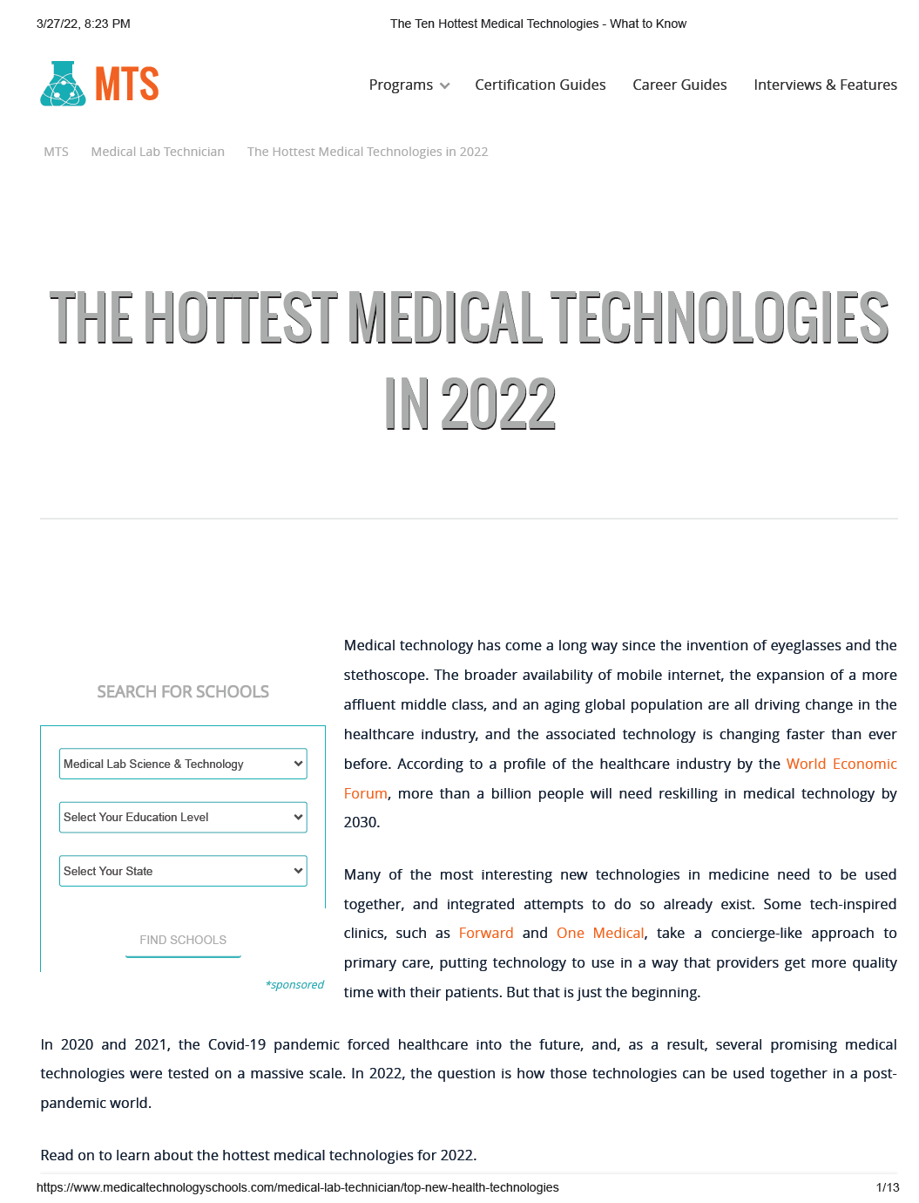
Hottest Medical Technologies in 2022
Remote Patient Monitoring
Artificial Intelligence
Digital Therapeutics
Technology in Mental Health
Internet of Medical Things (IoMT)
https://www.medicaltechnologyschools.com/medical-lab-technician/top-new-health-technologies

Slide 5
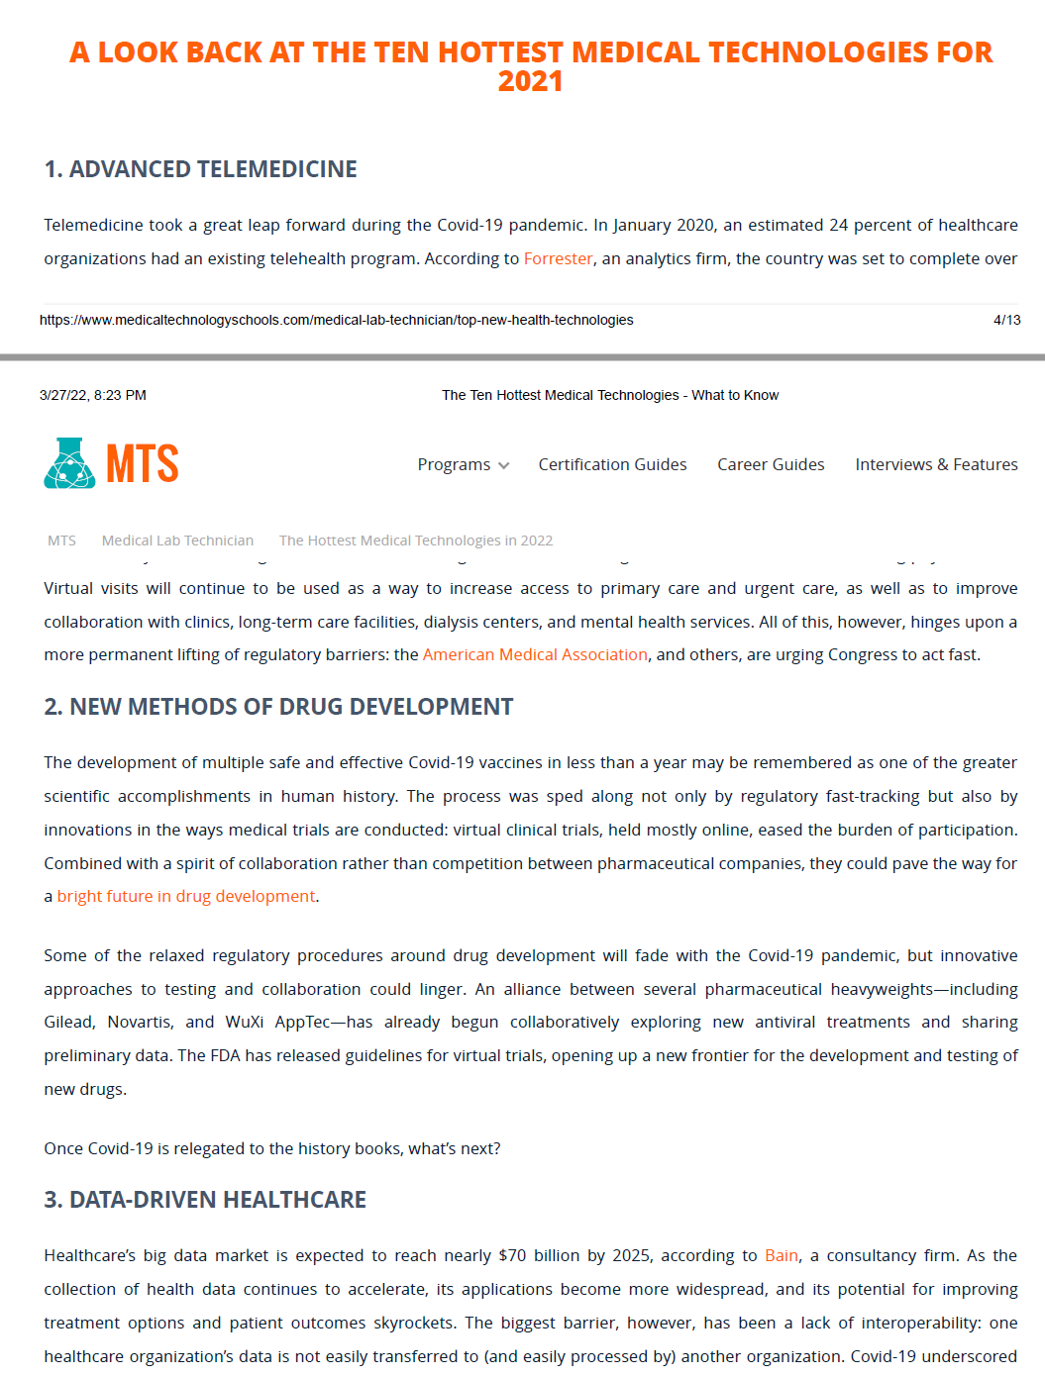
10 Emerging Trends in Health IT for 2021
Advanced Telemedicine
New Methods of Drug Development
Data Driven Healthcare
Nanomedicine
5G-Enabled Devices
Tricorders
Healthcare’s Digital Assistants
Smarter Pacemakers
A Lab on a Chip
Wearable with a Purpose
https://www.medicaltechnologyschools.com/medical-lab-technician/top-new-health-technologies

Slide 6
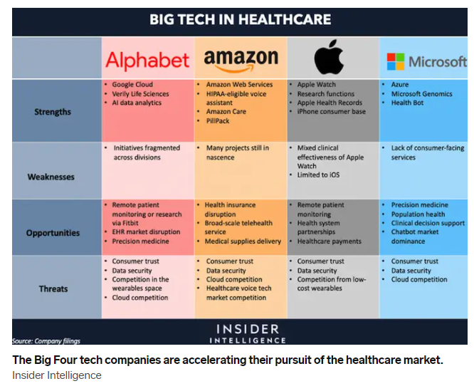
Big Tech in Healthcare
Why are these companies getting involved in healthcare?
https://www.businessinsider.com/big-tech-in-healthcare-report

Slide 7
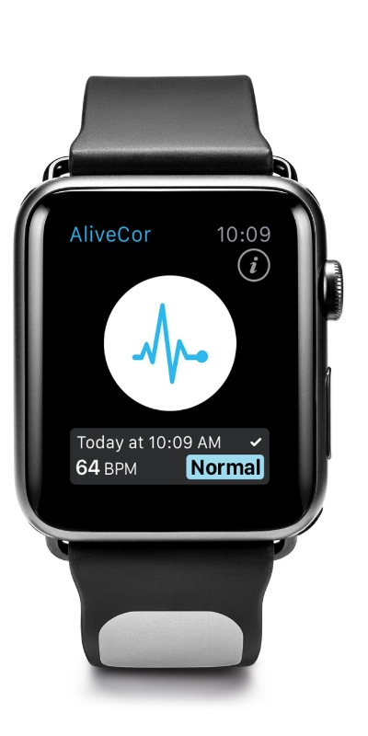
FDA clears first EKG reader for Apple Watch
FDA cleared the first medical device accessory for the Apple Watch in November 2017
AliveCor’s electrocardiogram reader
  Kardia Band introduce in Oct 2016
  Uses AI to analyze data from the watch’s heart rate and activity sensors
  Detects 6 of the most common arrythmias
  Recently introduce their 6-lead ECG version for $179
https://www.theverge.com/2017/11/30/16718978/fda-medical-device-accessory-apple-watch-alivecor

Slide 8
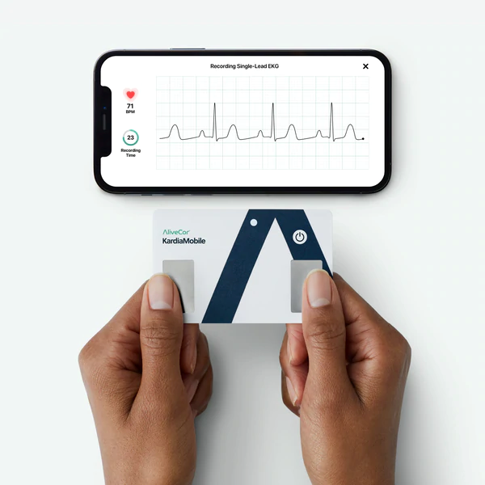
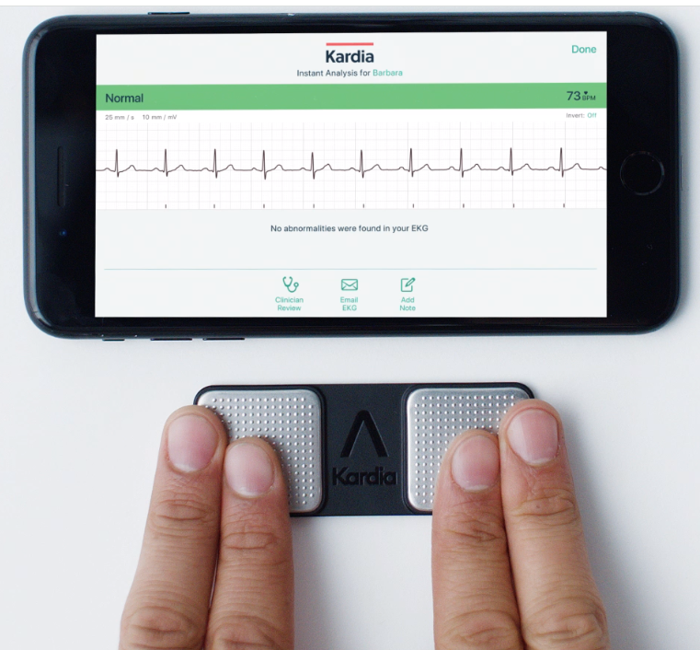
KardiaMobile
$78.99
$179

Slide 9
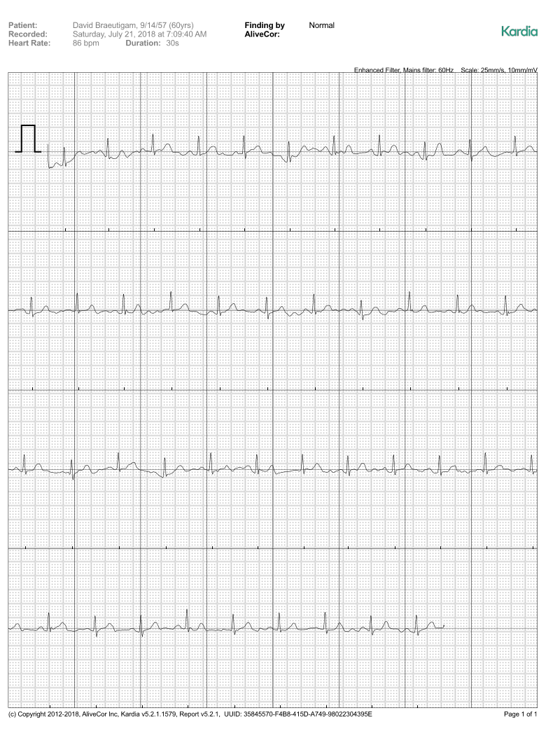
Here is the report you get back from AliveCor on your ECG
You can store it with AliveCor for $10 a month or $99 a year
Or you can just send it to your email in an encrypted PDF format
What lead is being recorded if I am using each finger to record?

Slide 10
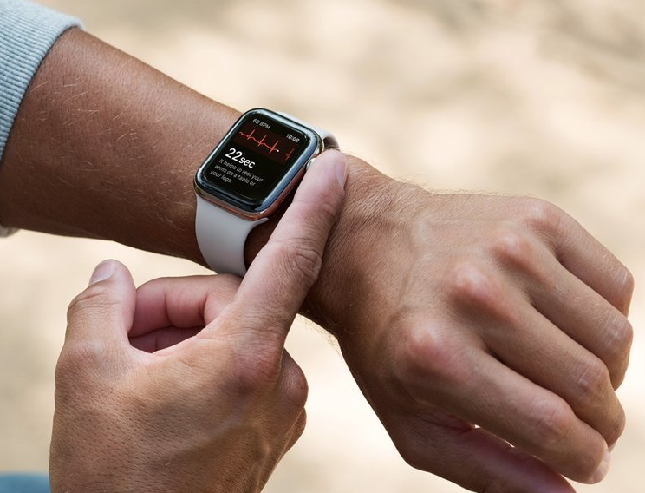
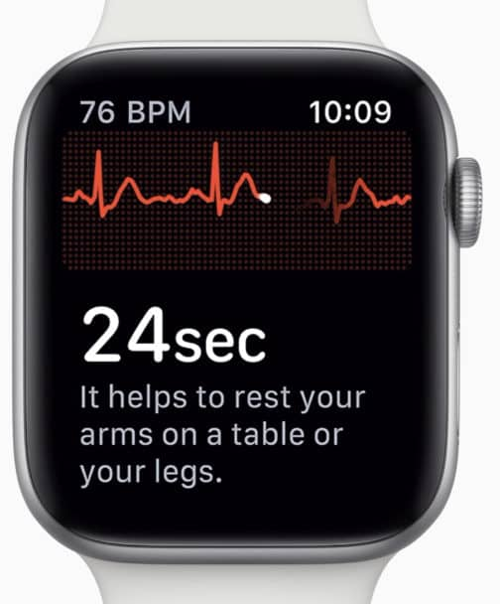
Apple Watch Series 4, 5, 6 and 7
Apple received FDA approval for taking an ECG on an Apple Watch on the Apple Watch 4 in 2019

Slide 11
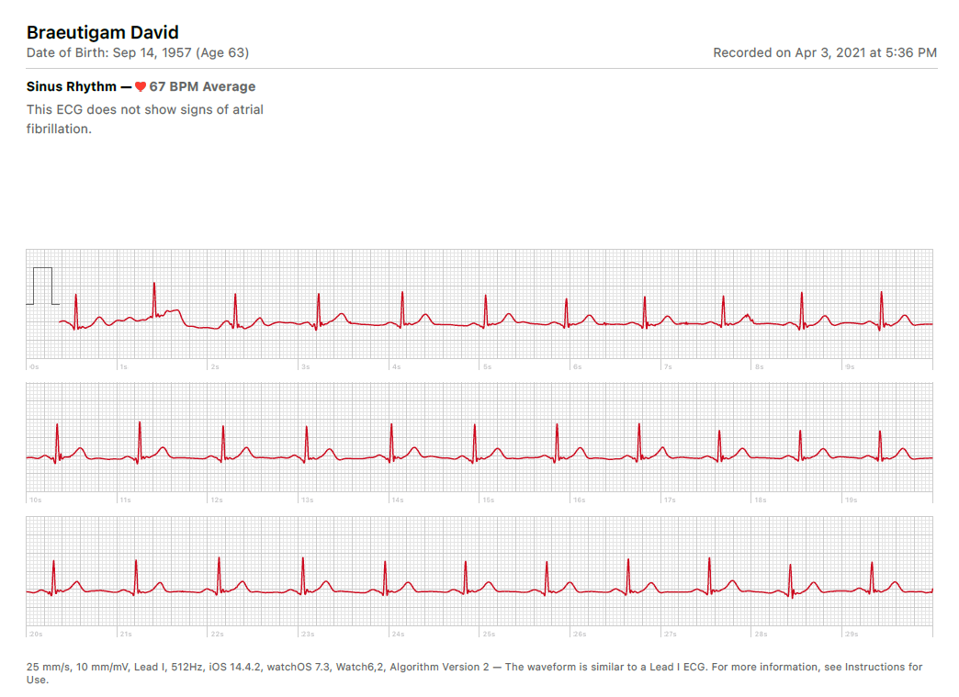
ECG on Apple Watch 6
What does this resemble?

Slide 12
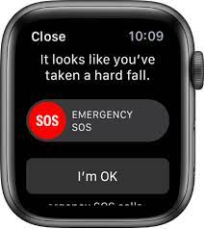
Apple Watch Fall Detection
With fall detection enabled, if Apple Watch SE or Apple Watch Series 4 or later detects a hard fall, it can help connect you to emergency services and send a message to your emergency contacts. If Apple Watch detects a hard fall and that you have been immobile for about a minute, it will make a call to emergency services automatically.
If you entered your age when you set up your Apple Watch or in the Health app and you’re age 55 and over, this feature is turned on by default. However, anyone 18 years and older can also turn on fall detection on Apple Watch SE and Apple Watch Series 4.

Slide 13
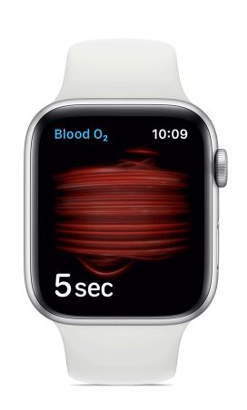
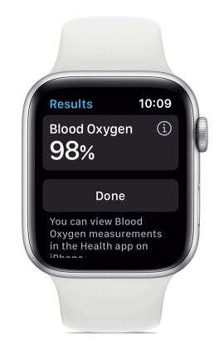
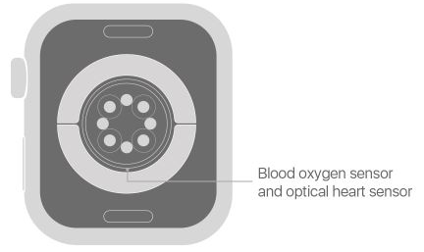
Apple Watch 6
Oxygen Saturation added with the Apple Watch 6

Slide 14
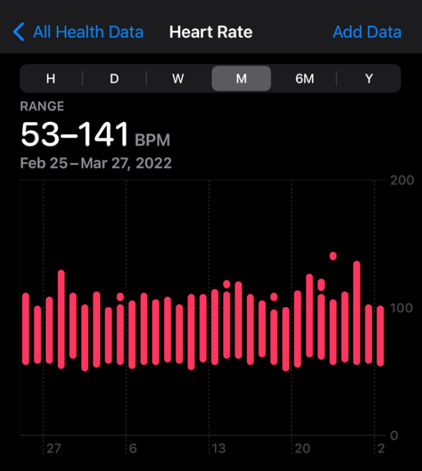
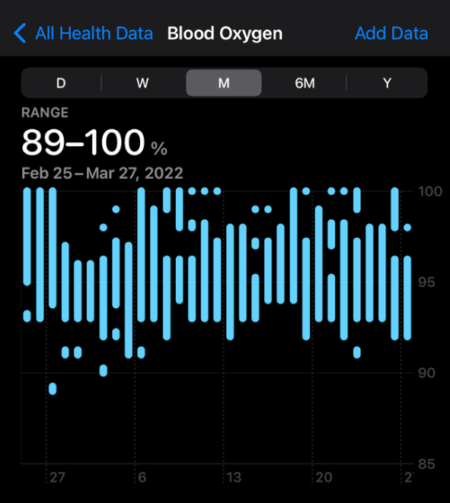
HR and SpO2 Data From Apple Watch 6

Slide 15
Large Hospital Systems create nonprofit drug company*
Hospital executives expressed frustration over scarcity of essential drugs
“This is a shot across the bow of the bad guys”, said Dr. Marc Harrison, chief executive of Intermountain Healthcare
The hospitals state they are tired of the increasing shortages and price escalation
*NY Times January 18, 2018

Slide 16
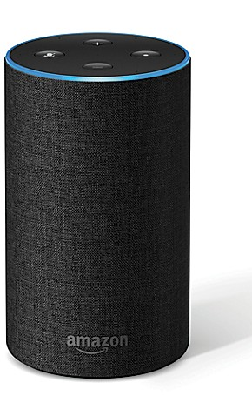
A.I. for the Simple Things
“Amazon could assume drug distribution. They could start to use voice platforms, like Alexa, to help discuss symptoms and get feedback, to coordinate hospital post-op care through voice-activated A.I., to do these and other rote things.”
— Dr. Eric Topol, director, Scripps Translational Science Institute in San Diego
https://www.nytimes.com/2018/01/30/business/amazon-health-care-plan-reaction.html?action=click&contentCollection=Technology&module=RelatedCoverage&region=Marginalia&pgtype=article

Slide 17
“Alexa, I Have a Sore Throat and a Runny Nose”
Alexa’s response
“This might answer your question …”
“Here is what I found on WikiPedia …”
  Pain medication such as nonsteroidal anti-inflammatory drugs …
  Mayo Clinics advises gargling with salty warm water and resting the voice
  Without treatment the symptoms typically lasts two to seven days

Slide 18
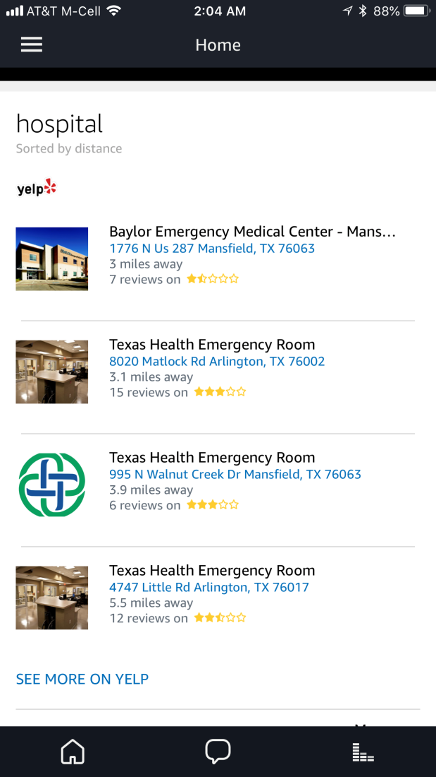
“Alexa, What’s the Closest Hospital”
“Based on your zip code settings here are a few examples …”
By using only your zip code the closest hospital is not always listed first

Slide 19
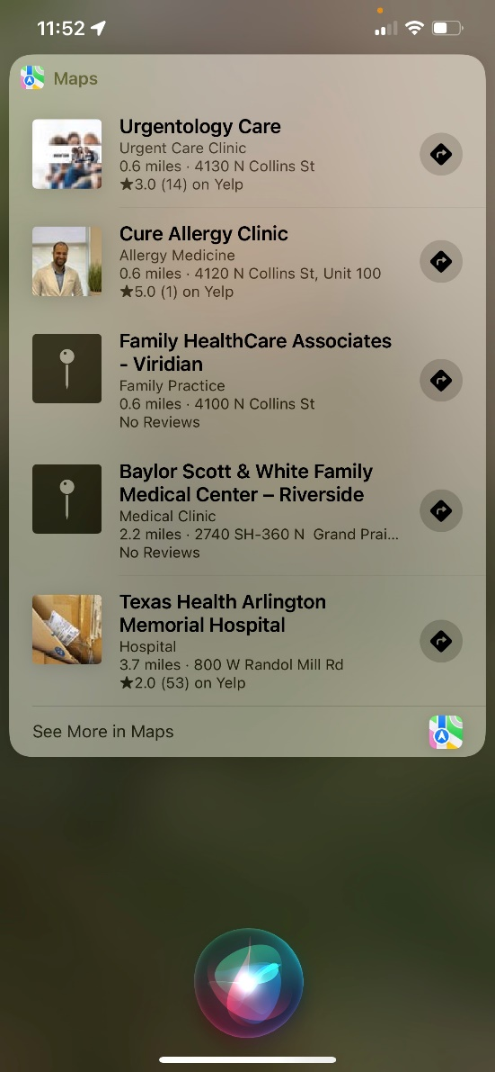
“Hey Siri I have a Runny Nose and a Sore Throat”
Siri did a pretty good job of pointing out clinics and hospitals nearby.
It is much better than the first time I tried this several years ago.

Slide 20
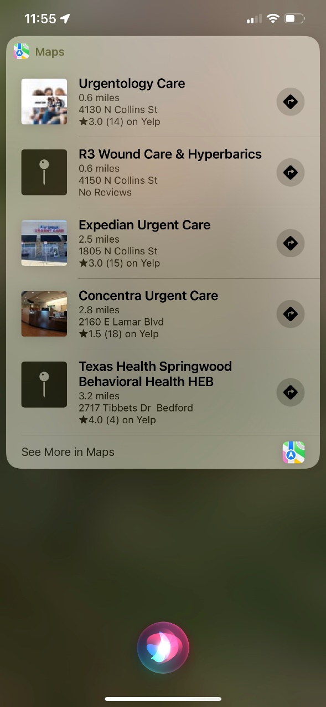
“Hey Siri What’s the Closest Hospital”
None of these are traditional hospitals but they are clinics
Not sure how wound care & hyperbarics would help though!
Behavioral Health? Maybe Siri knows I should go there for treatment!!

Slide 21
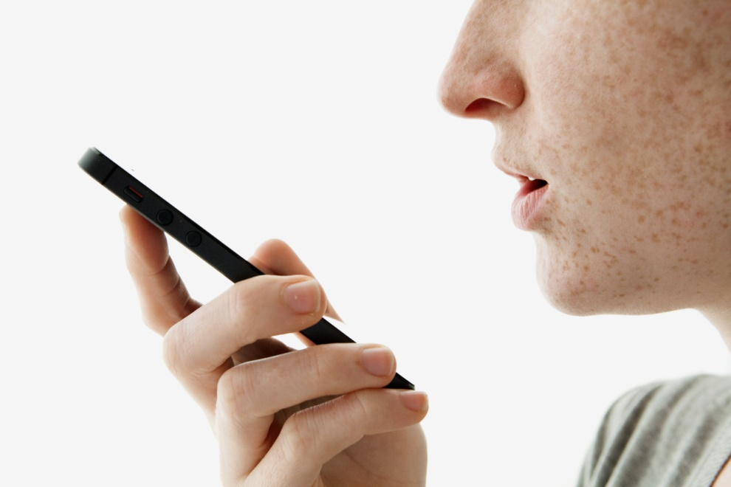
Speak to Your CMMS
Wouldn’t it be great to talk to your CMMS instead of typing everything?
At least one current CMMS allows you to speak to your phone to document a work order
How’s that for a time saver!
I would hope we don’t get the crazy autocorrect issues though!

Slide 22
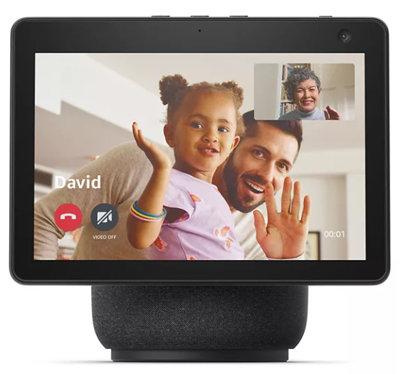
Using a smart speaker to consult with your doctor
Imagine being able to talk with a doctor over a device at your home?
Amazon, Facebook, Lenovo and Google are designing similar devices for the home
Telehealth surged during the pandemic

Slide 23
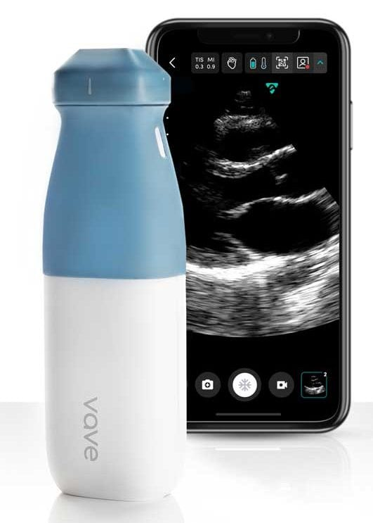
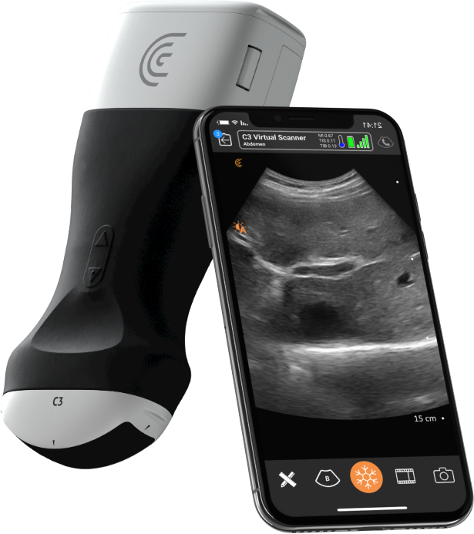
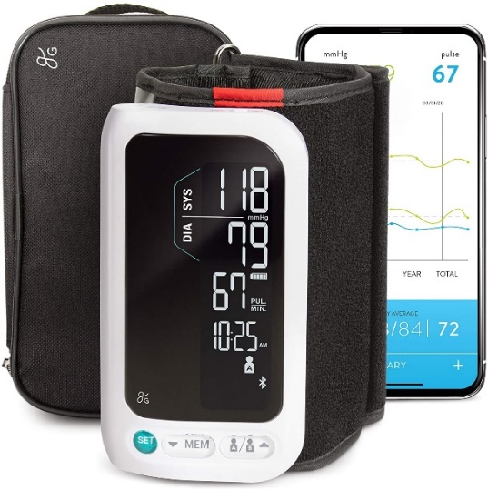
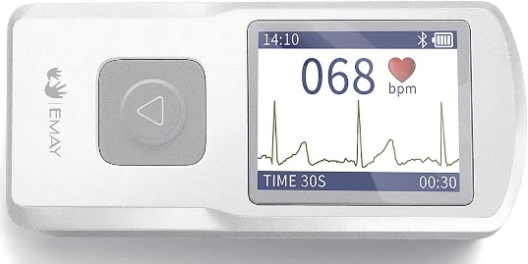
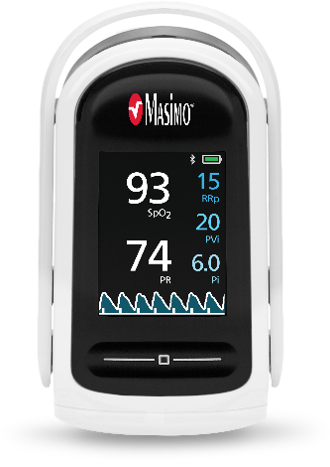
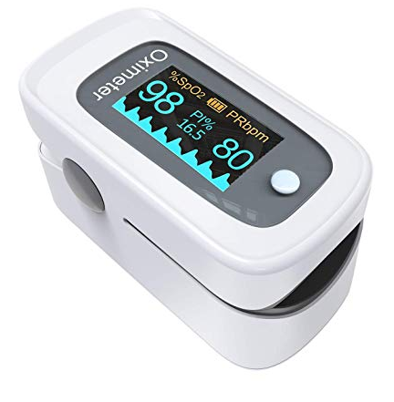
Medical Devices on Your Phone
Ultrasound
EKG
Pulse Oximetry
NIBP

Slide 24
What Can You Do with These?
Buy these devices and test them for accuracy and ease of use
I’ve tested my Pulse Oximeter with the new BC Biomedical Pulse Oximeter simulator, and it is very accurate
I’ve tested my Apple Watch with bedside monitors and its very accurate
I’ve bought and used both the KardiaMobile and the Apple Watch
I have not evaluated a handheld ultrasound!

Slide 25
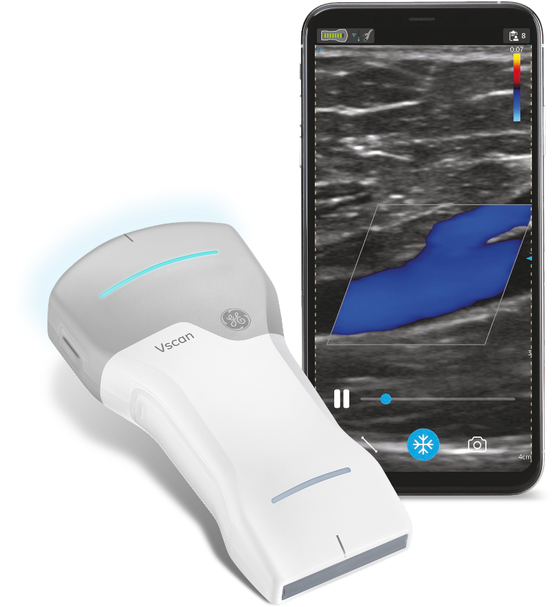
Handheld, Wireless Portable Ultrasound
GE Vscan Air – Dual transducer
Clarius – no subscription with cloud storage and 3-year warranty
Vave – subscription service with new probe every two years and cloud storage
Butterfly blueprint - $2,399 per probe plus additional costs for diagnostic tools, procedural tools, education, and collaboration

Slide 26

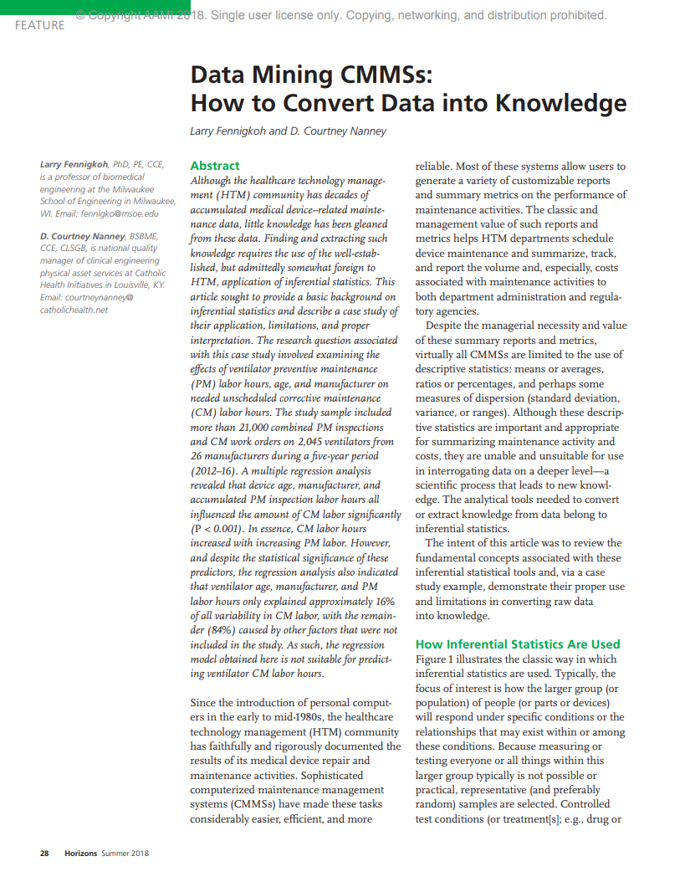
Medical Data and Knowledge
Mine your data in your CMMS to make better informed decisions
Good information is the key to better decisions. Make sure your data is clean and accurate.
Your CMMS is not just about PMs but about using data to make better decisions
AAMI Horizons Summer 2018

Slide 27
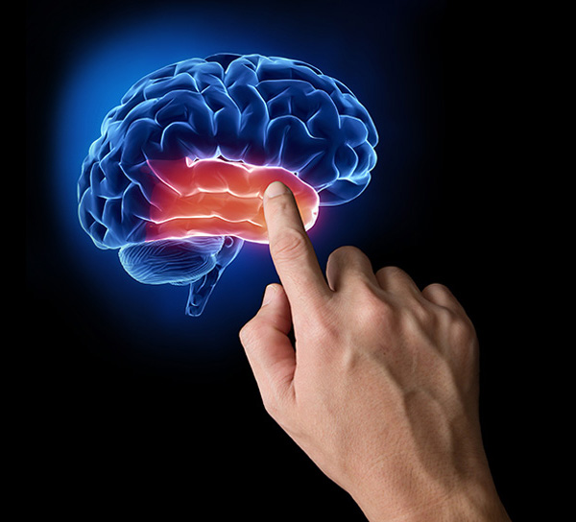
Holographic Imaging
Holographic Imaging Market to witness remarkable growth by 2024
Detect serious issues with sensitive organs such as the brain, the abnormalities of which are particularly difficult to interpret
This technology finds applications in ophthalmology, urology, pathology, and orthopedics
http://realviewimaging.com/medical/

Slide 28
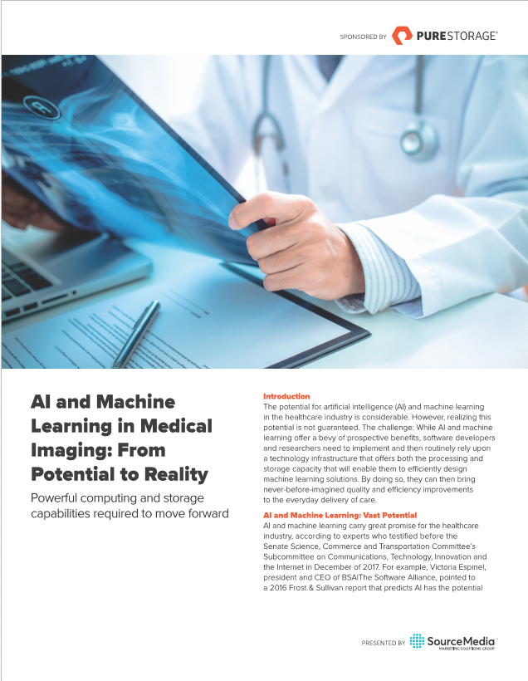
AI and Machine Learning in Medical Imaging
AI could improve health outcomes by 30-40%
Mayo is using it for genetic markers in MRI
Stanford has developed an AI algorithm that can diagnose up to 14 types of medical conditions
Memorial Sloan Kettering using for prostate cancer

Slide 29
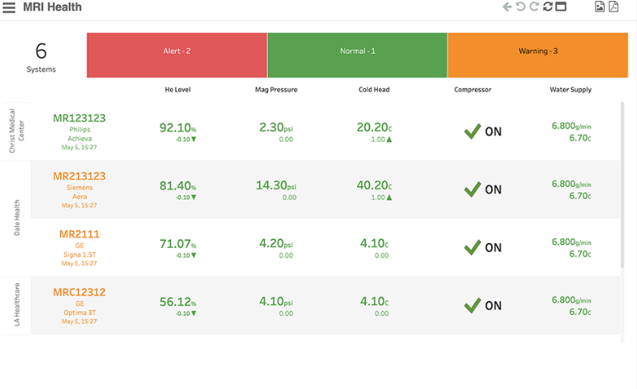
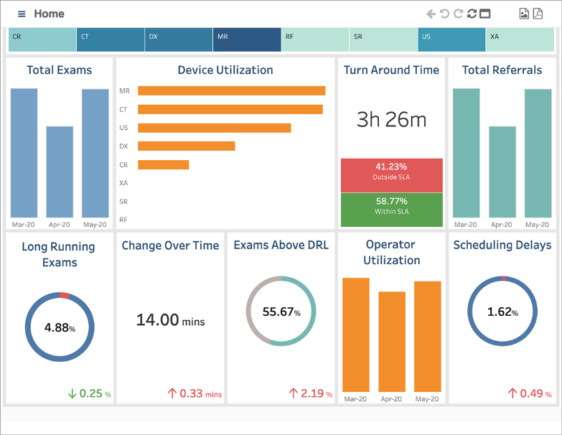

AI and Machine Learning in Medical Imaging
Derive actionable insights from your machine log data
  Know when a tube needs to be replaced
  Increases uptime since you KNOW when to replace components
  Know the usage of devices
  Do you need more MRIs or CTs?

Slide 30
AI for the Operating Room
Using AI and computer vision during surgery*
Uses AI to ‘road map’ surgeries as it happens
Reduces risk
Makes surgery safer
*OR Today October 2018 Digital Surgery Deploys Surgical AI System for the Operating Room

Slide 31
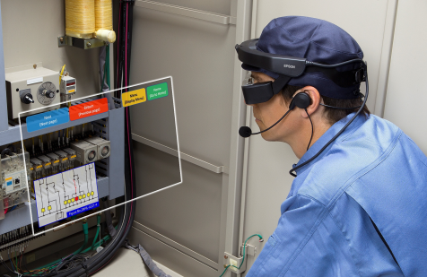
Virtual Training
Milwaukee, Wis – June 1, 2018, With 25 percent of the Healthcare Technology Management (HTM) population expected to retire over the next 10 years, hospitals and healthcare systems face an increasing challenge to train the next generation of professionals safely, affordably and efficiently. At AAMI 2018, GE Healthcare introduced interactive, customizable training options enabled by Virtual Reality (VR) technology for HTM professionals who service CT and MR equipment.
CBET has recently introduce a new virtual training program for biomed and imaging

Slide 32
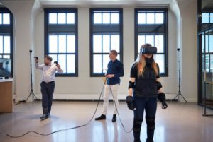
Virtual Reality in Medical Equipment Planning
Initial design of hospitals was on paper
Later mockups were done to give a better idea of flow and room
Newer VR technology will give physicians, clinicians and planners a better idea of space and equipment location
https://mcdmag.com/2017/09/enhancing-healthcare-planning-through-virtual-reality/

Slide 33
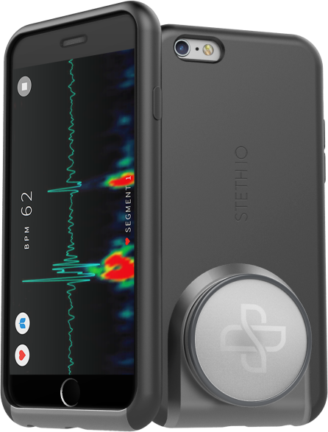
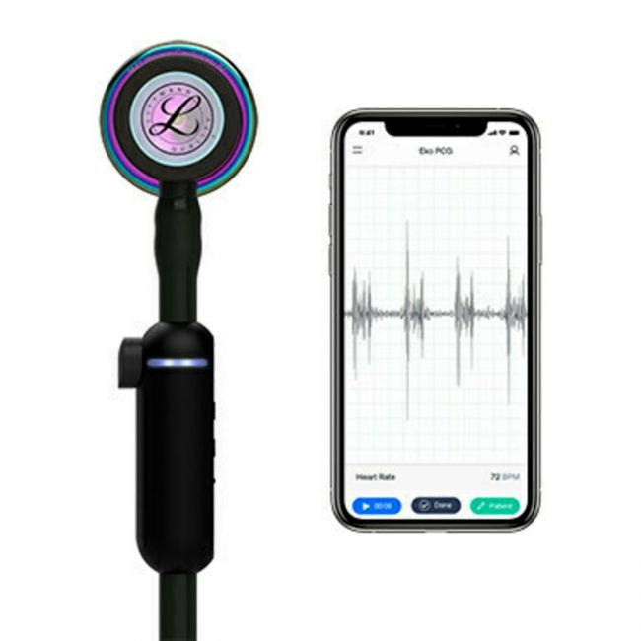
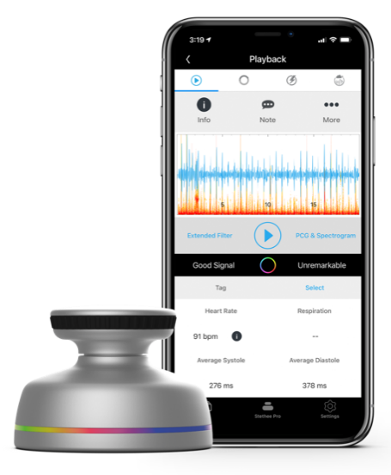
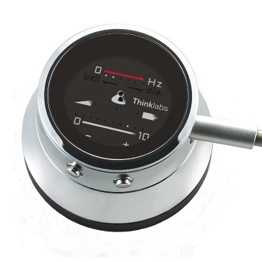
Smart Stethoscopes
Smart Stethoscopes are being designed by several companies that interface with a smart phone or smart watch
https://www.ekohealth.com/
https://www.3m.com/3M/en_US/p/d/v101297844/
https://www.beckershospitalreview.com/cardiology/smart-stethoscope-can-spot-heart-failure-study-finds.html

Slide 34
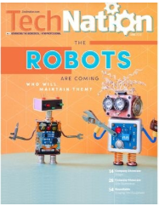
Robots
Surgical robots
UV cleaning robots
Supply chain robots
Pharmacy robots
Is anyone taking care of robots at your hospital?
https://1technation.com/the-robots-are-coming-who-will-maintain-them/

Slide 35
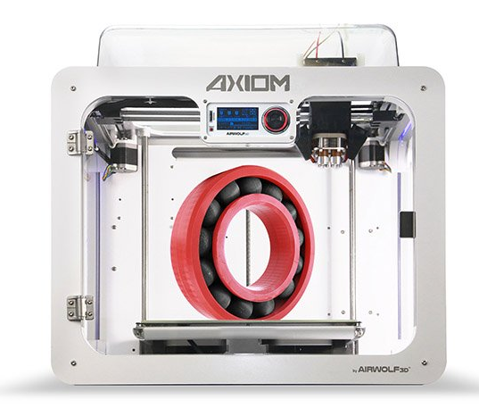
3D Printing
Imagine being able to print parts for your equipment?
The U.S. Military training for BMETs is already working on this at their school in San Antonio, Texas.

Slide 36


Slide 37
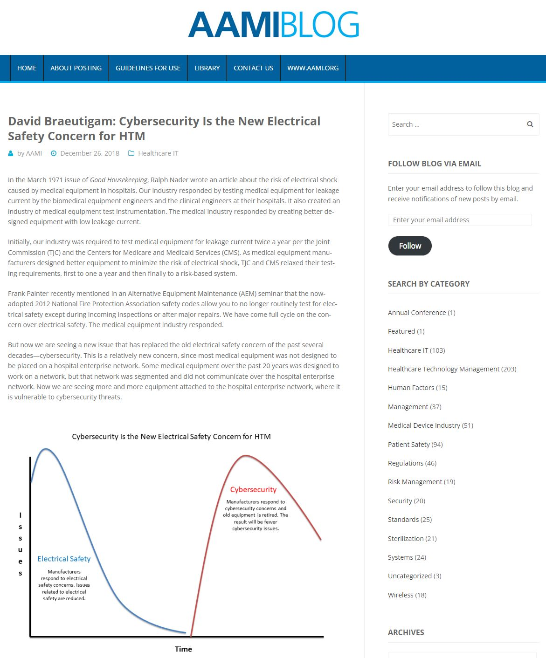
Cybersecurity is the new Electrical Safety Concern for HTM
AAMIBlog December 2018
Cybersecurity Is the New Electrical Safety Concern for HTM
  Electrical safety testing was the big concern in the 1970s
  Cybersecurity is the big concern today
https://aamiblog.org/2018/12/26/david-braeutigam-cybersecurity-is-the-new-electrical-safety-concern-for-htm/

Slide 38









Cybersecurity and HTM
HTM and IT need to work TOGETHER to solve
HTM needs staff that understands Cybersecurity and how to work with their vendors and IT counterparts
At each AAMI and MDExpo Conferences there are more and more Cybersecurity companies displaying their products
https://www.himss.org/resources/cybersecurity-healthcare#:~:text=Cybersecurity%20in%20healthcare%20involves%20the,as%20the%20%E2%80%9CCIA%20triad.%E2%80%9D

Slide 39
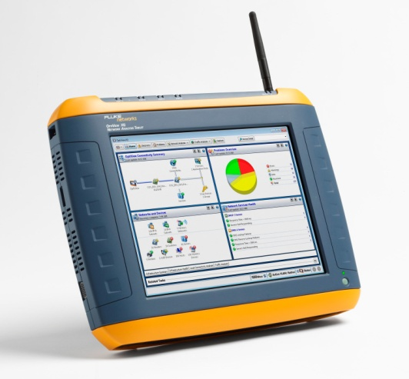
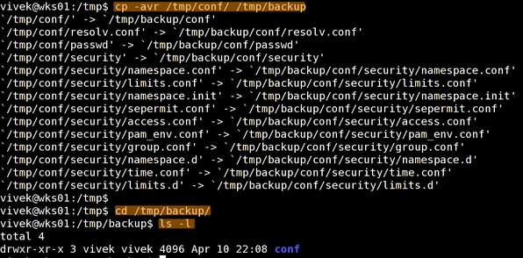

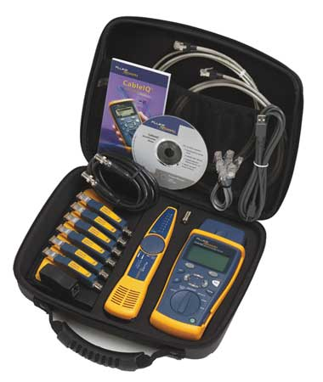
We Now Have New Tools!

Slide 40
Identify Network Medical Devices
Identify IP address, MAC address, OS version, patch version, virus protection vendor and version, etc.
Identify the type of PHYSICAL security on devices – i.e., cable lock, locked door, etc.
Work with vendors to obtain MDS2 and determine the OS version, patches, etc. that you should be running at for maximum protection
Many CMMS vendors interface with Cybersecurity companies to auto populate this data

Slide 41
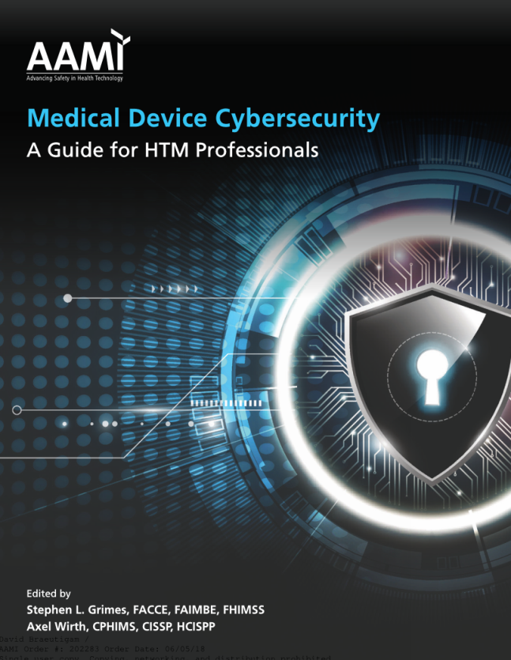
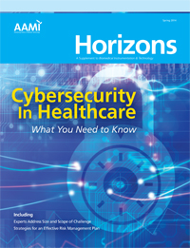

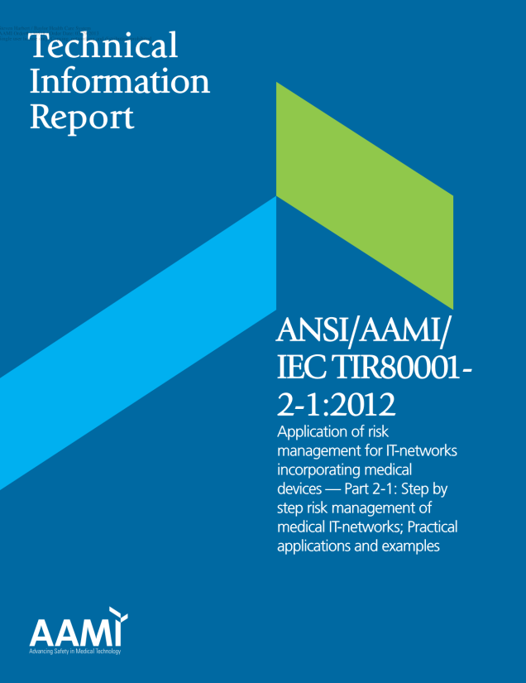
Resources Available
AAMI Horizons 2014
AAMI Medical Device Cybersecurity
AAMI TIR57:2016 Principles for medical device security
IEC 800001
Search BI&T for Cybersecurity papers
Subscribe to information on Cybersecurity
  HealthITAnalytics.com
  HITInfrastructure.com
https://www.aami.org/training/training-suites/regulatory/medical-device-cybersecurity-101-for-htm-professionals

Slide 42
9 Reasons Why Healthcare is the Biggest Target for Cyberattacks
Private patient information is worth a lot of money
Medical devices are an easy entry point
Staff needs to access data remotely
Workers don’t want to disrupt practice
Lack of education on online risks
Number of devices in a hospital
Healthcare information needs to be shareable
Smaller organizations often an easier target
Outdated medical equipment from a security standpoint
https://swivelsecure.com/solutions/healthcare/healthcare-is-the-biggest-target-for-cyberattacks/

Slide 43
Change is Constant
As a security and risk professional in healthcare, there’s one thing you can always count on – change is constant. Innovative ways of delivering quality care are dramatically transforming the digital landscape in this sector. One of the biggest game changers is the push for new Internet of Things (IoT) devices and other connected technologies designed to enhance patient care and save lives. While these innovations have enormous benefits for patients and caregivers, they come with new security and compliance challenges.
https://www.forescout.com/company/blog/need-strategy-compliance-asset-management-healthcare-facility-start-visibility/

Slide 44


Connected Medical Devices
Do you know how many connected devices you have at your hospital?
Probably 90-95% of your imaging devices are connected
The balance of IV pumps, patient monitoring, EKG carts, Lab equipment, etc.
Roughly 50% of medical equipment is connected NOW!!
Expect that to grow in the future.
https://www2.deloitte.com/content/dam/Deloitte/global/Documents/Life-Sciences-Health-Care/gx-lshc-medtech-iomt-brochure.pdf

Slide 45

Barriers to Connected Medical Devices
Cost
Privacy concerns/data security
Health system bureaucracy
Training and attitude of patients
Trust in accuracy of data
Government health-related regulation
Awareness of devices
Attitudes and training of health care professionals
https://www2.deloitte.com/content/dam/Deloitte/global/Documents/Life-Sciences-Health-Care/gx-lshc-medtech-iomt-brochure.pdf

Slide 46
What Does All This Mean for HTM?
Our field is evolving – but it always has
More IT knowledge and IT work will be required
More information about data and what to do with it will be required
WE need to be prepared for these new changes
The CORE of what we do does not change though – providing patient safety!

Slide 47
Does Technology Mean Less Biomeds?
Technology can help make our lives better, but it needs constant support. You can’t install technology and walk away without some support
  Google voice, Alexa, and Siri are not perfect voice translators
  Smart light bulbs are not smart when they need a firmware update
  Ring and Wi-Fi enable door locks are great but still need support
Medical equipment is technology based and needs our constant support
How often do you reboot a central monitoring system to “fix it”?

Slide 48
What Should You Do?
Make sure your CMMS is clean and up to date
  Good data is KING for the c-suite
Make sure IT information is included in your CMMS including:
  IP address, MAC address, patches, virus info, OS, etc.
Have all staff trained on basic IT: A+ and Network+
Create a position for Cybersecurity of Medical Devices in your department
If you are a department head, then get ITIL certification to understand how IT works
Start working with IT and use proactive Cybersecurity measures
  Accruent, Asimily, CloudPost, CyberMDX, Nuvolo, ZingBox, ordr, Cynergistek, etc.
This should be a requirement at all every biomed school
We learned A&P to understand medical equipment to be able to interact with clinical staff – why don’t we do the same with IT?

Slide 49
Prepare for the Future
Get your CBET or CRES if you are a BMET
Get your A+, Net+, and Sec+
Finish a degree if you don’t have your AAS
Get your CHTM and ITIL if you in management
Get a bachelor’s degree if interested in management
You can’t get these overnight so prepare for your future

Slide 50




What Can Vendors Do?
Make service information, parts, and training available to biomeds
Provide a common port for analysis – like the on-board diagnostics (OBD) port on an automobile

Slide 51



New Sources of Biomed Information
There are lots of new sources of information for biomeds
Better Biomed has a YouTube Channel
The Bearded Biomed has a Podcast
There is a Biomed 101 app for Apple and Android
There are several more HTM podcasts

Slide 52
Final Thoughts
If HTM does not embrace the changes in healthcare someone else will take charge and leave us out

Slide 53
Questions and Discussion

