Slide 1

SafeTEE PMI’s:
Demonstrating TEE Probe Preventive Maintenance Inspections

Slide 2


Agenda
Introduction, objectives, and outcomes
Technology review
TEE challenges
Points of wear
Root cause analysis
TEE preventive maintenance
Hands-on session
Next-level success

Slide 3
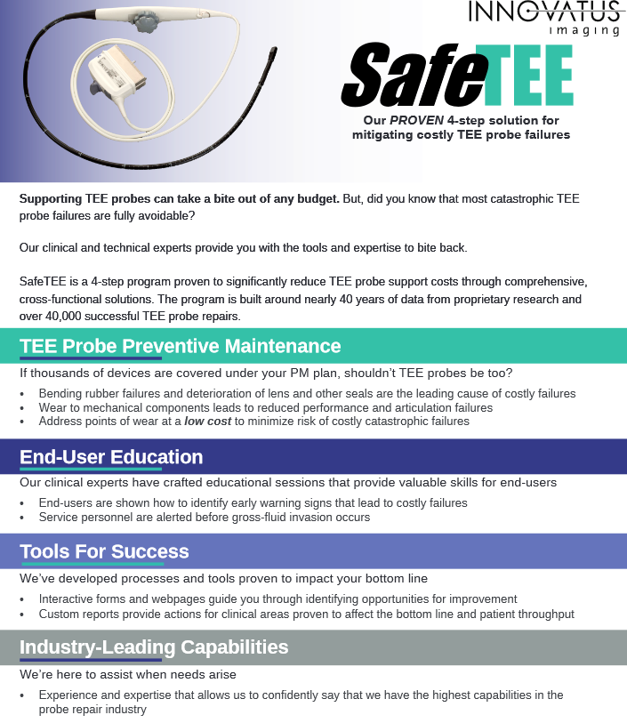

Slide 4

Introduction
Purpose, objectives, and outcomes
Discuss challenges shared by ALL facilities
Recognize common points of wear on a TEE probe
Raise your comfort level and technical competency with TEE probe
Present a cost savings that can be realized through TEE preventive maintenance inspections (PMI)
Provide knowledge and tools for success

Slide 5

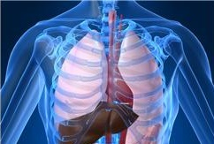
Technology Review
TEE transducers are designed to view the heart from within the esophagus
Trans-esophageal echocardiography (TEE)
Used if a standard echocardiogram is unclear due to a barrel chest, congestive obstructive pulmonary disease or obesity

Slide 6
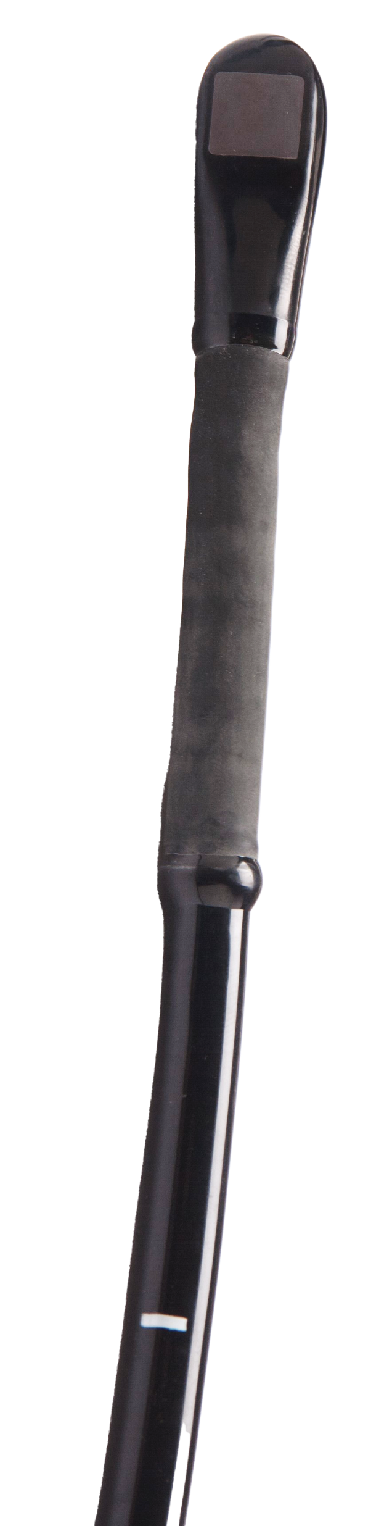
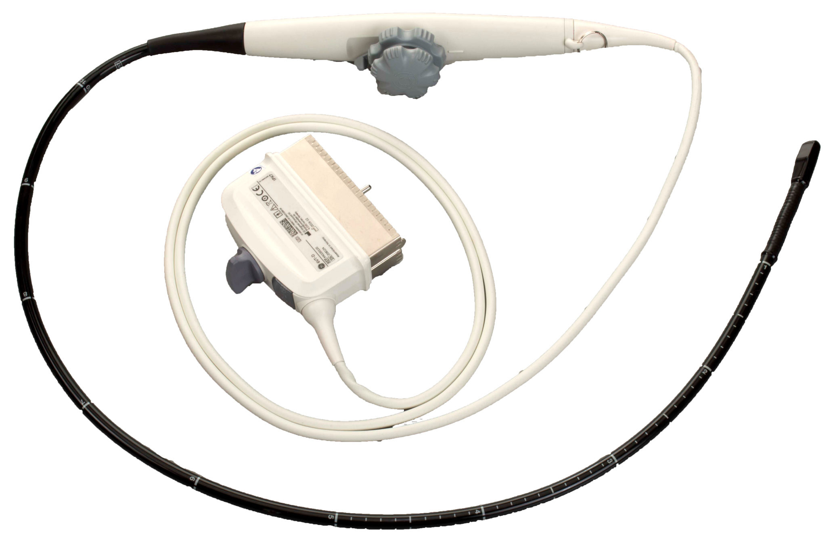
Technology Review
Image Orientation Controls
Control Housing
Lens / Array
Distal Tip
Articulation Knobs
Bending
Rubber
Adhesive Glue Beads
Collars
Bending
Rubber
Insertion Tube

Slide 7
Challenges
Areas of use and points of care
Non-Invasive Cardiology
  Outpatient studies
Inpatient Hospital
  Bedside studies
Surgical Suite
  Open-heart surgery
Central Processing
  Cleaning & Disinfection
Few other device types are subject to as much cross-functional team usage and handling
Patient Rooms
Non-Invasive Cardiology
Echocardiology
Surgical Suite
Central Processing

Slide 8

Challenges
TEE probe costs
New
  $25,000K - $60,000
OEM replacement/exchange
  $12,000 - $30,000 (technology dependent)
Third-party replacement
  $5,000 - $28,000 (technology dependent)
Third-party repair
  $500 - $12,000 (vendor and technology dependent)
Few other “accessory” devices are as costly to support

Slide 9

Challenges
Lack of preventive maintenance
Subject to wear during EVERY use
  Scratches, scrapes, and minor damage during use and transport
  Exposure to highly acidic GI fluids
  Exposure to harsh chemical cleaners and disinfectants
    Even approved chemicals may degrade materials over time
Wear occurs slowly, over-time, and the results are cumulative
If thousands of devices in your facility are included in a comprehensive PM plan, why aren’t your TEE probes?

Slide 10

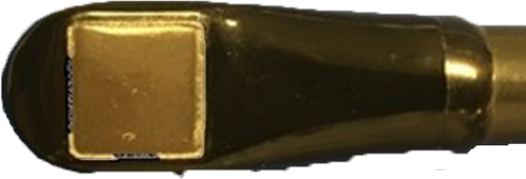
Points of Wear
The seal surrounding the lens will degrade and deteriorate
Open seals can enable fluid entry
  Caustic disinfectants
  Body fluids and cross-contamination

Slide 11
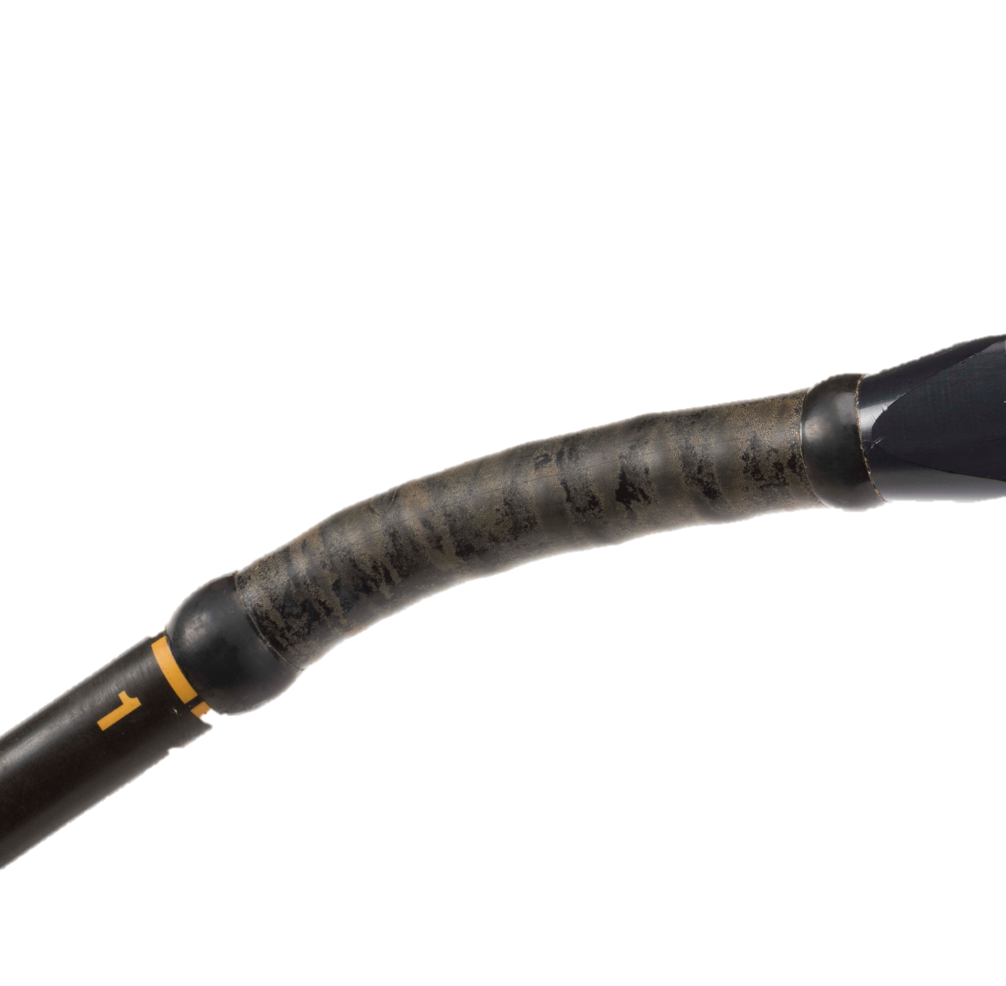
Points of Wear
Bending rubbers begin to become more-brittle after 100-150 uses
More-prone to perforate when contacting a hard/sharp object

Slide 12
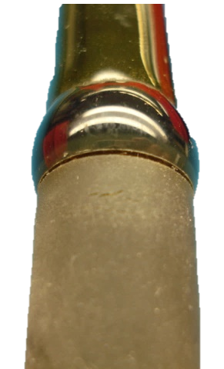
Points of Wear
Seals at each end of the bending rubber will separate over time
Open seals can enable fluid entry
  Caustic disinfectants
  Body fluids and cross-contamination

Slide 13
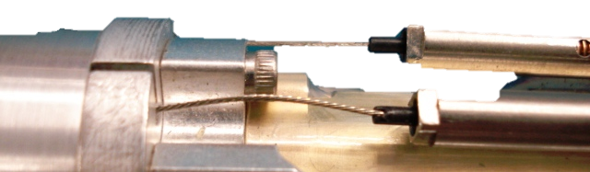
Points of Wear
The articulation’s range of motion will decrease over time due to stretching of the internal control cables
Reduced range of motion causes users to exert more force on the control knobs
  Eventually leads to a hard failure

Slide 14
Root-cause analysis
Many (>70%) TEE probes sent-in for repair have failed as a result of gross fluid invasion
General/Normal Wear
and lack of inspection
Missing seals surrounding lens
Separated collars/glue beads
Separated seals on distal tip
Overly brittle bending rubber
Trauma and Physical Damage
and lack of inspection
Damaged bending rubber
Damaged insertion tube
Cracked distal tip
Common to these modes of failure is EACH is detectable, meaning that costly catastrophic failures are highly preventable

Slide 15
Root-cause analysis
General/Normal Wear
Bending rubbers WILL wear and become brittle
Seams and seals WILL degrade
Articulation range of motion WILL decrease
Trauma and Physical Damage
Accidents WILL occur
Most physical damage occurs as a result of gaps in the care and handling process
Another part of our SafeTEE program is designed to help facilities assess their care and handling process
Address through a comprehensive PM program

Slide 16
Preventive Maintenance
In-house Inspections
Visual inspections by cleaning personnel between EVERY use, PRIOR TO a leakage test
Visual and mechanical inspections by service personnel when concerns are identified (and at specific intervals)
Preventive Maintenance
Replace lens seal
Replace bending rubber and collars
Adjust articulation
Every 6 – 12 months
depending upon use
Frequent visual inspections are the primary means of avoiding gross fluid invasion
Addressing items known to wear can minimize costly preventable damage

Slide 17
In-house Inspections
Visual Inspection
  Distal tip: excessive gouges, cracks, separations
  Acoustic lens: excessive gouges, missing/damaged seal
  Glue beads/collars: separations, cracks, damages
  Bending rubber: wear, discoloration, perforations
  Insertion tube: dents, crushes, breaks, stiffness
  Control housing: buttons and knobs
  Cable: cuts, excessive kinks, pinches, roll-over damage
  Connector: deformation, bent pins, corrosion, oxidation

Slide 18
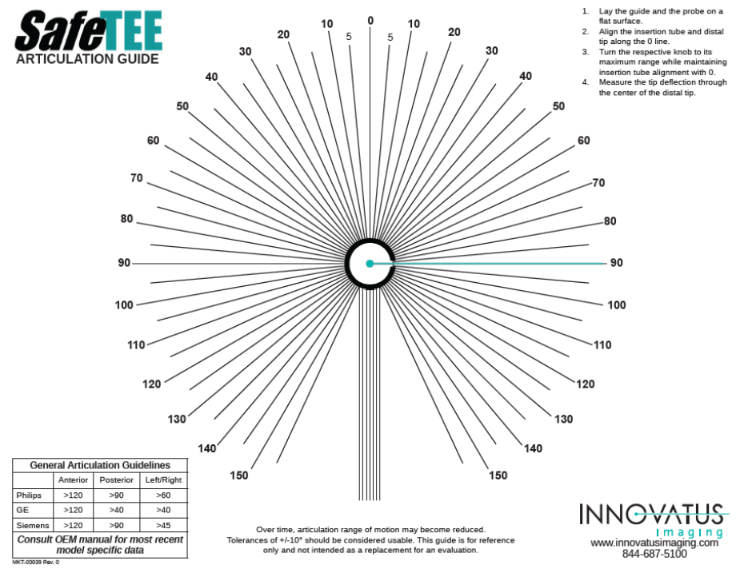
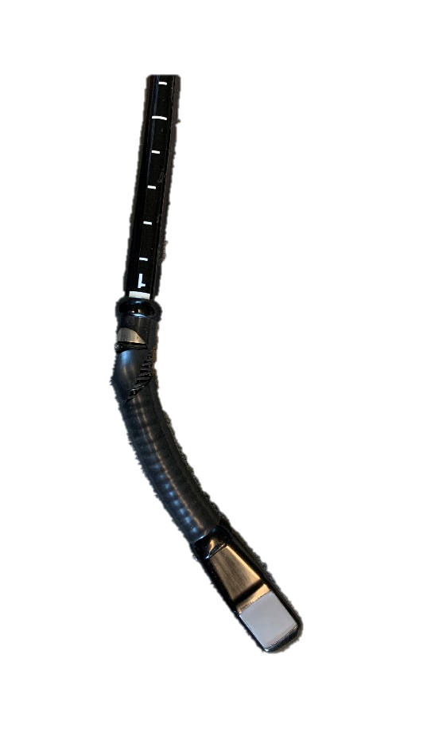
In-house Inspections
Mechanical Inspection
  Dead spot in articulation or lack of motion
    Rotate each knob and look for a dead spot in motion as the tip crosses the center point
  Maximum Deflection
    Align the insertion tube and distal tip along the 0 line.
    Turn the respective knob to its maximum range while maintaining insertion tube alignment with 0.
    Measure the tip deflection through the center of the distal tip.

Slide 19

Hands-On Session (5 - 10 minutes)
Visually assess the probes using lighted magnifiers
Functionally assess the articulation
Review findings

Slide 20
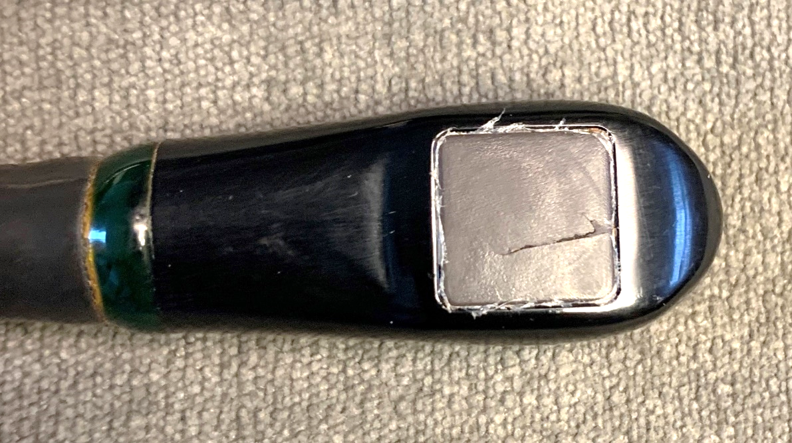
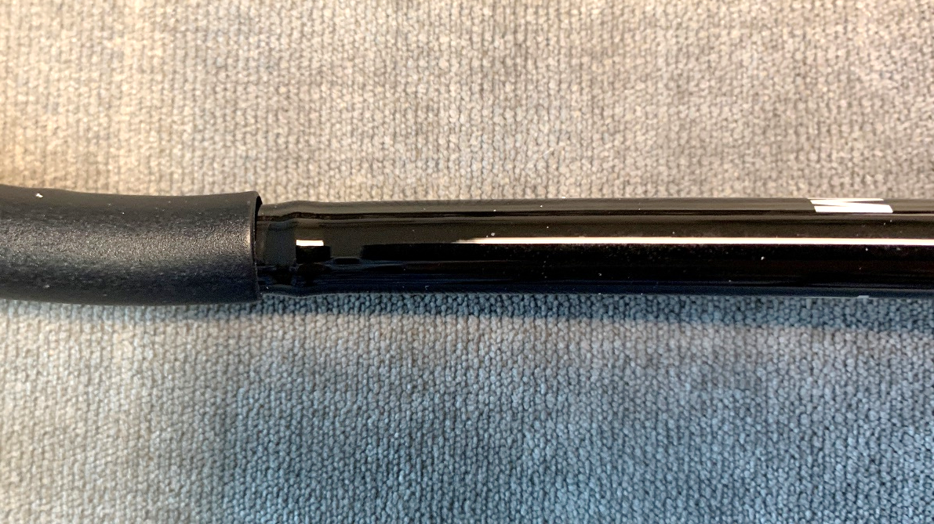
Review
Probe 1: Philips X8-2t
Cut in lens
Seal missing from around lens
Bioburden at bending rubber/collar
Broken insertion tube near control housing
Other items
Broken tube near bending rubber
Dent in tube at 40cm mark

Slide 21
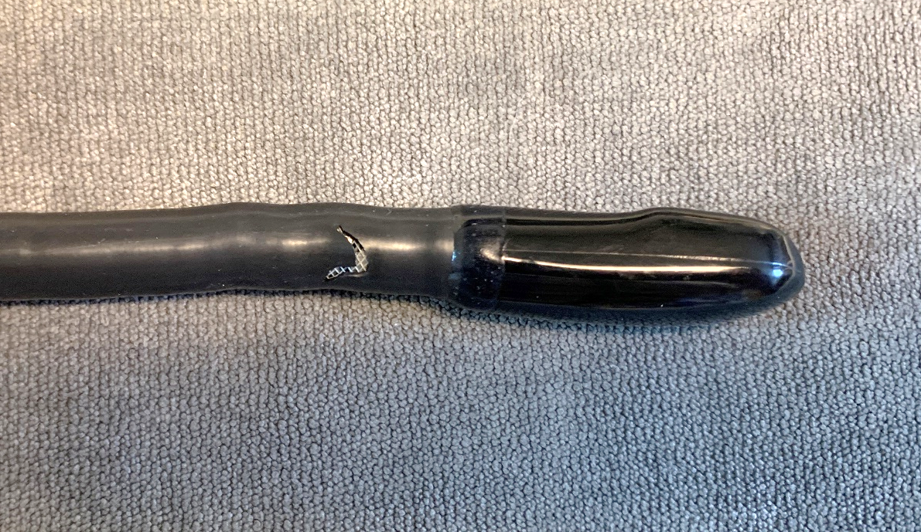
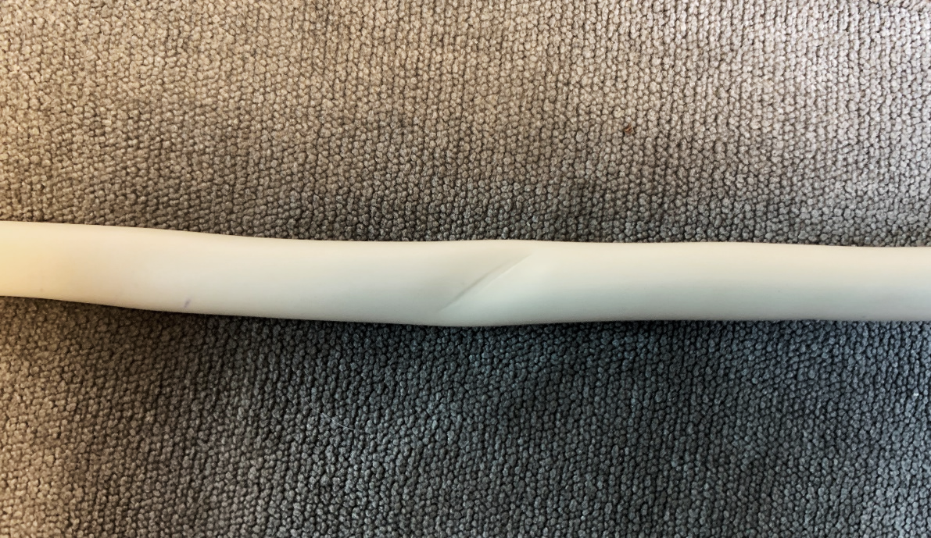
Review
Probe 2: Philips X7-2t
Perforated bending rubber
Other items
Pinched cable

Slide 22
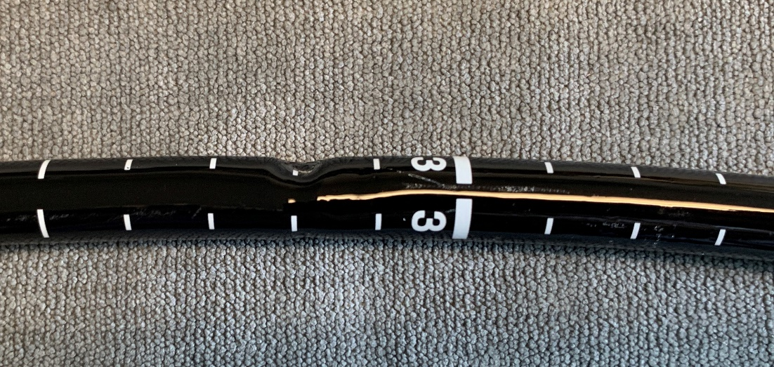
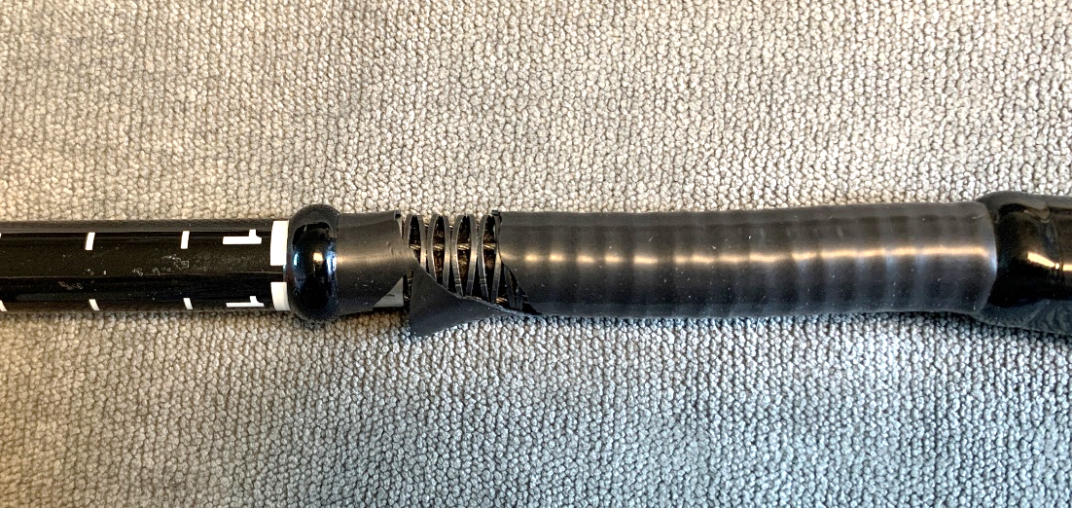
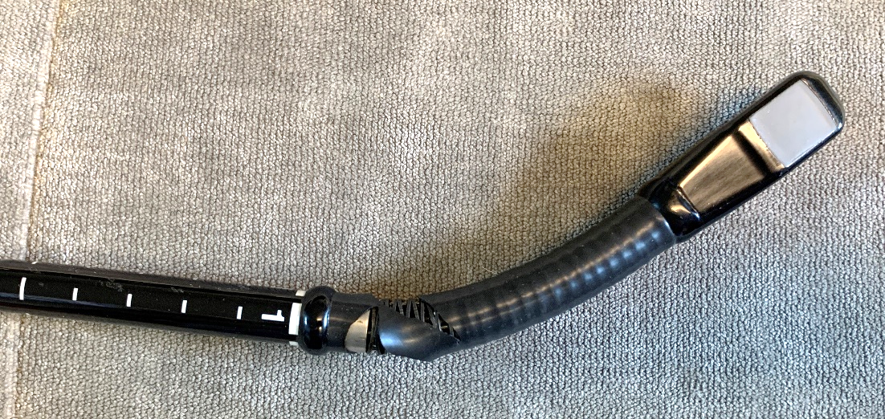
Review
Probe 3: GE 6VT-D
Perforated bending rubber
Tube broken due to bite near 30cm
Articulation slipping and non-functional in 2-directions
Other items
Multiple bites between 10 – 20 cm
Bite marks to sides of distal tip
Damage between distal tip and 40cm MAY be considered “bite damage” IF damage is present on both sides of the tube
Tube damage beyond 40cm can be considered a “crush” from external force due to distance from tip

Slide 23
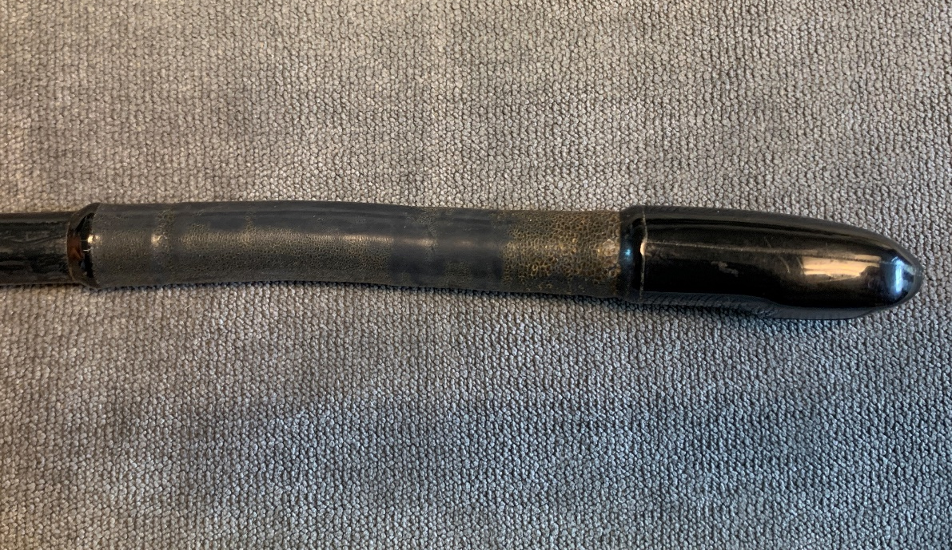
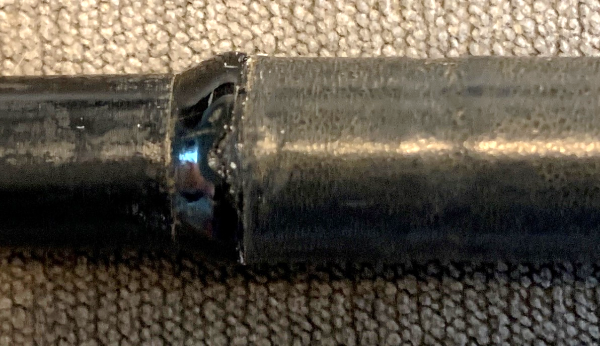
Review
Probe 4: Philips X8-2t
Overly brittle bending rubber
Deteriorated/damaged collar/glue bead
Other items
Bioburden coating bending rubber
Dead spot in articulation motion (front-to-back)
This is an ideal candidate for preventive maintenance

Slide 24
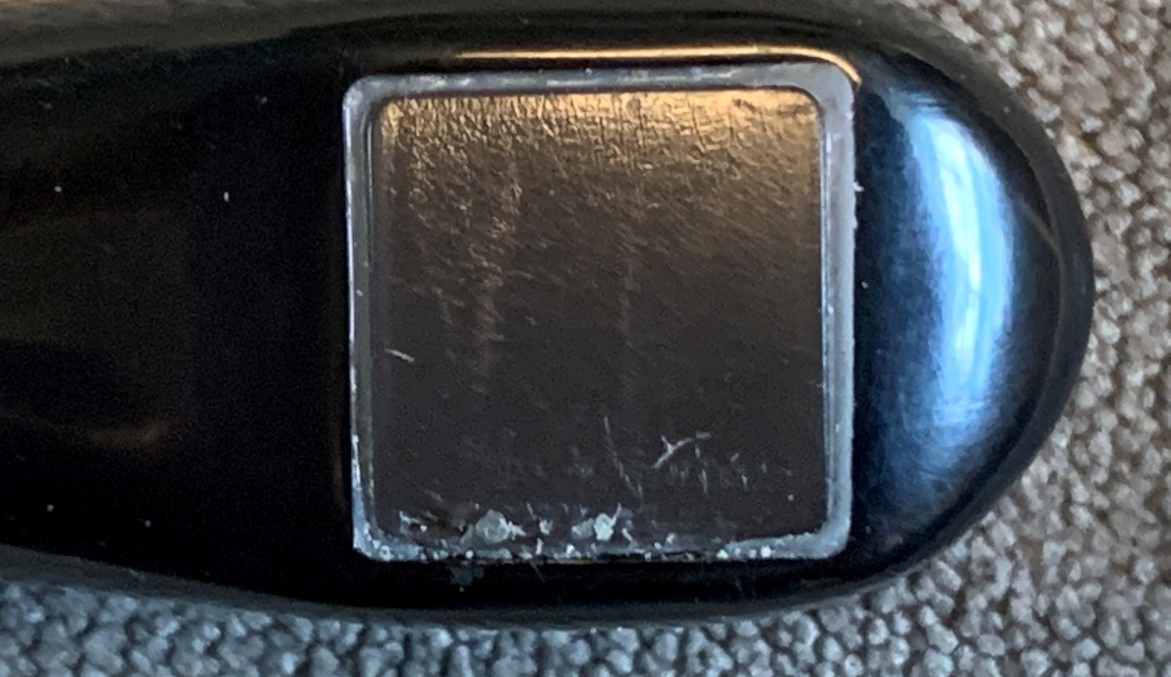
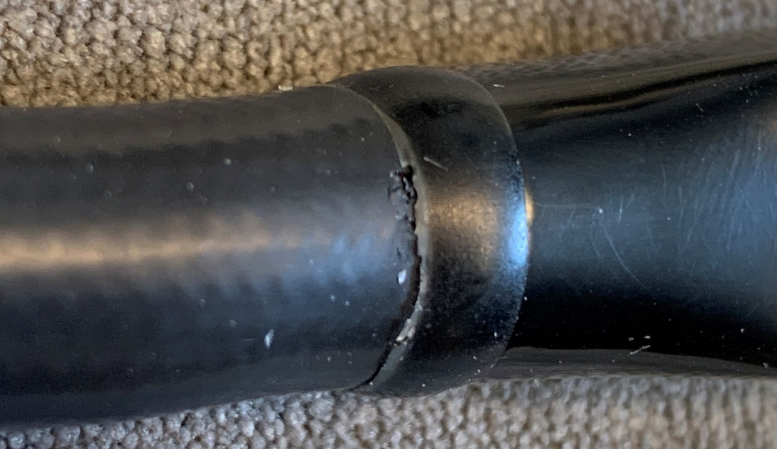
Review
Probe 5: Philips X7-2t
Damaged seal around lens
Separated collar/glue bead
This is an ideal candidate for preventive maintenance

Slide 25
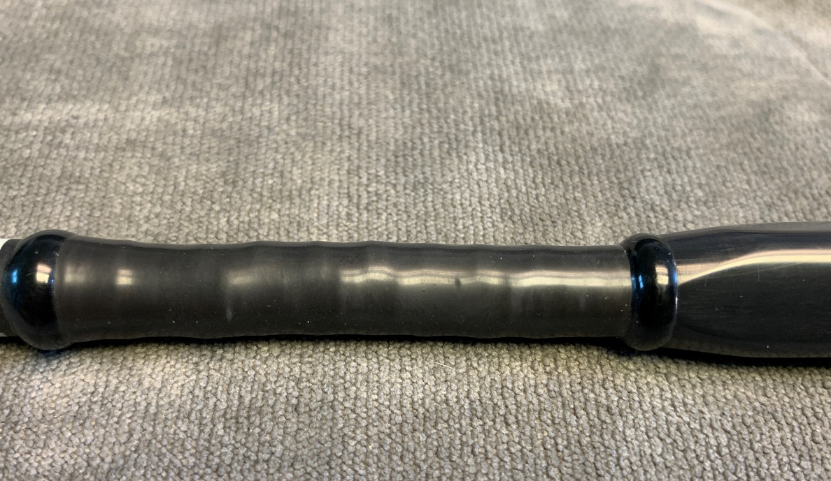
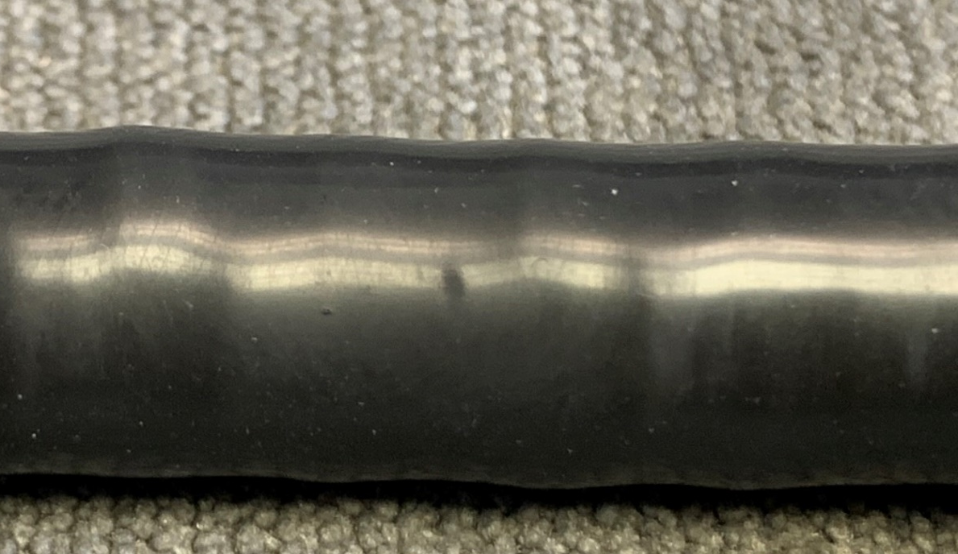
Review
Probe 6: GE 6Tc
Worn bending rubber
Potential puncture waiting to occur
This is an ideal candidate for preventive maintenance

Slide 26
Next Level Success
Visual inspection guide
Train end-users
Add TEEs to PM schedule
SafeTEE process analysis
Pick up visual inspection guides at booth 400
Identify early warning signs
Learn more about SafeTEE process analysis at booth 400
Minimize preventable failures

Slide 27
Proven Cost Savings
Sample Data
Number of TEEs in facility | 10
Current number of failures/year | 6
Cost to replace TEE with OEM or current provider | $22,000
Average cost of TEE probe repair | $5,000
Annual cost to replace TEEs with current provider | $132,000
Annual lost revenue for cancelled exams ($1,000/exam and 2 cancelled exams/day) | $24,000
TOTAL ANNUAL COSTS WITH CURRENT STRATEGY | $156,000
TEE PM Program
PM cost per probe | $1,000
Total cost of PM program | $10,000
Assume 1 random TEE failure | $5,000
Total Cost for PM Program | $15,000
Comparison
Total spend with current strategy | 156,000
Total spend with PM program | 15,000
Potential savings by delaying TEE replacement using PM program | $141,000
Savings over current strategy | 90%

Slide 28
Summary
Review
Presented root causes of common costly failures
Presented a plan PROVEN to get results
Provided tools to make YOU the expert help you SUCCEED
Perspective
The money saved by eliminating several catastrophic failures can justify the expense of one employee to fully manage TEE care and handling
More Information
www.InnovatusImaging.com
SafeTEE@innovatusimaging.com
844-687-5100

