Slide 1
Is AEM Right For Your Department?

Slide 2
Notes:
Discuss WW2E Pyramid / Lean Six Sigma Journey (Virginia Mason Model)

Slide 3
Seth Blanchard
Supervisor, Clinical Engineering
18+ years of success as a data-driven, growth-focused program and project leader
10-year tenure at WakeMed Health & Hospitals
Adept at identifying and driving innovative opportunities to accelerate daily processes, strengthen vendor or partner relations, empower employees, and eliminate sources of risk or waste
Loyal and committed to patient safety

Slide 4
WakeMed Health & Hospitals
3 Hospitals – 1000 Bed Health Care System
7 Emergency Departments
Dedicated Children’s Hospital
80+ Physician Practices
Over 8000 employees
Leading Provider of Health Services in Wake County, North Carolina

Slide 5
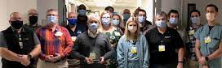
Clinical Engineering Department
Staffed by 22 Employees across 3 hospitals
Manage 31,000+ device inventory
$12 Million Dollar Operating Budget
2 Time Winner of the NCBA Shop of the year

Slide 6
What is Alternative Equipment Maintenance (AEM)?
“In the United States, the Centers for Medicare & Medicaid Services (CMS) requires that healthcare facilities maintain, inspect, and test all inventoried medical equipment in accordance with manufacturers' recommendations or with strategies of an alternative equipment maintenance (AEM) program" (Joint Commission 2014).
“With some exceptions, an AEM program allows a healthcare facility to adjust its maintenance, inspection, and testing frequency and activities for facility and medical equipment from what is recommended by the manufacturer, based on a risk-based assessment by qualified personnel" (CMS 2013).

Slide 7
Why AEM?
Provide Safe Maintenance Practices (Most Important Reason!!!)
Reduce Costs (PM parts/vendor service, Contract Reductions, etc.,.)
Reduce Labor (free up time for other tasks/projects, process improvement initiatives, etc.,.)
PM Completion (100% for High Risk AND Non-High Risk)
Retention (Improved Morale, PDO/healthy home-work life balance, Technical Training)
Comply with The Joint Commission (TJC) and Centers for Medicare and Medicaid Services (CMS)
Notes:
CMS made TJC change the 90% target to 100% for Non-High Risk
2600 PMs per month + unscheduled + installation projects
TJC used to ask an HTM department to justify why they are using and AEM program, now I am hearing that they are asking why a department is not using an AEM program

Slide 8
How To Have a Successful AEM Program
“In the United States, the Centers for Medicare & Medicaid Services (CMS) requires that healthcare facilities maintain, inspect, and test all inventoried medical equipment”
Standardized Inventory
Device Category and Model cleanup (Standardization Labor/Cost….?)
High Risk and Non-High Risk (TJC EC.02.04.01 EP3)
Standardized Maintenance Checklists
Proper Documentation (needed for evidence-based assessment)
Clear Department Policies for device inclusion, risk categories, and AEM inclusion
Identify (in the inventory) devices that are on AEM/Non-AEM, High Risk/Non-High Risk
A means to continuously monitor and analyze predictable and preventable failures (PPF)
Notes:
Standardized Inventory – How do you classify what is a medical device? FDA states “Medical devices range from simple tongue depressors and bedpans” It is important to have a clear way you determine what is and is not included in your inventory
Dev Cat and Mod Cleanup – These first 2 points are where I think a lot of depts fail to have a successful AEM program. How many of you have admin rights to add, edit, or delete device categories and model names from your CMMS. Keep your hands up, how many of you are the only ones in your dept with sole admin rights? If you have more than one person how do you correct for interpretations? If I wheeled in an Electrosurgical Unit and asked 20 Biomeds; “What is this device”? How many different names will I get? ESU, Electro Surgery Unit, Electro Surgical Unit, Electro Surgical Device, Bovie… It is even more difficult cleaning up models. Infant Warmer Example… blender, scale
TJC now classifies devices into 2 risk categories. We used to have 7 depending on the device, how it was used, and where it was used.
Make sure your PM schedule is standardized and that each technician is performing the same PM process if you do have the device under the AEM program
Legal Document – Description “Broke” Solution “Fixed” not enough data to determine if the device should be in the AEM program… tell the story of the repair process
Dept. Policy – How do you eliminate interpretation?
Identify – For TJC, and for your staff to know what is on an AEM program and which devices are High/Non-High Risk
Have a means to monitor going forward devices that should be included, excluded, or modified in your AEM program

Slide 9
With some exceptions, an AEM program allows a healthcare facility to "adjust its maintenance, inspection, and testing frequency and activities for facility and medical equipment from what is recommended by the manufacturer, based on a risk-based assessment by qualified personnel" (CMS 2013).
Devices that cannot be placed on an AEM program include those that have a specific maintenance requirement imposed by a federal, state, or local law; imaging/radiological equipment; medical lasers; and equipment for which you do not have sufficient maintenance history to support inclusion in an AEM program.
Notes:
To date, I am not aware of any Federal Laws or requirements regarding medical equipment but please be sure to check state and local laws
Sufficient maintenance history is rather loose. There is no specific timeline given. Leaves this up to you to determine.
WakeMed has identified a minimum of 2 years of model history prior to consideration of device inclusion into AEM

Slide 10
With some exceptions, an AEM program allows a healthcare facility to "adjust its maintenance, inspection, and testing frequency and activities for facility and medical equipment from what is recommended by the manufacturer, based on a risk-based assessment by qualified personnel" (CMS 2013).
Risk-Based Assessment
Records provided by the hospital’s contractors (Vendor Service Reports)
Information made public by nationally recognized sources (FDA, Manufacturer Alerts/Recalls, MedSun, etc.,.)
Records of the hospital’s experience over time (In-House Service Work Orders)
Notes:
Are you maintaining these service reports in your CMMS?

Slide 11
With some exceptions, an AEM program allows a healthcare facility to "adjust its maintenance, inspection, and testing frequency and activities for facility and medical equipment from what is recommended by the manufacturer, based on a risk-based assessment by qualified personnel" (CMS 2013).
CMS States
“In the case of medical equipment, a clinical or biomedical technician or engineer would be considered qualified…”
Notes:
This is again rather loose… but be sure to have on file everyone’s training certifications if asked

Slide 12
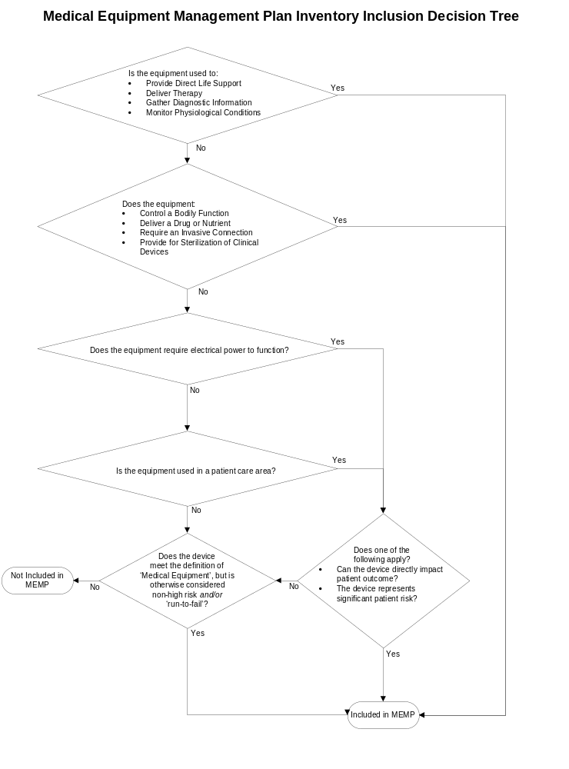
Solid Inventory
Medical Equipment – Fixed or portable devices used for the diagnosis, treatment, monitoring, and direct care of individuals (EC.02.04.01 EP 2)

Slide 13
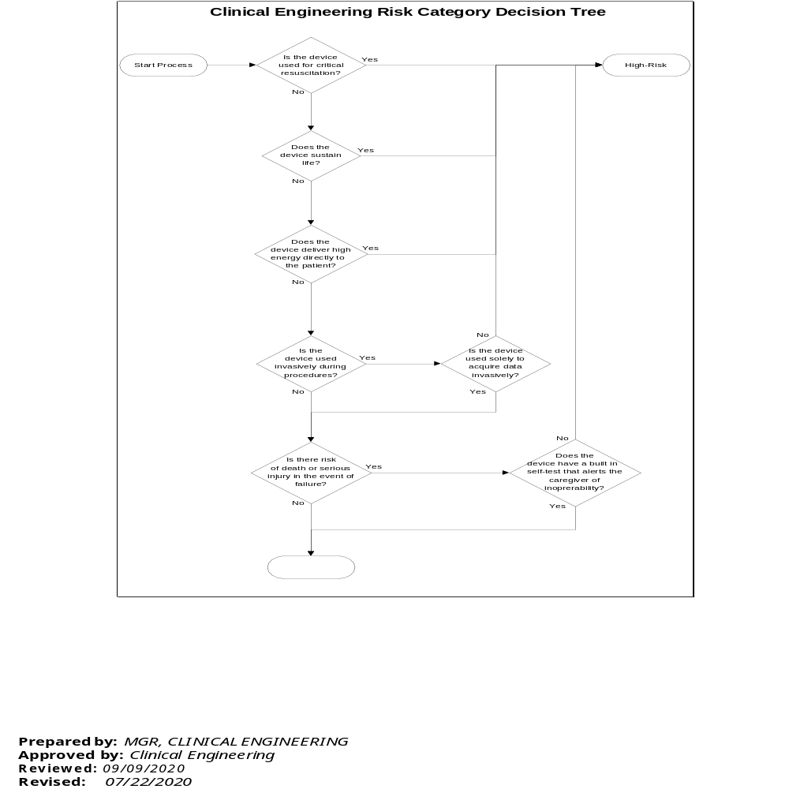
High Risk/Non-High Risk?

Slide 14
AEM/Non-AEM?

Slide 15
How to Track PPF
AEM Question 1: Was failure predictable? i.e., PM related calibration drift, PM related battery failure, or PM related component failure (excluding user replaceable accessories)?
AEM Question 2: Would a change in the PM frequency, or addition to the PM schedule have prevented this failure?
AEM Question 3: Would a change to the PM procedure or the addition of a procedural step have prevented this failure?

Slide 16
How Do You Know If Your Program Is Successful?
Metrics… Develop a way to track and trend unscheduled work!

Slide 17
Questions?
Seth Blanchard
seblanchard@wakemed.org
Office: 919-350-5636
Cell: 910-409-4369

